Slide 1



Mayoral Fund 2025
Mayor of Limerick, John Moran
Notes:
Change background colour by changing the colour in the Format Background / Solid Fill

Slide 2


Agenda
A quick word on budgetary context
Guiding Principles for Allocation
Overall Allocations
A look at the Specific Projects being Funded
Q&A

Slide 3
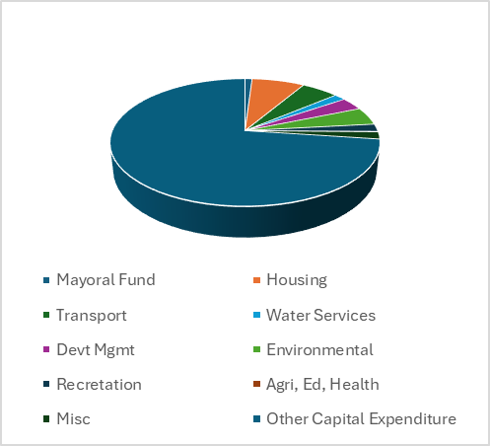
Budgetary Context
Mayoral Fund
With the introduction of the DEM, a further allocation from central government of funds was granted to Limerick to help drive the mayoral programme – the #MoreForLimerick programme – and supplement the regular budget for 2025.
  The funds totaling 10.5 million are modest compared to the overall Budget 2025 allocations approved by the Council in November 2025 but are nonetheless important to move a number of key priorities forward.
  The full 2025 budget allocations are shown in Fig 1

Slide 4
Guiding Principles for Allocation
The spending advances an outcome specified for delivery in the #MoreForLimerick programme.
For 2025, shovel ready projects from the #MoreforLimerick programme have been identified and prioritized, especially where the funds can be used to leverage additional funding. Other projects will come in later years when more funding is available.
Ideas which will be transformative pilots also get priority to show why the solution Limerick needs may need to be a new innovative approach and not just a One Size Fits All nationally applicable policy. These pilots should help unlock greater funding in later years.

Slide 5
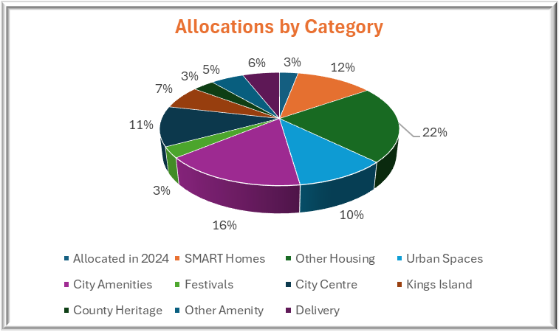
Overall 2025 Allocations
.

Slide 6
1. Carryover from 2024
  Some of the 2024 fund was already allocated on projects as follows:-
                €65,000 for community grants
        €107,000 for the animation of city, festivals and events
        €18,000 for improvement works in the city centre
        €120,000 for the RIAI design work for Moyross
        €5,000 for Support for international city relationships
  Additional allocations were made in 2024 for certain other projects such as advisory and other work on the SMART homes but these are carried over to 2025 and discussed below.

Slide 7
1. Carryover from 2024
€315,000
  Some of the 2024 fund was already allocated on projects as follows:-
                €65,000 for community grants
        €107,000 for the animation of city, festivals and events
        €18,000 for improvement works in the city centre
        €120,000 for the RIAI design work for Moyross
        €5,000 for Support for international city relationships
  Additional allocations were made in 2024 for certain other projects such as advisory and other work on the SMART homes but these are carried over to 2025 and discussed below.

Slide 8
2. SMART Homes – No. 1 Priority
A priority objective of the programme is to find a new modular solution to provide transitional housing on state lands while more permanent solutions are being delivered. Accordingly:
€300,000 of spending has been allocated to salary and other costs to advance the feasibility of the SMART housing initiative
A further €1,000,000 is now allocated to secure or activate lands for live projects

Slide 9
2. SMART Homes – No. 1 Priority
€1,300,000
A priority objective of the programme is to find a new modular solution to provide transitional housing on state lands while more permanent solutions are being delivered. Accordingly:
€300,000 of spending has been allocated to salary and other costs to advance the feasibility of the SMART housing initiative
A further €1,000,000 is now allocated to secure or activate lands for live projects

Slide 10
3. Other Housing Projects
Housing needs to come from many different sources. We have already signed contracts for the construction of public housing, including at Bourke Avenue, Ballylanders, Broadford and Galbally
In addition to other funds to help drive forward the overall housing projects (See Section below), other allocations are being made:
  A further €100,000 has been allocated for further housing design work in regeneration areas
  €1,400,000 has been allocated to help fund the purchase of new lands suitable for housing
  €100,000 to seed fund a project to secure planning permission for housing on state lands and
  €50,000 to fund analysis to identify further lands suitable for transport-oriented development in Limerick city in advance of the next development plan

Slide 11
3. Other Housing Projects
                €75,000 is allocated to fund securing advance on a legal structure for a new pilot to finance and repurpose derelict buildings for affordable rental.
                €400,000 is allocated to seed capital such a venture for Abbeyfeale, our town of the future.
            €100,000 is allocated to start work on the feasibility of a new structure for citywide student housing in conjunction with the three third-level institutions
            €75,000 - is further allocated to help with other student housing initiatives
  Other changes underway will mandate Limerick 2030 to play a much greater role in the delivery of housing – especially in county towns

Slide 12
€2,300,000
3. Other Housing Projects
                €75,000 is allocated to fund securing advance on a legal structure for a new pilot to finance and repurpose derelict buildings for affordable rental.
                €400,000 is allocated to seed capital such a venture for Abbeyfeale, our town of the future.
            €100,000 is allocated to start work on the feasibility of a new structure for citywide student housing in conjunction with the three third-level institutions
            €75,000 - is further allocated to help with other student housing initiatives
  Other changes underway will mandate Limerick 2030 to play a much greater role in the delivery of housing – especially in county towns

Slide 13
4. Better Quality City/Town Spaces
Enhancing our city centre and urban spaces will require investment of very significant amounts far in excess of the mayoral fund. Initiatives for the medieval Kings Island are separately discussed.
For 2025, funds are being allocated for trial pilot initiatives in the Georgian quarter and key county towns.
  €300,000 to trial initiatives to deal with vacant retail spaces
  €600,000 towards capital works on greening and other works on the public realm of Newtown Pery
  €50,000 to enhance lighting and conditions of laneways
  €100,000 towards improvements of public realm in Newcastle West
  €45,000 for grants to encourage improvements of historic shop fronts in the three metropolitan districts.

Slide 14
4. Better Quality City/Town Spaces
€1,095,000
Enhancing our city centre and urban spaces will require investment of very significant amounts far in excess of the mayoral fund. Initiatives for the medieval Kings Island are separately discussed.
For 2025, funds are being allocated for trial pilot initiatives in the Georgian quarter and key county towns.
  €300,000 to trial initiatives to deal with vacant retail spaces
  €600,000 towards capital works on greening and other works on the public realm of Newtown Pery
  €50,000 to enhance lighting and conditions of laneways
  €100,000 towards improvements of public realm in Newcastle West
  €45,000 for grants to encourage improvements of historic shop fronts in the three metropolitan districts.

Slide 15
5. City Centre Amenities
Our city centre needs to be improved so that greater numbers coming to Limerick to work will want to live there.
  The following specific projects are allocated funds:
    €240,000 towards initial design work of the Colbert Quarter municipal sports facility
    €300,000 to secure additional URDF funding for the design work on the new city centre pedestrian bridge across the Shannon to Cleeves
    €1,000,000 to restart the stalled Innovate Engine projects and secure the ownership of the Royal Cinema
    €100,000 for the preparation of the initial business case for the redevelopment of the Royal Cinema
    €75,000 for initial work to update the business case for the Game Cube

Slide 16
5. City Centre Amenities
€1,715,000
Our city centre needs to be improved so that greater numbers coming to Limerick to work will want to live there.
  The following specific projects are allocated funds:
    €240,000 towards initial design work of the Colbert Quarter municipal sports facility
    €300,000 to secure additional URDF funding for the design work on the new city centre pedestrian bridge across the Shannon to Cleeves
    €1,000,000 to restart the stalled Innovate Engine projects and secure the ownership of the Royal Cinema
    €100,000 for the preparation of the initial business case for the redevelopment of the Royal Cinema
    €75,000 for initial work to update the business case for the Game Cube

Slide 17
6. Activities and Festivals
Much of the funding of festivals and activities across the county is funded by the regular budget. For example, €1,680,788 is allocated for 2025 under the heading of Festivals & Concerts out of a total funding of nearly €4.7m for the operation of the Arts Programme
The mayoral funding for 2025 will be focused on initiatives which add to our existing offering.
  €50,000 is allocated to the new “All we have are Days” which debuted over the February Bank Holiday weekend in Limerick City and Newcastle West and Kilmallock
  €50,000 will be spent on other Creative Sector Initiatives
  €50,000 is allocated for further Christmas decorations in the city Centre and Kilmallock with funds having been allocated to Newcastle West in 2024
  €125,000 is allocated to find a Christmas Market in Limerick City Centre
  €50,000 for a new Food Festival offering which will be open to competitive tender

Slide 18
6. Activities and Festivals
€325,000
Much of the funding of festivals and activities across the county is funded by the regular budget. For example, €1,680,788 is allocated for 2025 under the heading of Festivals & Concerts out of a total funding of nearly €4.7m for the operation of the Arts Programme
The mayoral funding for 2025 will be focused on initiatives which add to our existing offering.
  €50,000 is allocated to the new “All we have are Days” which debuted over the February Bank Holiday weekend in Limerick City and Newcastle West and Kilmallock
  €50,000 will be spent on other Creative Sector Initiatives
  €50,000 is allocated for further Christmas decorations in the city Centre and Kilmallock with funds having been allocated to Newcastle West in 2024
  €125,000 is allocated to fund a Christmas Market in Limerick City Centre
  €50,000 for a new Food Festival offering which will be open to competitive tender

Slide 19
7. Revitalising the City Centre
2024 saw more work done last year to tidy up our streets and public realm, add additional animation and help make streets safer. 2025 will push this forward.
The Arthur’s Quay consultation brought clarity to some of the key questions in that area and will permit us to invest in assets we now know the public want to retain. Other major strategies are also nearing completion - city centre transport, historic public realm, laneways and shop-fronts strategies
Safer Streets - €130,000 was secured from the Department of Justice for community wardens and these are being hired. An additional €100,000 is allocated to support Safer Community Initiatives.
“Welcome to Limerick” office - Some remedial work was completed in 2024 on the former Tourist Office at Arthurs Quay. €100,000 is allocated for more repair work and €250,000 and €25,000 to install the 'Welcome to Limerick' office there and carry out related research

Slide 20
7. Revitalising the City Centre
Retail Supports – A further €200,000 has been allocated to initiatives to help the retail sector in Limerick city centre and county towns and as part of the boosting of supports. €75,000 is allocated to fund an SME and Retail Champion
Physical Assets – Funds are allocated for more clean-up of city centre assets:
  €150,000 to resolve some of the critical repairs needed to save LCCC’s building at 58 O’Connell Street
  €110,000 for works on the Daniel O’Connell Monument and Patrick Sarsfield Monuments including that at Cathedral Place
  €150,000 to secure additional funds for repairs to the 1916 Monument and for a full assessment of the condition and repairs work needed to restore Sarsfield Bridge on its 200th birthday
Waste Management – €40,000 has been allocated to help assess new options for waste management in the city centre and key county towns
Public Realm Improvements have been discussed separately already

Slide 21
7. Revitalising the City Centre
€1,200,000
Retail Supports – A further €200,000 has been allocated to initiatives to help the retail sector in Limerick city centre and county towns and as part of the boosting of supports. €75,000 is allocated to fund an SME and Retail Champion
Physical Assets – Funds are allocated for more clean-up of city centre assets:
  €150,000 to resolve some of the critical repairs needed to save LCCC’s building at 58 O’Connell Street
  €110,000 for works on the Daniel O’Connell Monument and Patrick Sarsfield Monuments including that at Cathedral Place
  €150,000 to secure additional funds for repairs to the 1916 Monument and for a full assessment of the condition and repairs work needed to restore Sarsfield Bridge on its 200th birthday
Waste Management – €40,000 has been allocated to help assess new options for waste management in the city centre and key county towns
Public Realm Improvements have been discussed separately already

Slide 22
8. Kings Island – A focus area
King’s Island is a priority of my mayoralty as it should be the heartbeat of historic Limerick. Unacceptable levels of dereliction and deprivation still need to be battled.
Most importantly, I signed contacts for €32 million of critical flood proofing works for St Mary’s Park and the historic Kings Island. The work is well underway with a completion date expected in October 2026
This work now allows safe investment into a number of other important projects, including:
  Design work is underway so that Sonny’s Corner will see Limerick’s first pet-friendly public housing scheme with considerable upgrading of the nearby historic public realm. Design work is funded and well underway in preparation for Part 8 application
  To avoid a haphazard approach, a public consultation about the use of ALL the publicly owned buildings in Englishtown concluded in Q4 of 2024. This led to a recently approved Part 8 application for a new design hub at the centrally located Medieval Fireplace site on Nicholas Street. An application for €6 million of funding (THRIVE 2) can now be made

Slide 23
8. Kings Island Continued
  Work began in 2024 to remove hoarding around the derelict St Mary’s Garda station. We want this to become the home of the long talked about Fashion Museum and Incubator. The Fashion Incubator in Austin Texas may become a partner. €500,000 is allocated to stabilise the building and prevent further deterioration and begin the preparation of a business case to secure funding to save the building and realise the rest of the project.
  €200,000 is allocated to contribute to the restoration of derelict sites within the walled town.
  Archaeological work on a LCCC owned site on Bridge Street has commenced to clear the way for a public housing scheme on the site. We are investigating the possibility of including a commercial element in the design given its strategic location.
  Governance changes are underway at the Discover Limerick DAC (which owns King John’s Castle} and Limerick 2030 DAC which owns the nearby Opera Site. These will better equip both companies to drive on the development of their respective sites.
  Funding for maintenance of social housing was increased for 2025 by €1.3 million and much is located on Kings Island.

Slide 24
8. Kings Island Continued
It is not all about physical buildings
  A number of other social programmes have been funded from the Regeneration funds such as the “happee” programme
  In 2024, funding was allocated as part of the '101 Actions' for the clean-up of streets and animation last summer. This will continue in 2025.
  The accessibility ramp by the Alms' Houses was completed
  A critical grant of €1.5 million was made for the modernisation and retention of key municipal sports facilities at Grove Island

Slide 25
8. Kings Island Continued
€700,000
It is not all about physical buildings
  A number of other social programmes have been funded from the Regeneration funds such as the “happee” programme
  In 2024, funding was allocated as part of the '101 Actions' for the clean-up of streets and animation last summer. This will continue in 2025.
  The accessibility ramp by the Alms' Houses was completed
  A critical grant of €1.5 million was made for the modernisation and retention of key municipal sports facilities at Grove Island

Slide 26
9. Kilmallock and County Heritage Assets
A further focus of mine is better care for and use of our heritage assets right across the county but especially the medieval assets in Kilmallock to establish a basis for a much-enhanced quality of life, reputation and tourist offering for the town
Work is ongoing in the background to take better stock of heritage assets right across the county and assess their condition to establish future needs. In 2025 I would like to see works begin on key historical assets
In Kilmallock, ownership of the gate tower remains an obstacle to remedial works in 2025 but other projects are ongoing. Parks and paths providing access are being advanced and work to coincide with works to commence finally on the Medieval House on the main street.
€300,000 is allocated for heritage works including the Medieval House in Kilmallock and to begin initial work on a UNESCO application for the Georgianc City Centre. A 2025 priority has been to use the funds to facilitate and co-fund much larger funding applications for restoration for Kilmallock Medieval Mansion and the former bank in Rathkeale.

Slide 27
9 County Heritage - Continued
A further €65,000 has been allocated to progress or provide in part match funding applications for other programme priorities such as those in Bruff, Rathkeale, Kilfinane and Herbertstown. These projects remain key projects to be advanced during my mayoral term.
I have also begun to connect staff and students at local schools such as St Nessan’s with their local heritage assets in advance of further work on those. A mayoral order to transfer LCCC lands to the OPW to facilitate maintenance of one of the historic Mungret churches was signed.
Funding is being sought from government for the restoration of Adare Village Hall with planning permission already secured for the works.
Funds allocated to the restoration of monuments to Patrick Sarsfield may help the repair work on Sarsfield Rock at Ballyneety.

Slide 28
9 County Heritage - Continued
€700,000
A further €65,000 has been allocated to progress or provide in part match funding applications for other programme priorities such as those in Bruff, Rathkeale, Kilfinane and Herbertstown. These projects remain key projects to be advanced during my mayoral term.
I have also begun to connect staff and students at local schools such as St Nessan’s with their local heritage assets in advance of further work on those. A mayoral order to transfer LCCC lands to the OPW to facilitate maintenance of one of the historic Mungret churches was signed.
Funding is being sought from government for the restoration of Adare Village Hall with planning permission already secured for the works.
Funds allocated to the restoration of monuments to Patrick Sarsfield may help the repair work on Sarsfield Rock at Ballyneety.

Slide 29
10. Other amenity projects
Most of our amenity projects in 2025 will be funded directly from central government or from existing development levies.
For 2025, these include projects like:
  Recent Greenway funding of €1,150,000
  The building of the new Garda Station in Newcastle West
Accordingly, mayoral funds have been additionally targeted to projects identified as programme priorities which have not yet received funding especially to help submit applications for further funding. The monies have been allocated as follows:
  €60,000 has been allocated to enhance amenities identified in the programme . The exact list will be specified during 2025 based on factors like readiness for delivery and co-funding from other sources.
  €200,000 has been allocated to works on green spaces in Garryowen including St Patrick’s Well.

Slide 30
10. Other amenity projects
  €100,000 has been allocated to co-fund the playground in Athea now that planning permission has been granted.
  €50,000 has been allocated to upgrade the pocket park at the junction of Sexton Street and Parnell Street which was cleaned up in 2024.
  €20,000 has been allocated to seed the arts acquisition fund which will include art for enhanced public realm.
  €130,000 has been allocated to the provision of new or upgraded facilities for dog-parks like those in Castletroy, Norwood, Newcastle West and Mungret.

Slide 31
10. Other amenity projects
€560,000
  €100,000 has been allocated to co-fund the playground in Athea now that planning permission has been granted.
  €50,000 has been allocated to upgrade the pocket park at the junction of Sexton Street and Parnell Street which was cleaned up in 2024.
  €20,000 has been allocated to seed the arts acquisition fund which will include art for enhanced public realm.
  €130,000 has been allocated to the provision of new or upgraded facilities for dog-parks like those in Castletroy, Norwood, Newcastle West and Mungret.

Slide 32
11. Enhancement of Delivery
A learning from recent months has been the need to enhance resourcing of the delivery of such a comprehensive programme
A number of allocations are designed to improve this for 2025 and beyond:
  €300,000 to secure resources to drive the programme actions, €100,000 for each of the three pillars.
  €75,000 to provide for additional forward planning resources
  €50,000 to provide for better communication of the actions and for marketing of Limerick as a location for inward investment
  €75,000 for further business improvement and digitisation
  €50,000 to facilitate attendance by the mayor or other staff at meetings and events to further the delivery of the programme
  €75,000 for delivery of initiatives to combat health disadvantages and to permit greater cooperation with the HSE and the WHO.

Slide 33
11. Enhancement of Delivery
€625,000
A learning from recent months has been the need to enhance resourcing of the delivery of such a comprehensive programme
A number of allocations are designed to improve this for 2025 and beyond:
  €300,000 to secure resources to drive the programme actions, €100,000 for each of the three pillars.
  €75,000 to provide for additional forward planning resources
  €50,000 to provide for better communication of the actions and for marketing of Limerick as a location for inward investment
  €75,000 for further business improvement and digitisation
  €50,000 to facilitate attendance by the mayor or other staff at meetings and events to further the delivery of the programme
  €75,000 for delivery of initiatives to combat health disadvantages and to permit greater cooperation with the HSE and the WHO.

Slide 34
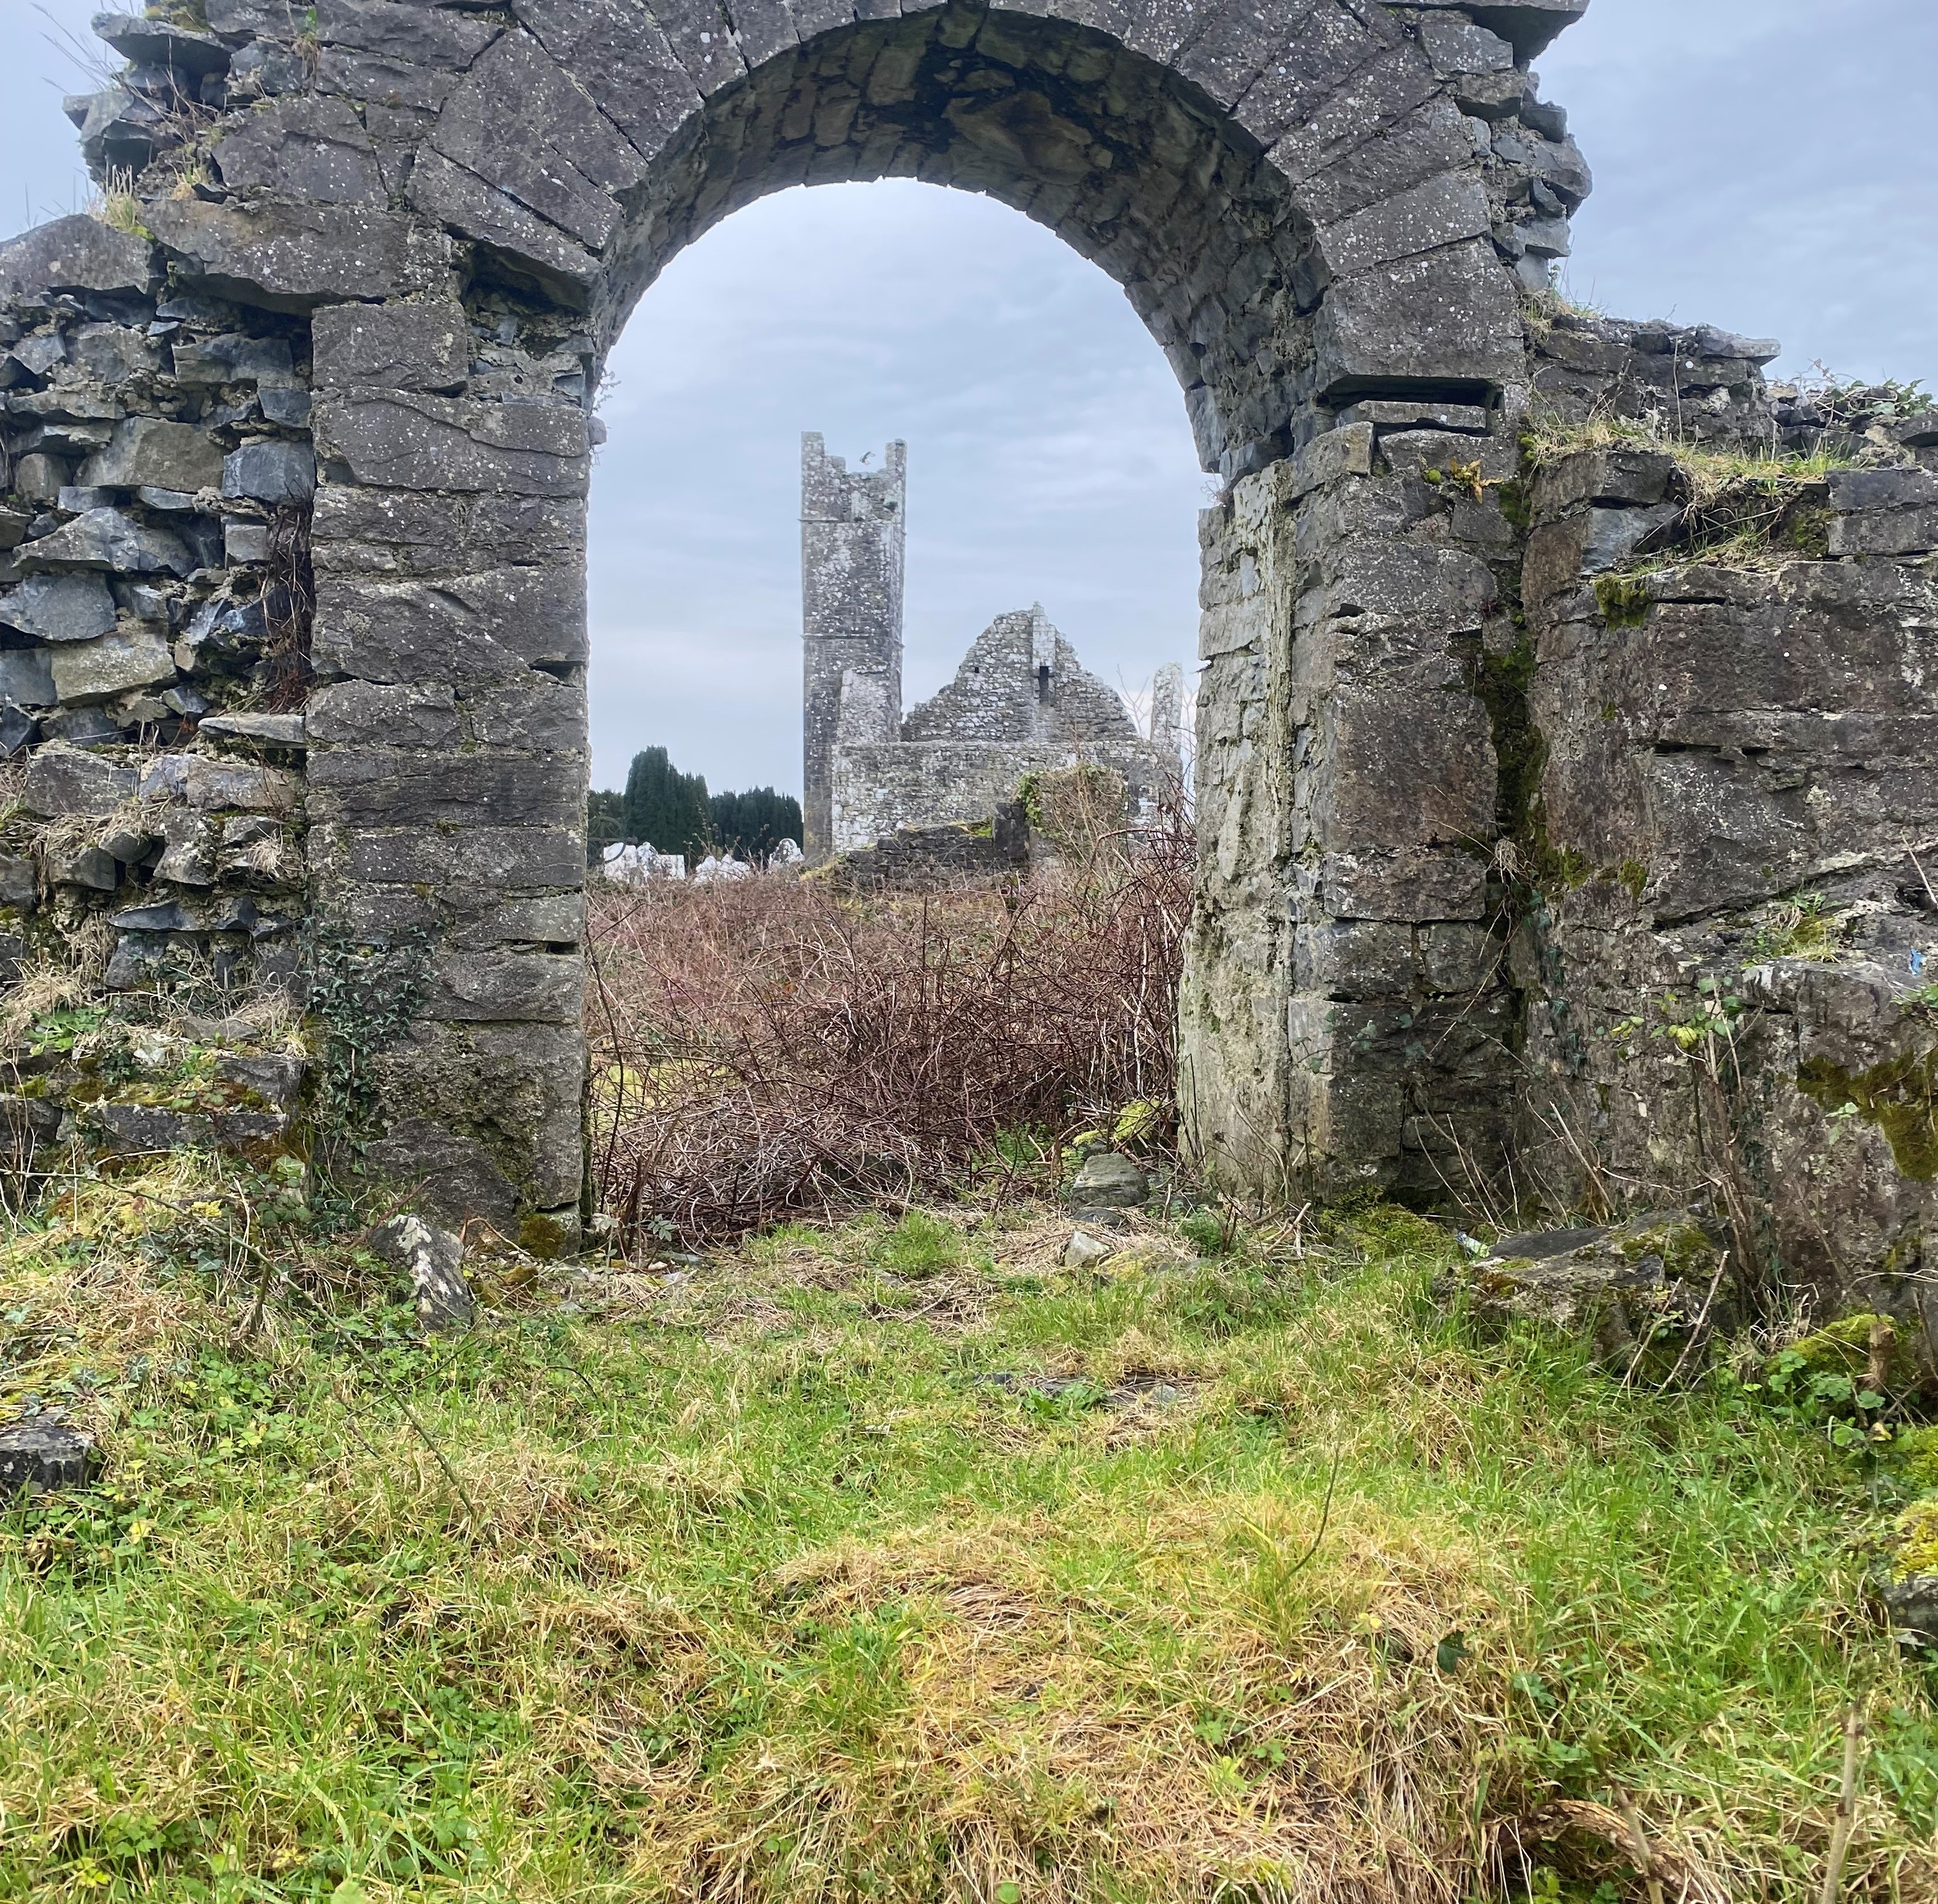
Q&A

