Slide 1
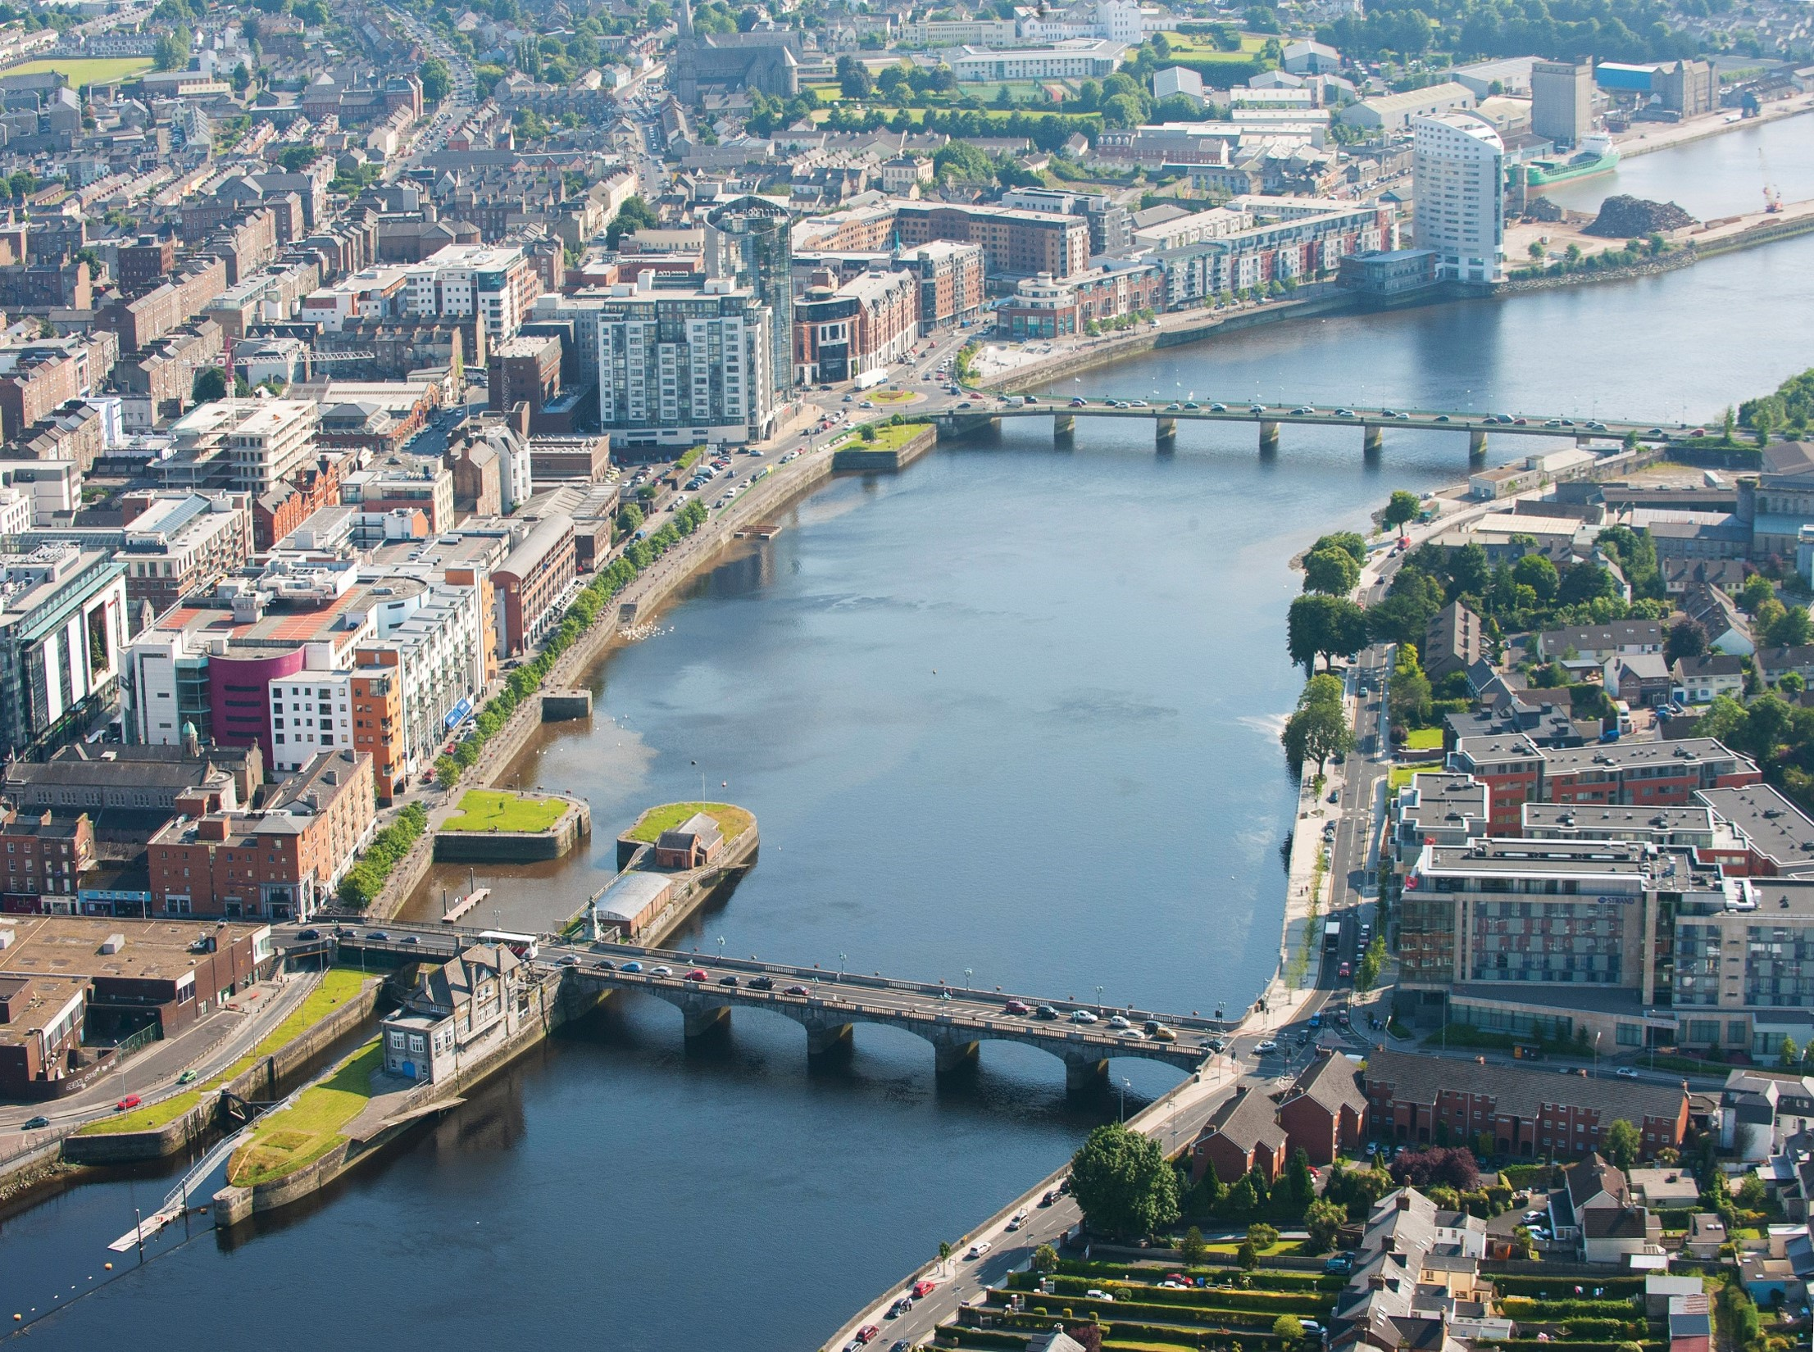
Limerick City Centre Transport Plan & Bus Connects Update Q1-2025 MARCH 2025
Hugh McGrath, Chartered Engineer
Senior Engineer,
Transportation and Mobility Directorate
Limerick City and County Council

Slide 2
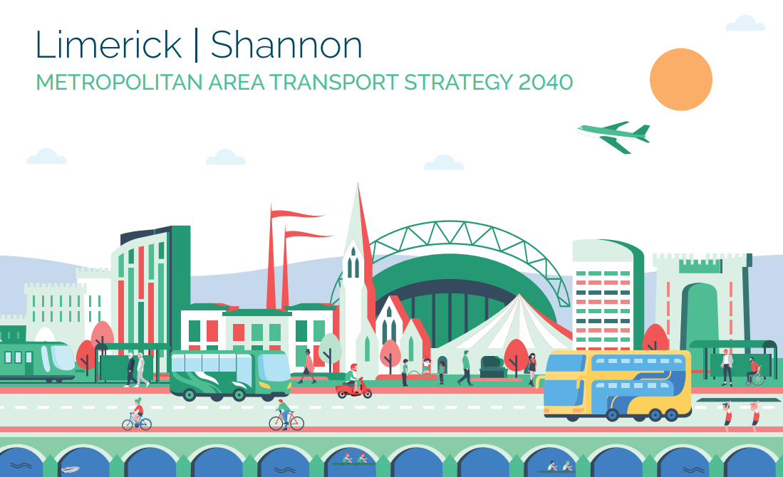
Limerick City Centre Transport Plan
Promote & Prioritise Sustainable Transport
& promote Modal Shift
Provide Active Travel and Public Transport infrastructure
Improve links for people to travel to:
Work, School & College
Enhance the public realm for people to:-
Live in & Visit the City Centre

Slide 3
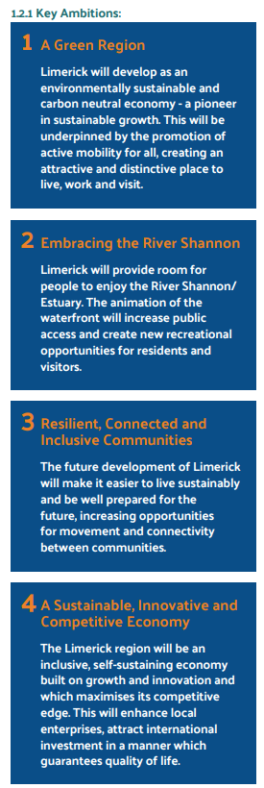
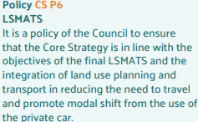
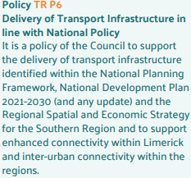
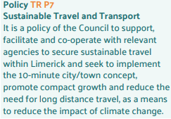
Limerick Development Plan 2022-2028 - Key Ambitions & Policy

Slide 4
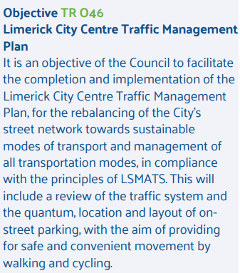
Rebalancing of Street network
towards
sustainable modes of transport
Management of all modes
Review of traffic system
Quantum, location & layout of on-street parking
Safe and convenient
walking & cycling
Development Plan Objective TR 046
Adopted by Elected Members

Slide 5
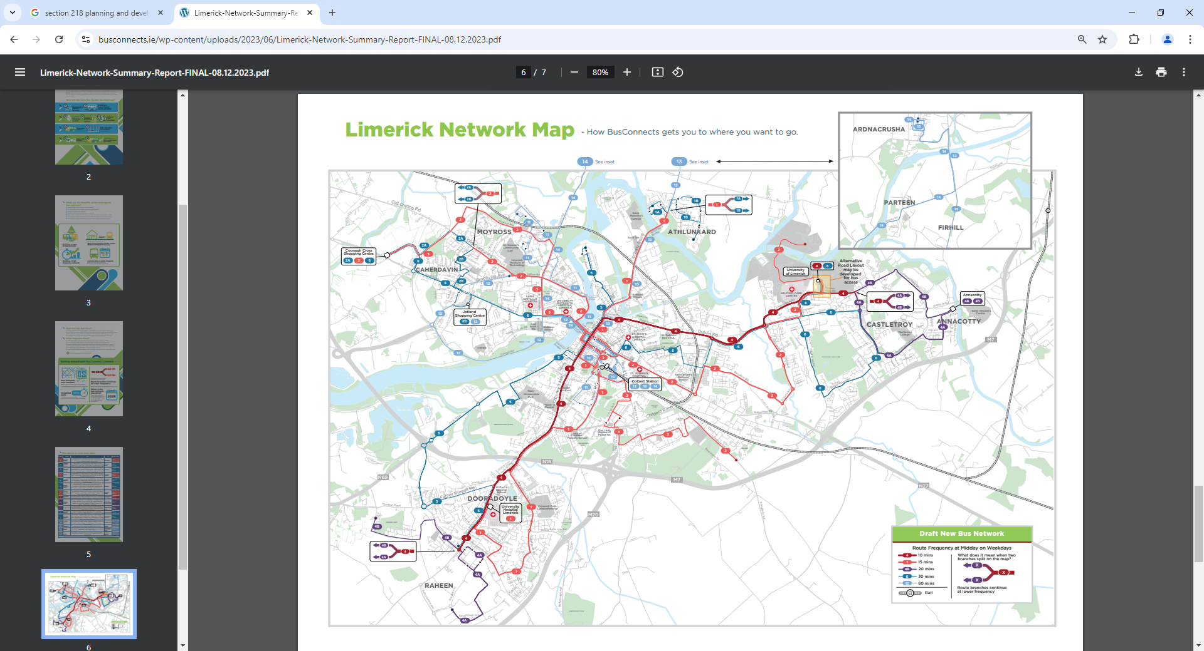
85km of Bus Lanes/Bus Priority
Increase bus services by 70% - 2027
Links to Connecting Ireland Bus Network
P&R Locations (approx.)
Bus Connects Network Redesign 2023
P

Slide 6
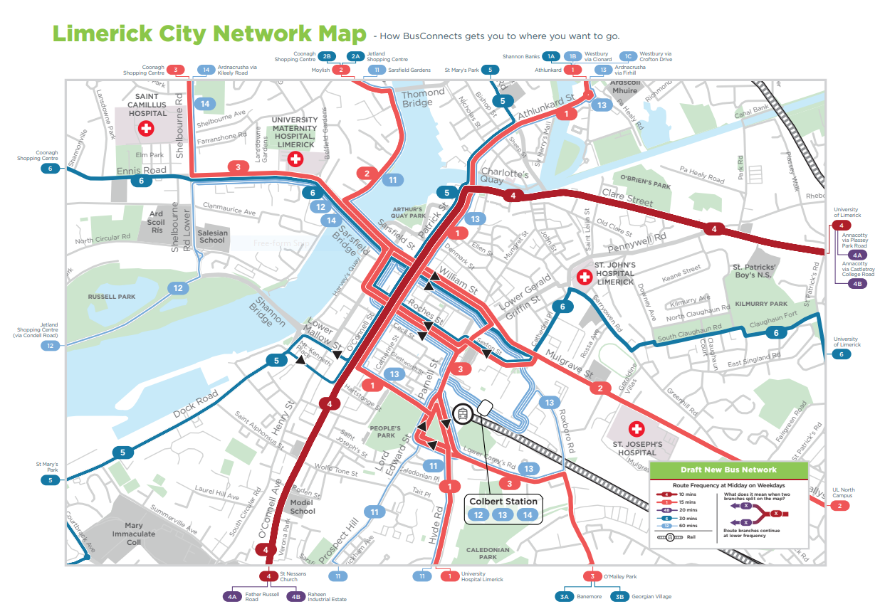
Transport Plan
Area of Focus

Slide 7
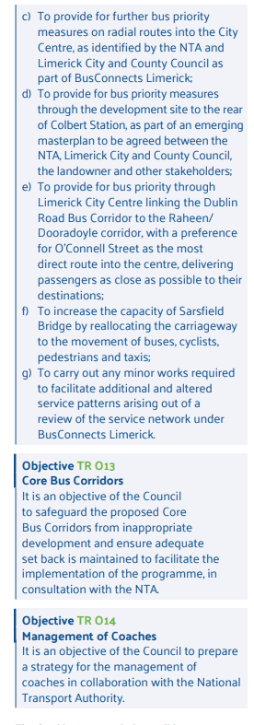
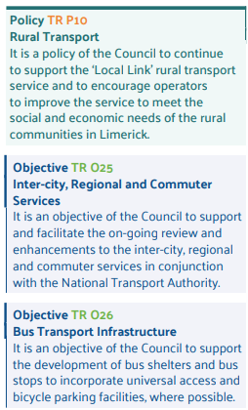
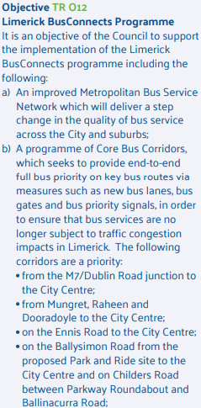
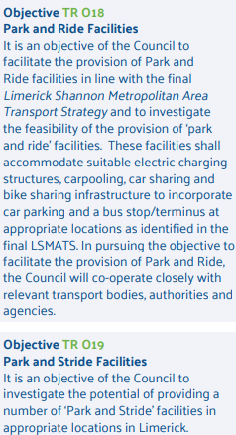
Limerick Development Plan-Buses

Slide 8
Limerick City Centre Transport Plan Steps
Step 1 - Inception (Q2-2024) Complete
Step 2 – Establish Scope and Objectives (Q2-2024) Complete
Step 3 – Baseline Assessment (Q3-2024) Complete
Step 4 – Option Identification and Development Underway
Step 5 – Plan Preparation Underway
Step 6 – Public Consultation Q2-2025
Step 7 – Plan Finalisation 2025

Slide 9
Bus Connects Implementation Challenges
Design & Construct New & upgraded Bus Stops. (NTA\LCCC\BÉ)
Review extent of Sheltered Stops. (NTA\LCCC\BÉ)
Ensuring residual traffic (local access etc.) &
operational\functional traffic is appropriately catered for (Deliveries, Coaches etc.)
Incorporate measures into Schemes underway or about to commence (NTA\LCCC)
Active Travel (e.g. Raheen – Quinns X , TUS to City Centre
Public Realm Improvements (e.g. City Centre Public Realm Plan) (LCCC)
Identify the most critical priority options in City Centre & Key Routes (NTA\LCCC\BÉ)
City Centre - Option identification & Development.
Resourcing of 70% increase in service (Drivers, Mechanics, Fleet, Funding etc.)

Slide 10
Bus Connects Update
Park & Ride sites at terminus of Bus routes at Raheen, Mackey & Coonagh being advanced through planning & land acquisition stage. (NTA\LCCC)
Bus Stop review with NTA well advanced for implementation of improvements over 2025 & 2026. Site visits complete Feb 2025. (NTA\LCCC)
Detailed design is now underway.
Bus Priority options & Limerick City Centre Transport Plan currently at Option identification & Development stage (Stage 4) . (LCCC\NTA)
Multi-criteria analysis (MCA) for East-West & North-South Corridors & Others.
Improved services as set out under the Network Redesign with the 70% improvement in levels of service expected to be delivered by 2027. However it is expected that improvements will be delivered incrementally where resources are in place.(NTA\BÉ)

Slide 11
Multi Criteria Analysis
MCA Criteria | Measure
Policy Alignment | Alignment to the Mayor Programme & Limerick Development Plan
Economic Impacts | Journey times, reliability, quality, cost savings, economic impacts
Accessibility Impact | Access to key leisure, retail sites. Improved connectivity for active travel
Social Impacts | Impact on those without a car & disadvantages communities.
Land Use Impacts | Public realm opportunities, alignment to NIFTI.
Safety Impacts | Personal security, impact on vulnerable road users
Climate Change Impacts | Increased sustainable transport journeys, reduction in car use.
Local Environmental Impacts | Improved air/noise quality, improved visual landscape.
Public Acceptability | Feedback from LCCTP survey
Equality Assessment | Impact on protected characteristic groups

Slide 12
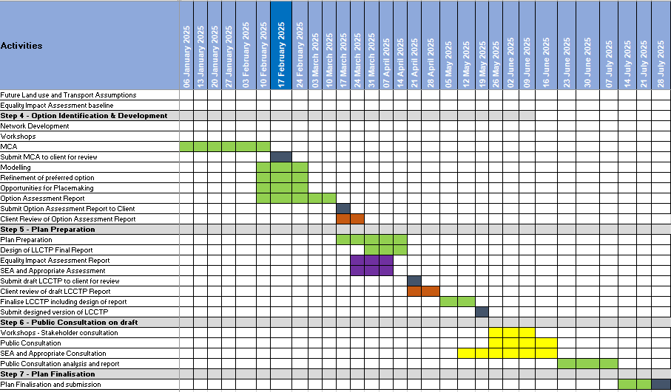
Programme – Feb 25 Update

Slide 13
Programme – Feb 25 Update

Slide 14
Success of Improved Bus Services More Journeys & improved times
In 2023, Bus Éireann passenger journeys in Limerick 4.6 million.
This was up 600,000 on 2022 a 15% increase year on year.
In August 2024 Bus Éireann introduced a 24 hour service on the 343 route to Shannon Airport with 20min frequency at peak times & 30min off peak. This route serves Coonagh & Ennis Road into Colbert.
Initial data showed that the introduction of the Bus Lane on O’Connell Street in 2022 reduced journey times through the city centre from 9mins to 3mins at peak times.
Subsequently Bus Éireann advised of 15 to 20min improved journey times at peak congestion.

Slide 15
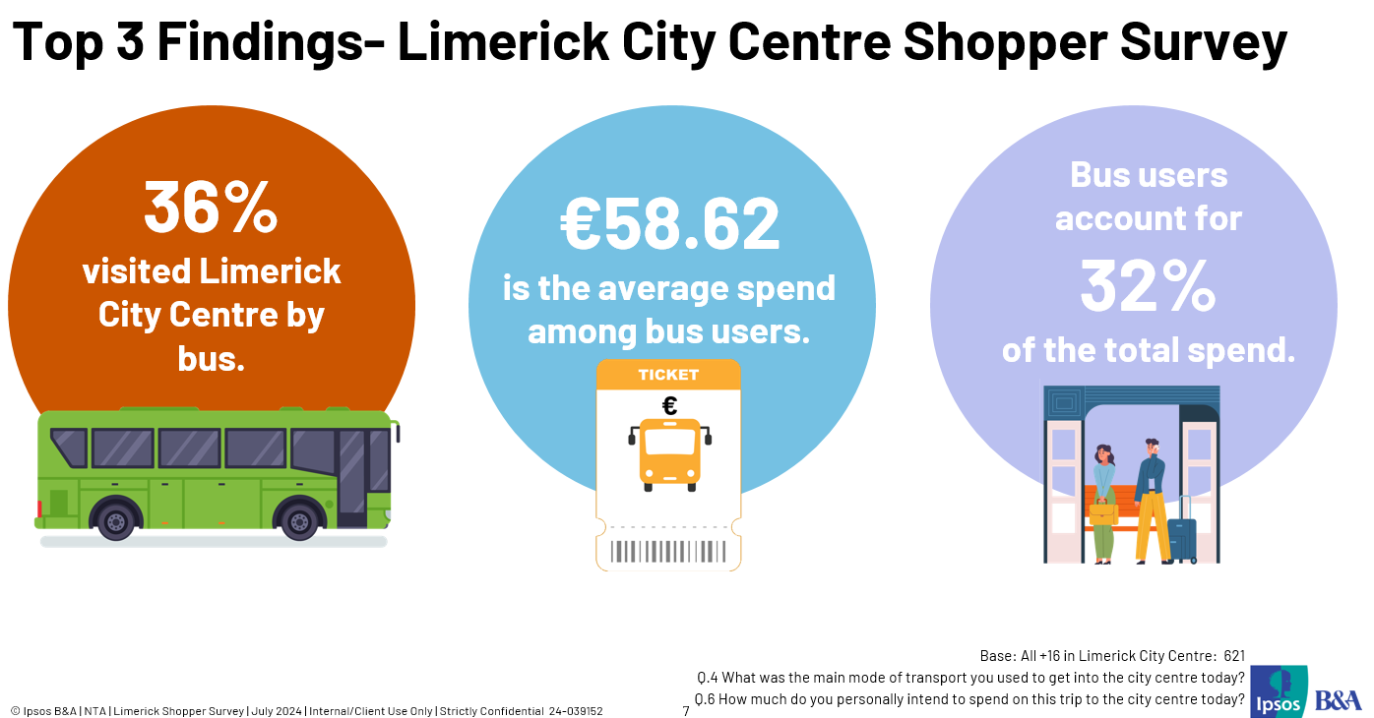
July 24

Slide 16
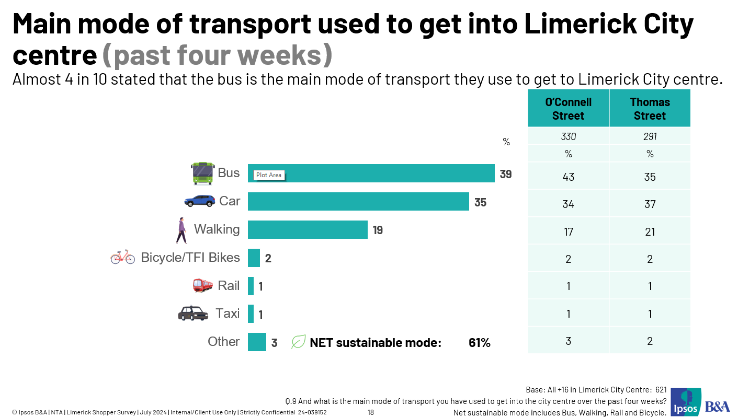
July 24

Slide 17
Increase PT
from 4% to 12%
Bus Trips up by 15% in 2023 over 2022
LSMATS
Mode Share
Targets
2016
to
2040
Increase Cycling from 3% to 14%
Increase Walking
From 23% to 33%
Decrease Car trips
From 70% to 41%

Slide 18
Thank You

