Slide 1
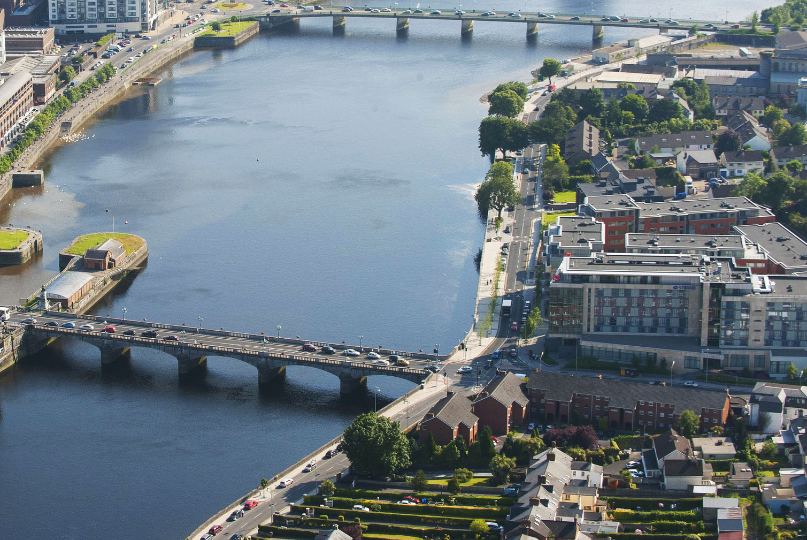

Limerick City Centre Shopper Survey Quantitative Survey
IPSOS B&A NTA
Prepared by:
Clare Kavanagh &
Laura Barbonetti
July 2024
© Ipsos B&A | NTA | Limerick Shopper Survey | July 2024 | | Internal/Client Use Only | Strictly Confidential 24-039152

Slide 2
Contents
1
Research Objectives and Methodology
2
Reasons for Visiting Limerick City Centre
3
4
Length of Visit in Limerick City Centre
Mode of Transport used
5
Anticipated Spend in Limerick City Centre
6
Summary of Results

Slide 3
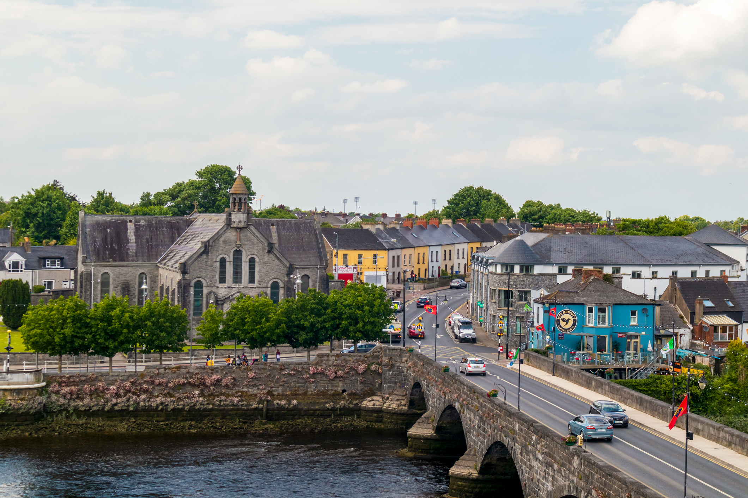
1. Research Objectives & methodology

Slide 4
Research Objectives & Methodology
Objectives
Methodology
Fieldwork
Sample
The core objective of this research was to investigate how much money users of different transport methods are spending in Limerick city centre.
The research also aimed to ascertain the purpose of visits, length of stay and frequency of visits by mode of transport into Limerick city centre.
Interviews were conducted face-to-face using tablets and a pre-programmed survey script.
Interviews were conducted in two key shopping locations in Limerick city centre: O’Connell Street & Thomas Street.
Respondents were aged 16+ year and living in Ireland.
Fieldwork for the project took place from 4th June to 9th July 2024.
Interviewing schedules were designed to deliver a robust cross section of visitors across time of day and weekday / weekend.
621 interviews were completed with the following spread across the two locations:
​ | N
O’Connell Street | 330
Thomas Street | 291
TOTAL | 621
The margin of error is +/-4% at C.L. 95%

Slide 5
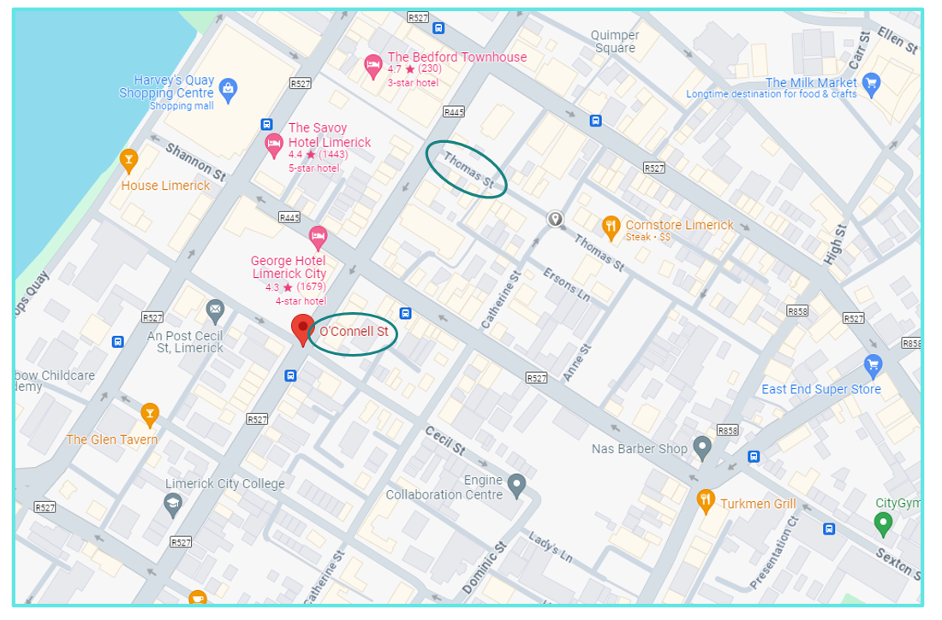
Interviews location Interviews equally split between Thomas Street and O'Connell Street.
Interview Location
621
%
Thomas St
47%
Mon
Tues
Wed
Thurs
Fri
Sat
Sun
O’Connell St
53%
Base: All +16 in Limerick City Centre: 621

Slide 6
Profile of sample 39% are under 35 years and almost half live outside Limerick City centre.
Gender
Limerick | O’Connell Street | Thomas Street
621 | 330 | 291
% | % | %
Age
Limerick | O’Connell Street | Thomas Street
621 | 330 | 291
% | % | %
Social Class
Limerick | O’Connell Street | Thomas Street
621 | 330 | 291
% | % | %
Where they live
Limerick | O’Connell Street | Thomas Street
621 | 330 | 291
% | % | %
Male
Female
ABC1
C2DEF
16 – 35
35-54
55+
Limerick City
Outside Limerick City
Base: All +16 in Limerick City Centre: 621

Slide 7
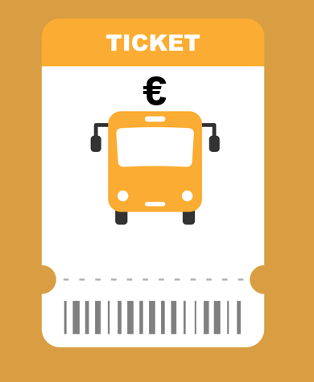
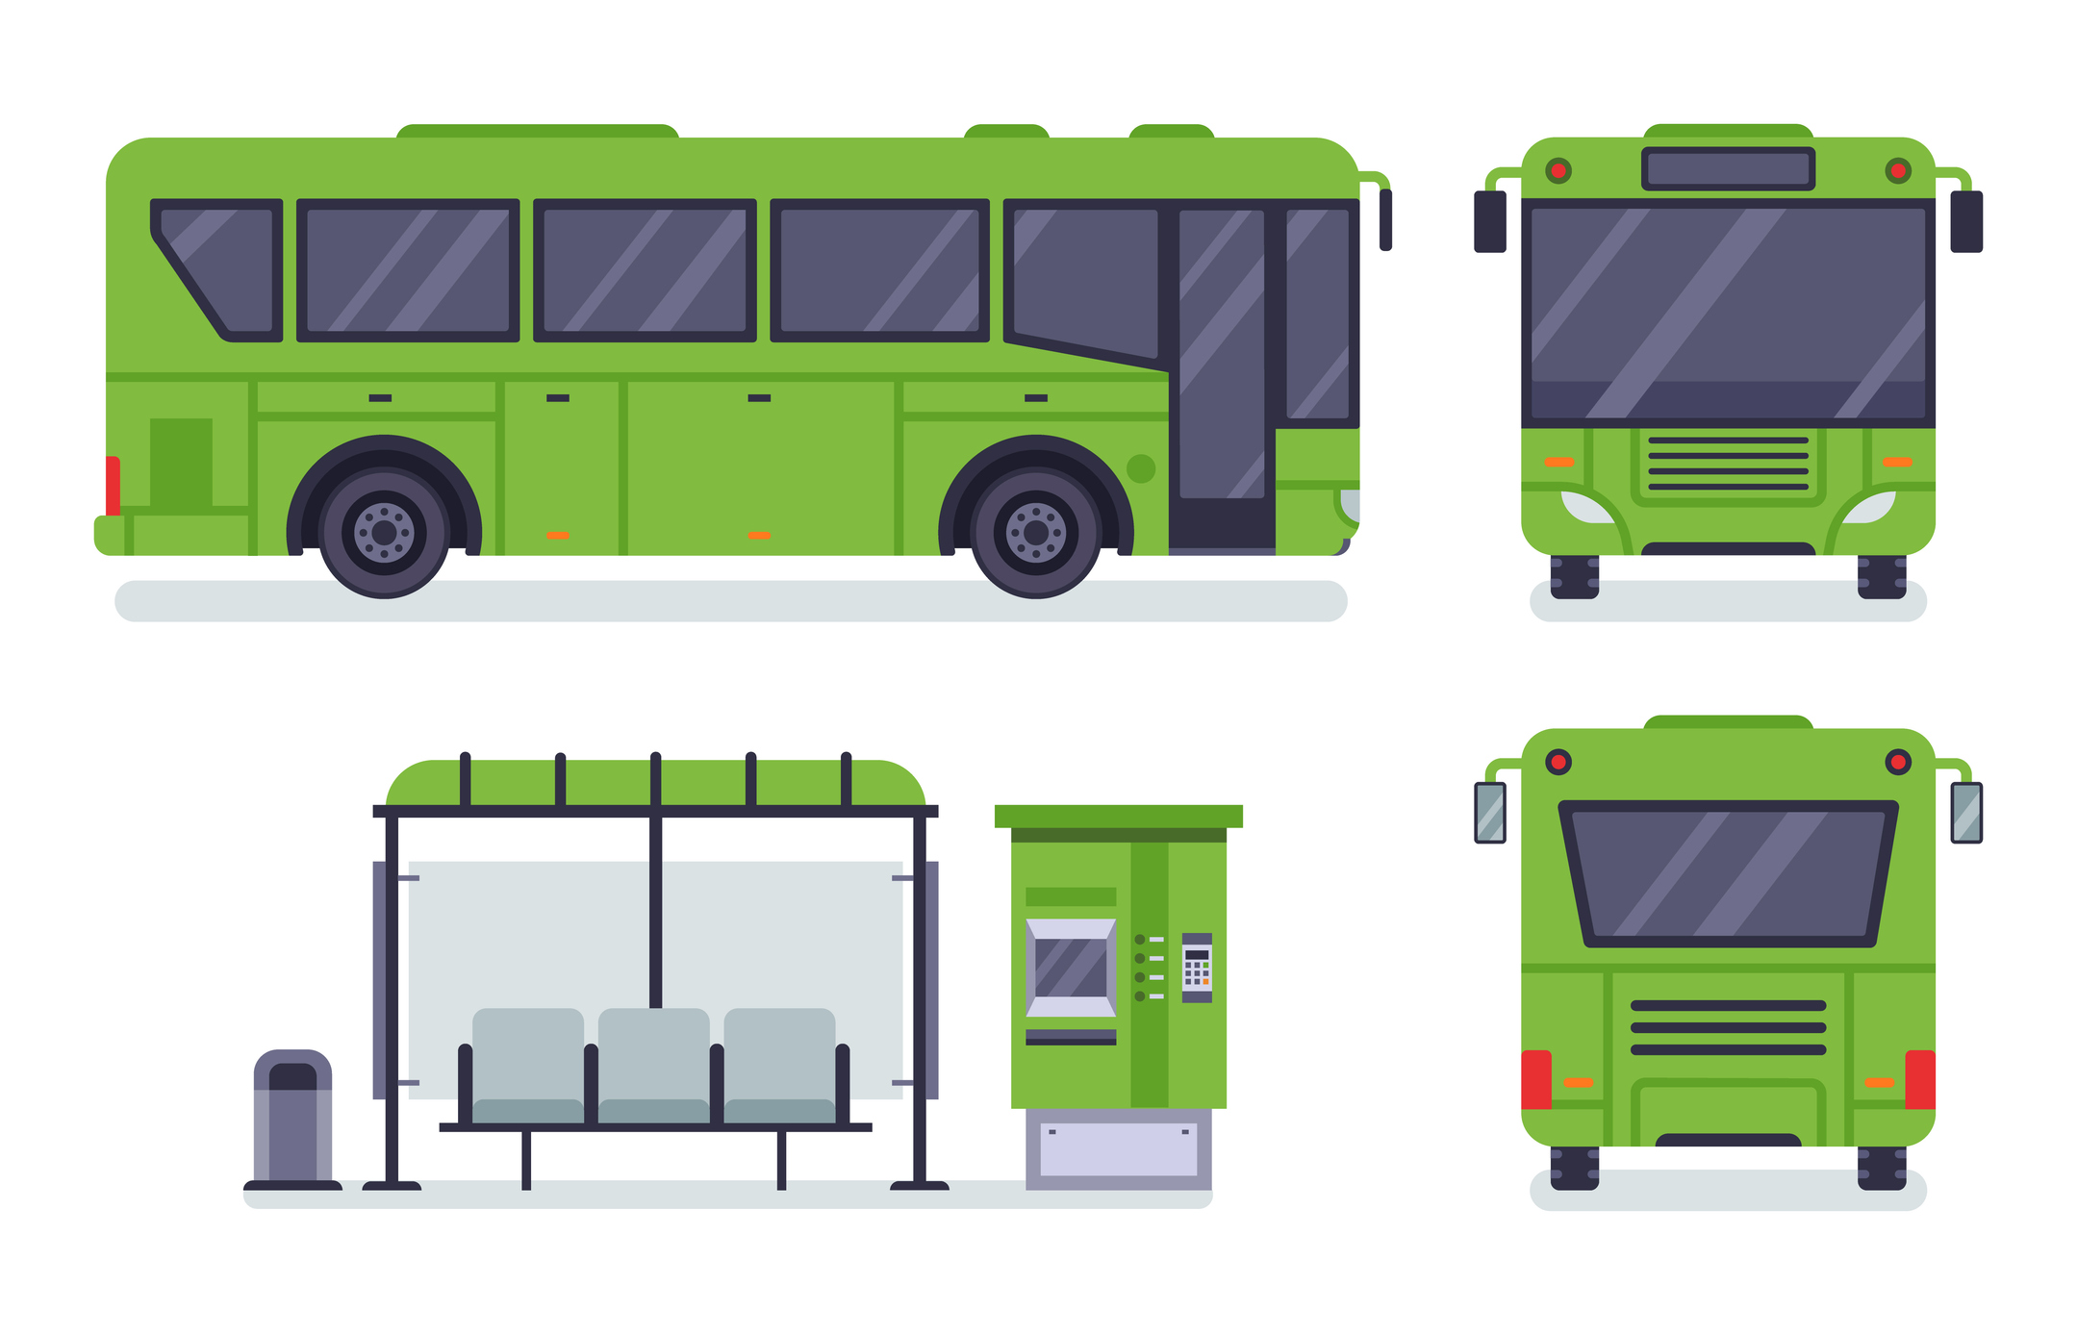
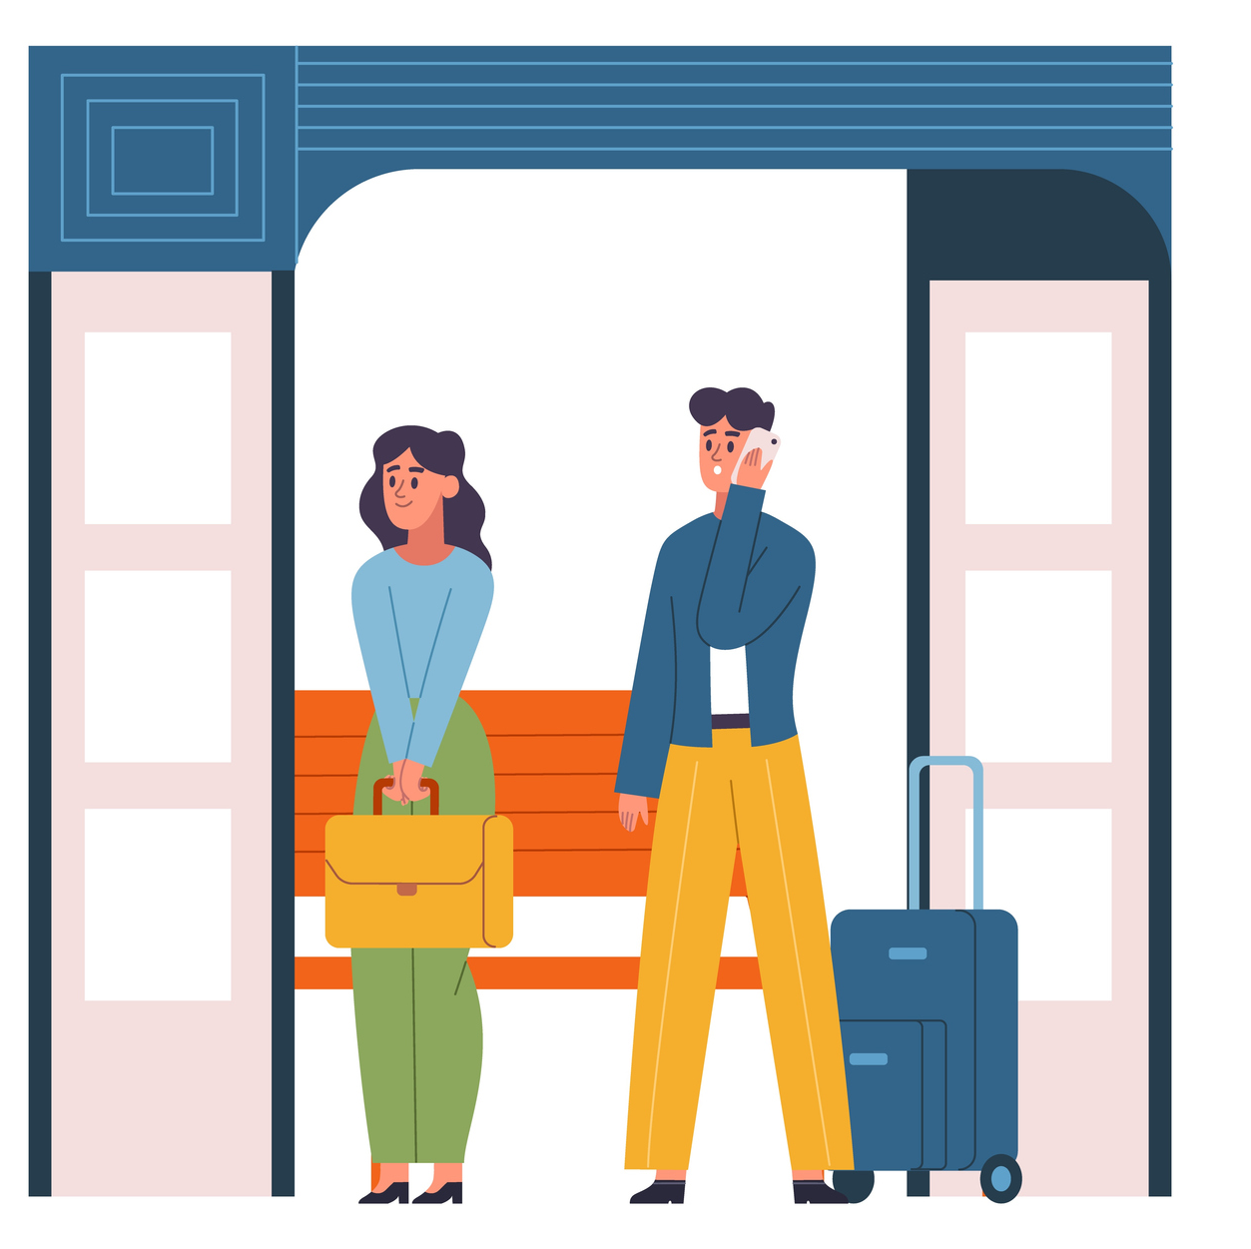
Top 3 Findings- Limerick City Centre Shopper Survey
36%
visited Limerick City Centre by bus.
Bus users
account for
32%
of the total spend.
€58.62
is the average spend among bus users.
Base: All +16 in Limerick City Centre: 621
Q.4 What was the main mode of transport you used to get into the city centre today?
Q.6 How much do you personally intend to spend on this trip to the city centre today?

Slide 8
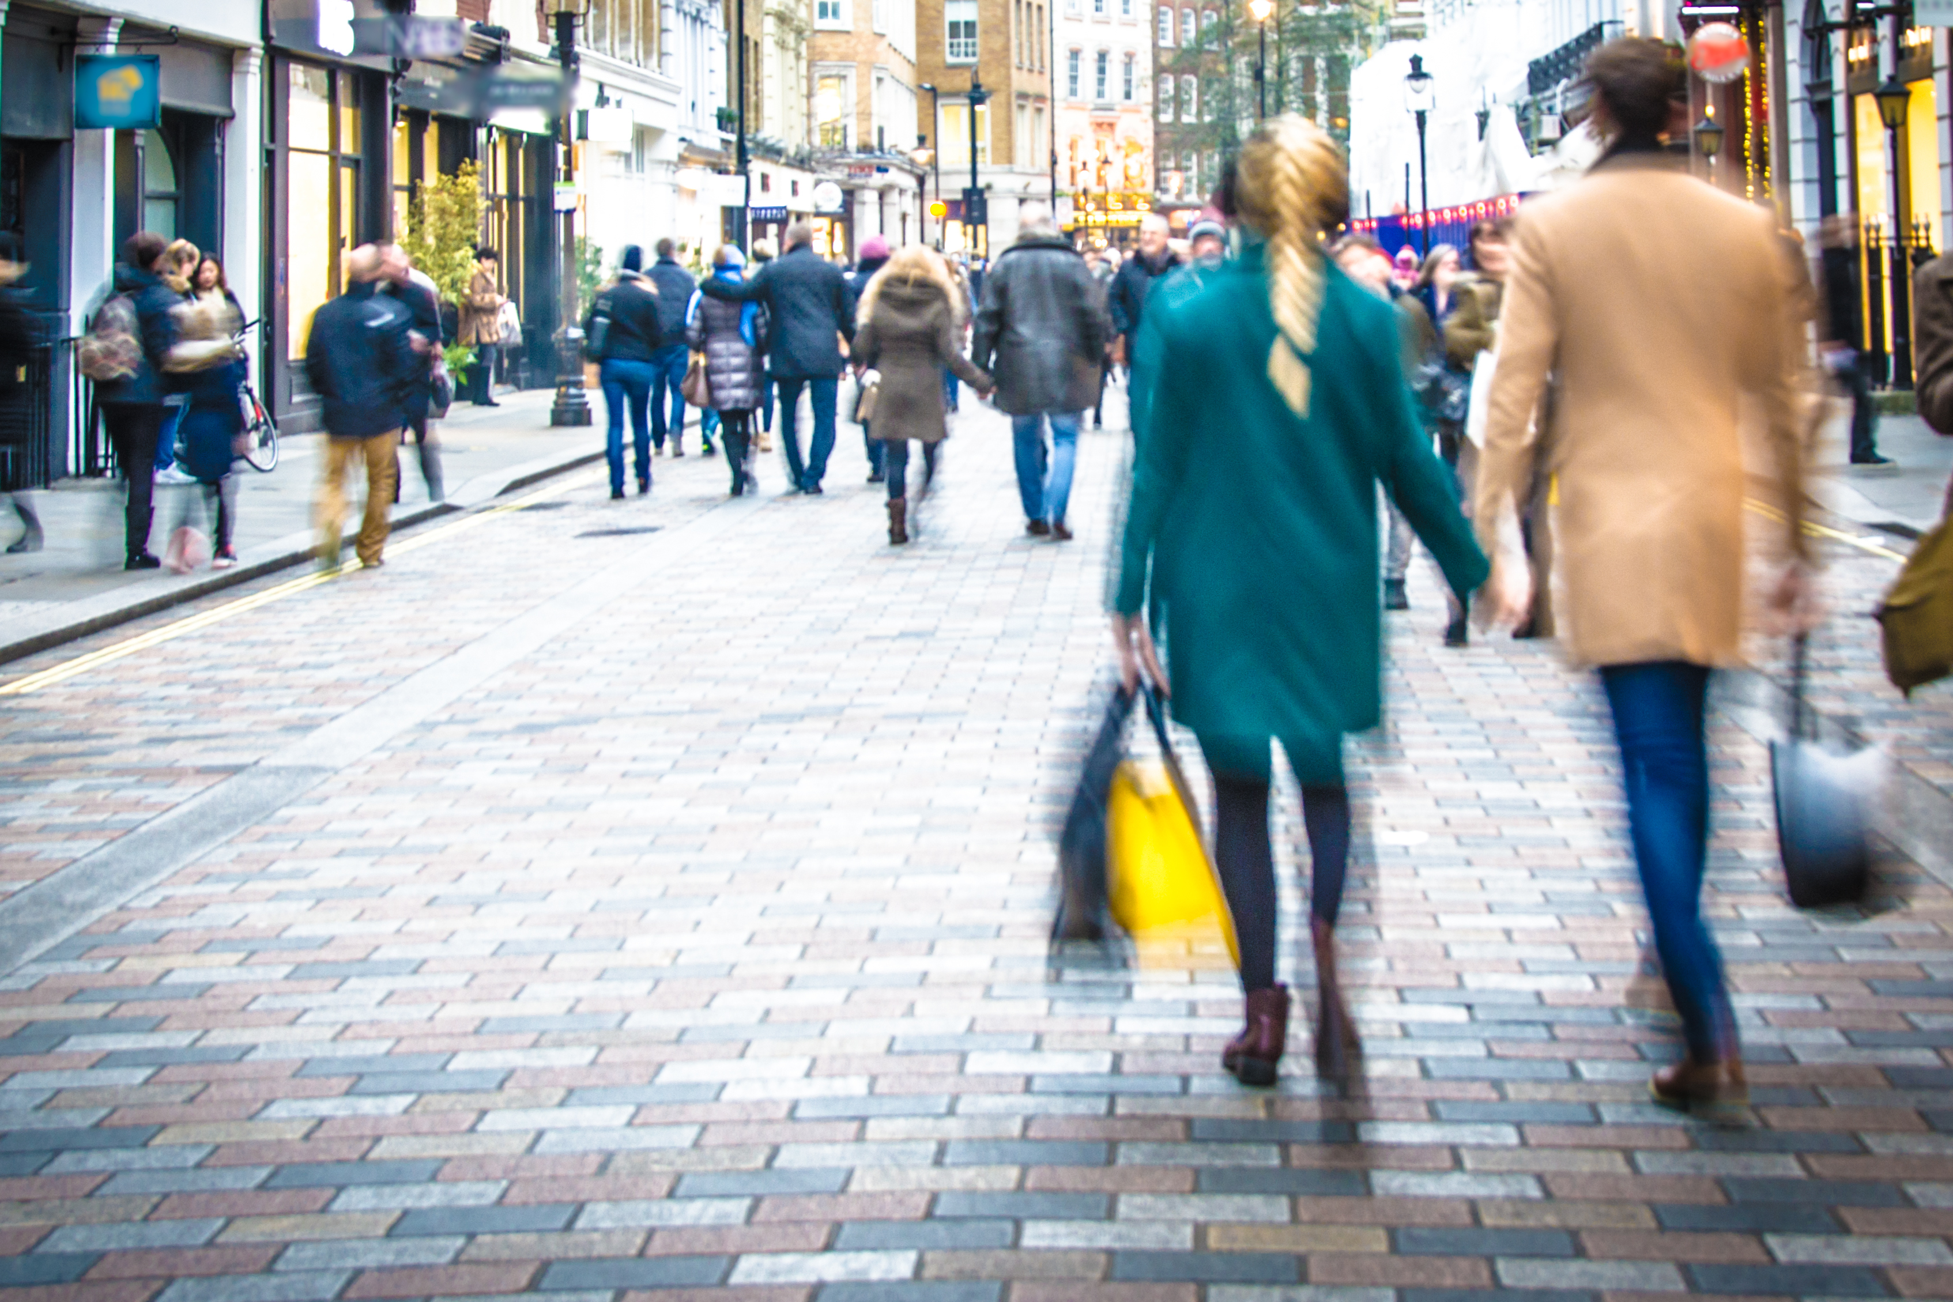
2. Reasons for visiting Limerick city centre

Slide 9


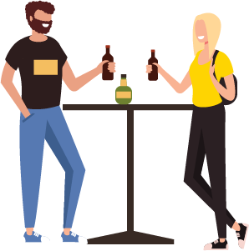

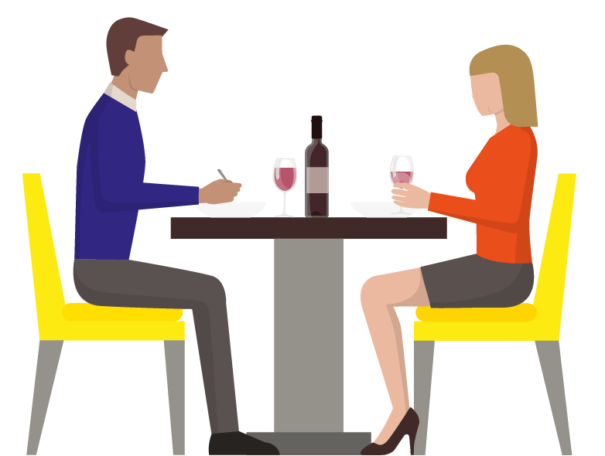

Main reason for visiting Limerick City centre (on the day of the interview)
Event/cinema/theatre
Other*
School/college/other education
Pub/have a drink out
Shopping
%
Restaurant/eat out
Main reason for visiting Limerick City centre is shopping mentioned by more than half of visitors.
Work/going to work
Main Reason Summary | %
Shopping | 56
ANY work or school | 16
ANY food or drink out | 12
Event/cinema/theatre | 3
Other | 12
Base: All +16 in Limerick City Centre: 621
Q.2 What is the main purpose of your trip to the city centre today?
*Other includes Leisure, Walks, Medical appointments, Beauty appointments and Church.

Slide 10
Profile of those visiting for shopping Those visiting for shopping are more likely to be female.
Gender
Limerick | Main purpose-Shopping
621 | 343
% | %
Age
Limerick | Main purpose-Shopping
621 | 343
% | %
Social Class
Limerick | Main purpose-Shopping
621 | 343
% | %
Where they live
Limerick | Main purpose-Shopping
621 | 343
% | %
Male
Female
ABC1
C2DEF
16 – 35
35-54
55+
Limerick City
Outside Limerick City
Base: All +16 in Limerick City Centre: 621
Q.2 What is the main purpose of your trip to the city centre today?

Slide 11
Other reasons for visiting Limerick City centre (on the day of the interview)
%
Going to a restaurant/ eating out
Shopping
Going to the pub/having a drink out
Working/going to work
Attending an event/cinema/theatre
Other
Visited Limerick City centre for more than one reason
Visited only for one reason
%
Eating out is the most common ‘other’ reason for visiting Limerick City centre.
Other Reasons Summary | %
ANY food or drink out | 31
Shopping | 14
ANY work or school | 2
Event/cinema/theatre | 1
Other | 6
Base: All +16 in Limerick City Centre: 621
Q.3 Are there any other reasons for your trip to the city centre today?
*Other includes Leisure, Walks, Medical appointments and Beauty appointments.

Slide 12
Reasons for visiting More than half visited Limerick city centre only for one reason.
 | Limerick (621) |  | O’Connell Street (330) |  | Thomas Street (291)
 | Main Reason | Other Reasons | Main Reason | Other Reasons | Main Reason | Other Reasons
 | % | % | % | % | % | %
Shopping | 56 | 13 | 57 | 15 | 53 | 10
Working/going to work | 13 | 2 | 14 | 2 | 13 | 2
Going to a restaurant/ eating out | 9 | 28 | 8 | 23 | 9 | 33
Going to the pub/having a drink out | 3 | 3 | 3 | 4 | 4 | 1
Attending school/college/other education | 3 | 0 | 2 | 0 | 4 | 0
Attending an event/cinema/theatre | 4 | 1 | 3 | 2 | 2 | 1
Other | 12 | 6 | 12 | 8 | 15 | 5
No other reason | - | 52 | 0 | 52 | 0 | 52
Base: All +16 in Limerick City Centre: 621
Q.2 What is the main purpose of your trip to the city centre today? SINGLE CODE ONLY
Q.3 Are there any other reasons for your trip to the city centre today? MULTICODE POSSIBLE

Slide 13
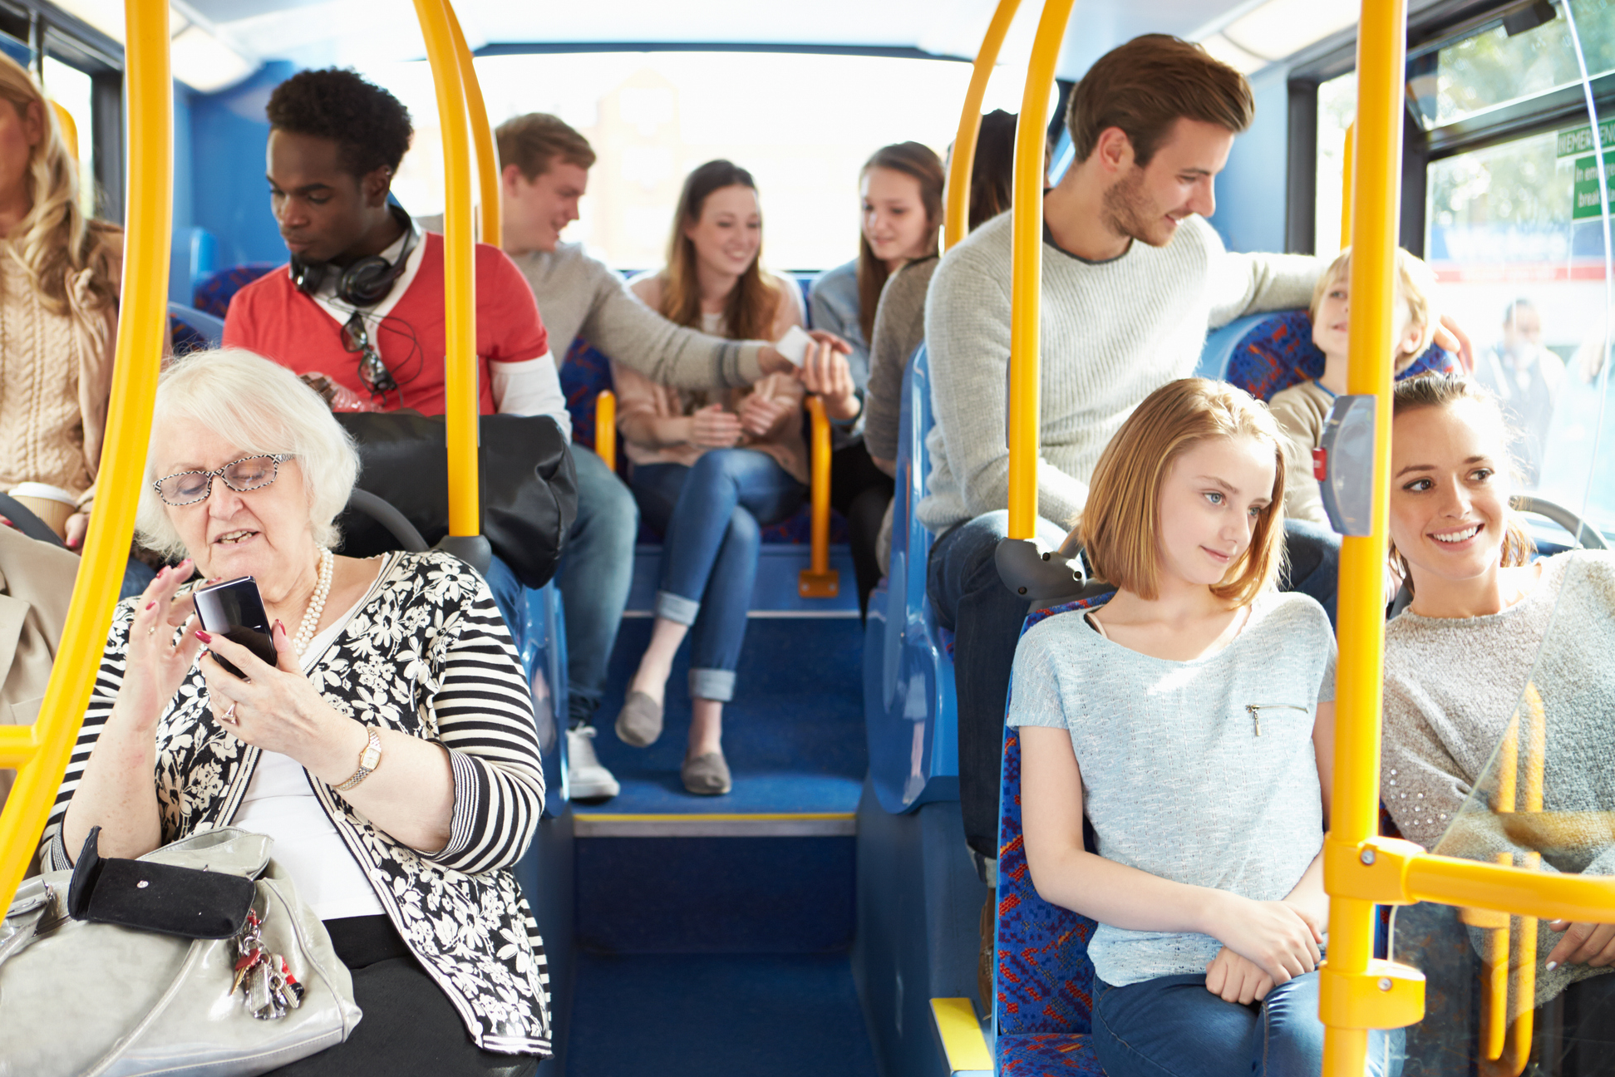
3. Mode of transport used

Slide 14

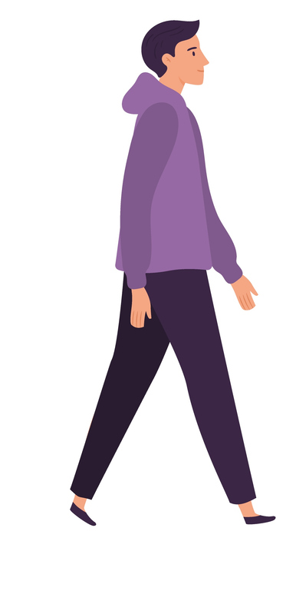

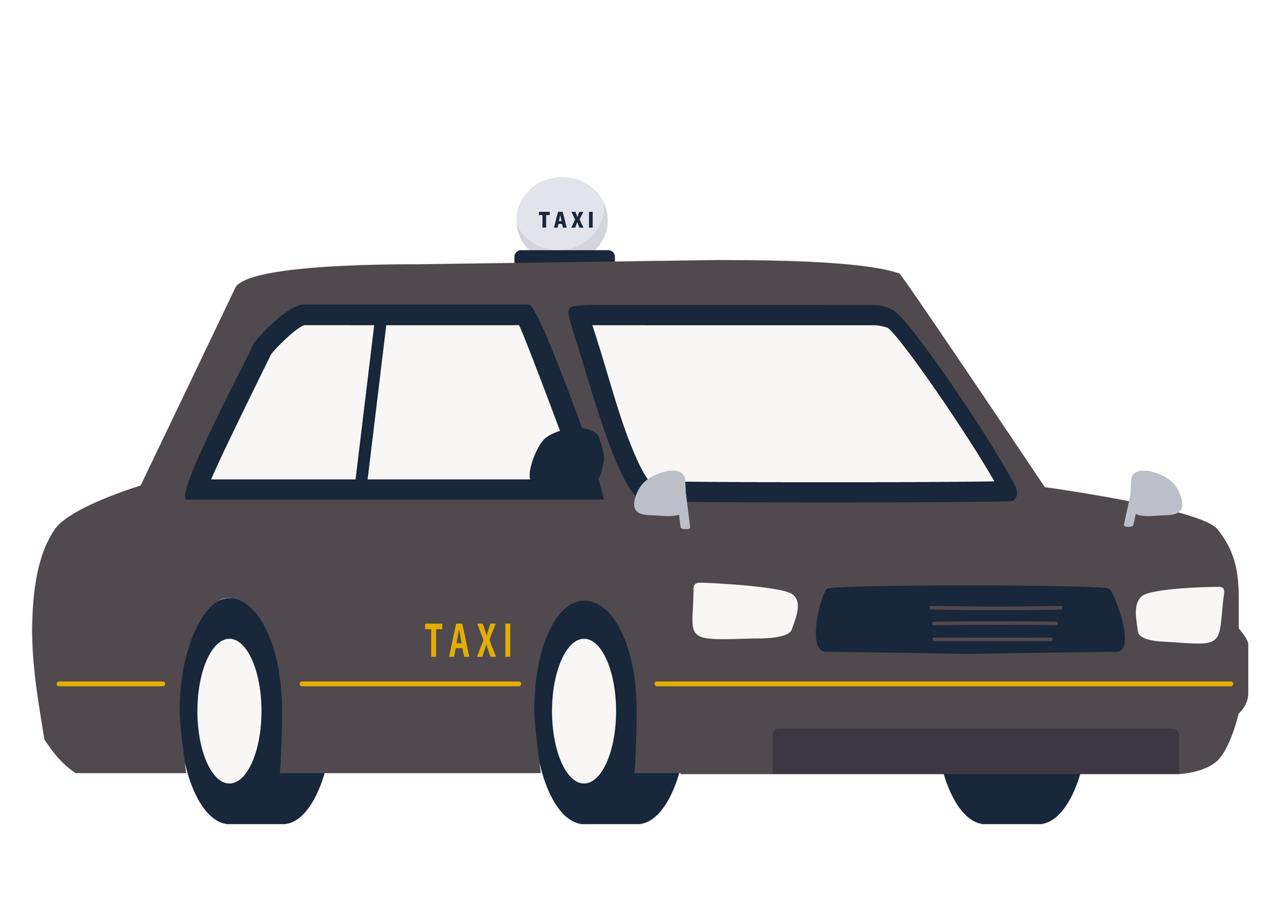
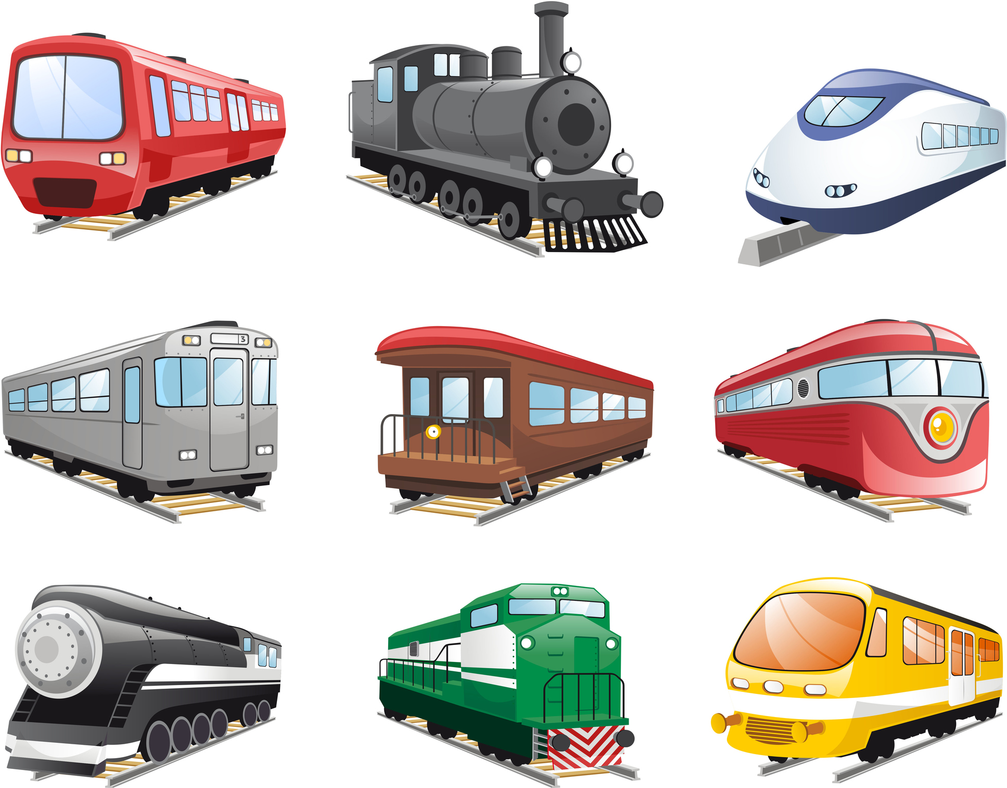
Modes of transport used (on the day of the interview)
To get into the city centre | To get home
621 | 621
% | %
Car
Bus
Walking
36% used the bus to get into Limerick city centre while 38% used the car.
Rail
Taxi
Bicycle/TFI bikes
Other
NET sustainable mode: | 60% | 58%
NET public transport: | 39% | 41%
Base: All +16 in Limerick City Centre: 621
Q.4 What was the main mode of transport you used to get into the city centre today?
Q.5 What will be the main mode of transport that you will use to get home today?
Net sustainable mode includes Bus, Walking, Rail and Bicycle.

Slide 15
Modes of transport used by demos Incidence of bus usage higher among those under 35 years.
Total |  | Gender |  |  | Age |  |  |  | Where they live |  |  | Location
 |  | Male | Female |  | Under 35 | 35-54 | 55+ |  | Limerick City | Outside Limerick City |  | O’Connell Street | Thomas Street
621 |  | 286 | 335 |  | 242 | 183 | 196 |  | 299 | 322 |  | 330 | 291
% |  | % | % |  | % | % | % |  | % | % |  | % | %
Car
Bus
Walking
All others**
NET Sustainable | 60%
NET Public transport | 39%
57% | 63% |  | 74% | 49% | 53% |  | 80% | 42% |  | 60% | 59%
37% | 41% |  | 46% | 32% | 38% |  | 40% | 38% |  | 42% | 36%
Base: All +16 in Limerick City Centre: 621
Q.4 What was the main mode of transport you used to get into the city centre today?
**Includes Rail, Taxi, Bicycle and Other .
Net sustainable mode includes Bus, Walking, Rail and Bicycle.

Slide 16
Modes of transport used by reason for visiting Higher incidence of bus use among those going to Limerick City centre for education.
MAIN REASON FOR VISITING
TOTAL |  | Shopping | Working/ going to work | Attending school/ college/other education | Going to a restaurant/ eating out | Going to the pub/having a drink out | Attending an event/ cinema/ theatre | Other
621 |  | 343 | 83 | 17* | 54 | 23* | 16* | 85
% |  | % | % | % | % | % | % | %
Car
Bus
Walking
All others**
NET Sustainable | 60%
NET Public transport | 39%
62% | 61% | 82% | 44% | 70% | 31% | 60%
42% | 39% | 65% | 26% | 48% | 19% | 33%
Base: All +16 in Limerick City Centre: 621
Q.4 What was the main mode of transport you used to get into the city centre today?
*Caution: small base **Includes Rail, Taxi, Bicycle and Other
Net sustainable mode includes Bus, Walking, Rail and Bicycle.

Slide 17
Parking in Limerick City Centre
Got dropped off
Other
Multi-storey car park
44% of those who used a car to get to Limerick city centre parked in a multi-storey car park.
%
Parked on the street
Base: All +16 used a car to get into Limerick City Centre: 233
Q.4a Where did you park today?

Slide 18
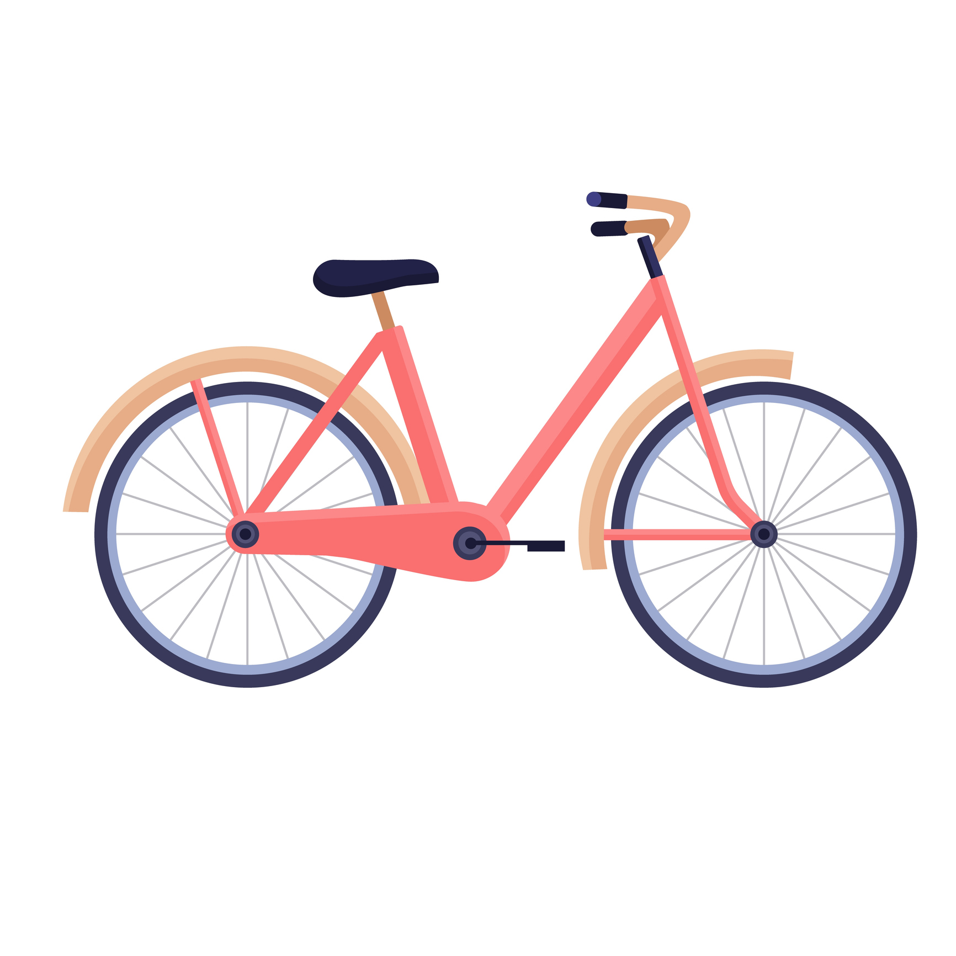
Main mode of transport used to get into Limerick City centre (past four weeks) Almost 4 in 10 stated that the bus is the main mode of transport they use to get to Limerick City centre.
O’Connell Street | Thomas Street
330 | 291
% | %
43 | 35
34 | 37
17 | 21
2 | 2
1 | 1
1 | 1
3 | 2
%
NET sustainable mode: | 61%
Base: All +16 in Limerick City Centre: 621
Q.9 And what is the main mode of transport you have used to get into the city centre over the past four weeks?
Net sustainable mode includes Bus, Walking, Rail and Bicycle.

Slide 19
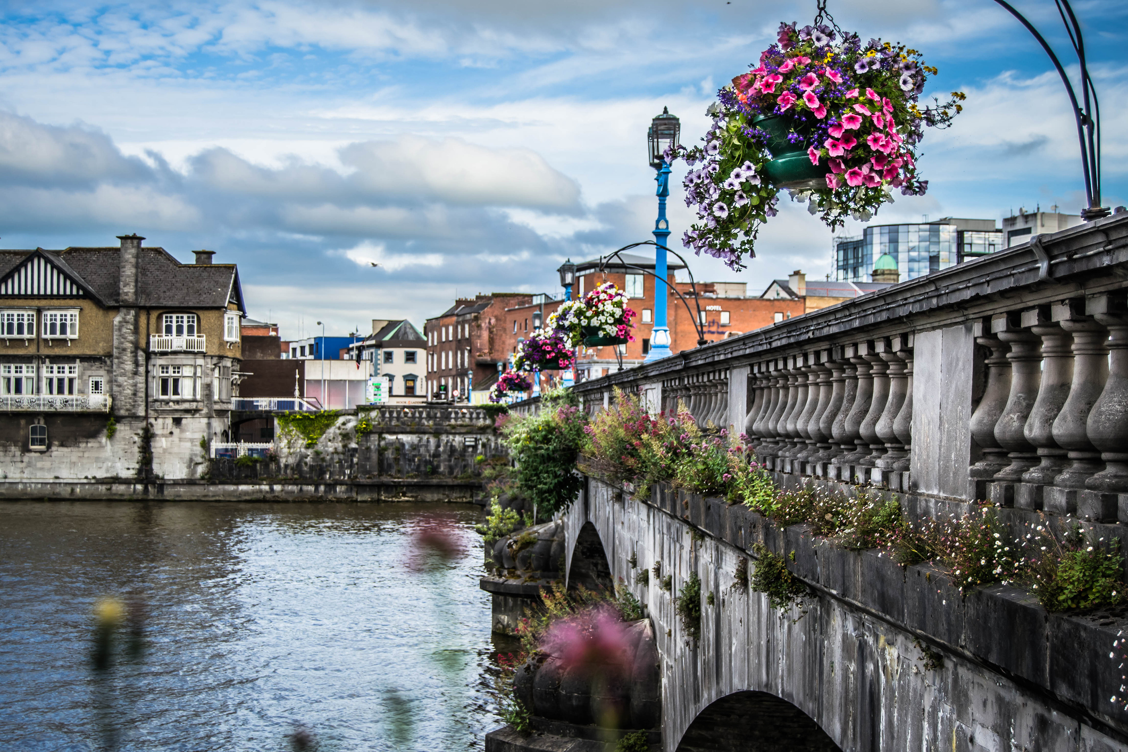
4. Length of visit in limerick city centre

Slide 20
Anticipated length of visit (on the day of the interview)
TOTAL
621
%
Less than 1 hour
Between 1 and 2 hours
Between 2 and 3 hours
Between 3 and 5 hours
Over 5 hours
60% anticipated to spend 2 or more hours in Limerick city centre.
Net 2+ hours | 60%
Base: All +16 in Limerick City Centre: 621
Q.7 Approximately how long do you expect to spend in the city centre today?

Slide 21
Anticipated length of visit by demos Younger cohort more likely to spend 2+ hours in Limerick City centre.
Total |  | Gender |  |  | Age |  |  |  | Where they live |  |  | Location
 |  | Male | Female |  | Under 35 | 35-54 | 55+ |  | Limerick City | Outside Limerick City |  | O’Connell Street | Thomas Street
621 |  | 286 | 335 |  | 242 | 183 | 196 |  | 299 | 322 |  | 330 | 291
% |  | % | % |  | % | % | % |  | % | % |  | % | %
Less than 1 hour
Between 1 and 2 hours
Between 2 and 3 hours
Between 3 and 5 hours
Over 5 hours
Net 2+ hours | 60%
61% | 58%
70% | 57% | 49%
48% | 70%
61% | 58%
Base: All +16 in Limerick City Centre: 621
Q.7 Approximately how long do you expect to spend in the city centre today?

Slide 22
Anticipated length of visit by main reason for visiting Those visiting for shopping more likely to stay for shorter visits.
MAIN REASON FOR VISITING
TOTAL |  | Shopping | Working/ going to work | Attending school/ college/other education | Going to a restaurant/ eating out | Going to the pub/having a drink out | Attending an event/ cinema/ theatre | Other
621 |  | 343 | 83 | 17* | 54 | 23* | 16* | 85
% |  | % | % | % | % | % | % | %
Less than 1 hour
1-2 hours
2-3 hours
3-5 hours
Over 5 hours
Net 2+ hours | 60%
50% | 93% | 71% | 75% | 82% | 87% | 49%
Base: All +16 in Limerick City Centre: 621
Q.7 Approximately how long do you expect to spend in the city centre today?
*Caution: small base

Slide 23
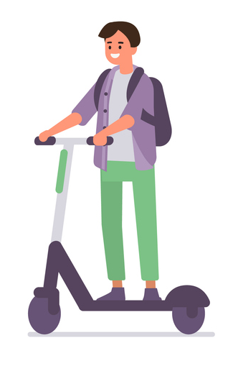
Anticipated length of visit by mode of transport used Those travelling to Limerick city by car or bus tend to spend a similar amount of time.
MODE OF TRANSPORT USED
TOTAL |  | Bus | Bicycle | Car | Rail | Taxi | Walking | E-scooter | Other
621 |  | 221 | 9* | 233 | 13* | 10* | 129 | 1* | 5*
% |  | % | % | % | % | % | % | % | %
Less than 1 hour
1-2 hours
2-3 hours
3-5 hours
Over 5 hours
Net 2+ hours | 60%
63% | 33% | 60% | 100% | 60% | 53% | 100% | 40%
Base: All +16 in Limerick City Centre: 621
Q.7 Approximately how long do you expect to spend in the city centre today?
*Caution: small base

Slide 24
Number of visits to Limerick City centre (past four weeks)
TOTAL
621
%
0
1-2
3-4
5-9
10+
Don’t know
58% have visited the city centre at least 5 times in the past four weeks.
Average no. of times: | 10.11
Base: All +16 in Limerick City Centre: 621
Q.8 Think again about the past four weeks, how many times have you visited the city centre?

Slide 25
Number of visits to Limerick City Centre by demos Same incidence of visits between O’Connell Street and Thomas Street visitors.
Total |  | Gender |  |  | Age |  |  |  | Where they live |  |  | Location
 |  | Male | Female |  | Under 35 | 35-54 | 55+ |  | Limerick City | Outside Limerick City |  | O’Connell Street | Thomas Street
621 |  | 286 | 335 |  | 242 | 183 | 196 |  | 299 | 322 |  | 330 | 291
% |  | % | % |  | % | % | % |  | % | % |  | % | %
0
1-2
3-4
5-9
10+
Average no. of times: | 10.11
10.42 | 9.85
12.35 | 9.58 | 7.84
12.41 | 7.97
10.10 | 10.11
Base: All +16 in Limerick City Centre: 621
Q.8 Think again about the past four weeks, how many times have you visited the city centre?

Slide 26
Number of visits to Limerick City Centre by main reason for visiting Those visiting for shopping visited Limerick City centre about 7 times past four weeks.
MAIN REASON FOR VISITING
TOTAL |  | Shopping | Working/going to work | Attending school/college/other education | Going to a restaurant/ eating out | Going to the pub/having a drink out | Attending an event/cinema/theatre | Other please specify
621 |  | 343 | 83 | 17* | 54 | 23* | 16* | 85
% |  | % | % | % | % | % | % | %
0
1-2
3-4
5-9
10+
Don't Know
Average no. of times: | 10.11 |  | 7.51 | 18.82 | 22.59 | 9.13 | 9.18 | 9.93 | 10.44
Base: All +16 in Limerick City Centre: 621
Q.8 Think again about the past four weeks, how many times have you visited the city centre?
*Caution: small base

Slide 27
Number of visits to Limerick City Centre by mode of transport used Those using the bus visited Limerick Centre 10 times in the past four weeks.
MODE OF TRANSPORT USED
TOTAL |  | Bus | Bicycle | Car | Rail | Taxi | Walking | E-scooter | Other
621 |  | 221 | 9* | 233 | 13* | 10* | 129 | 1* | 5*
% |  | % | % | % | % | % | % | % | %
0
1-2
3-4
5-9
10+
Don't Know
Average no. of times: | 10.11 |  | 10.38 | 15.89 | 6.47 | 4.75 | 7.90 | 16.30 | 3.00 | 15.40
Base: All +16 in Limerick City Centre: 621
Q.8 Think again about the past four weeks, how many times have you visited the city centre?
*Caution: small base

Slide 28
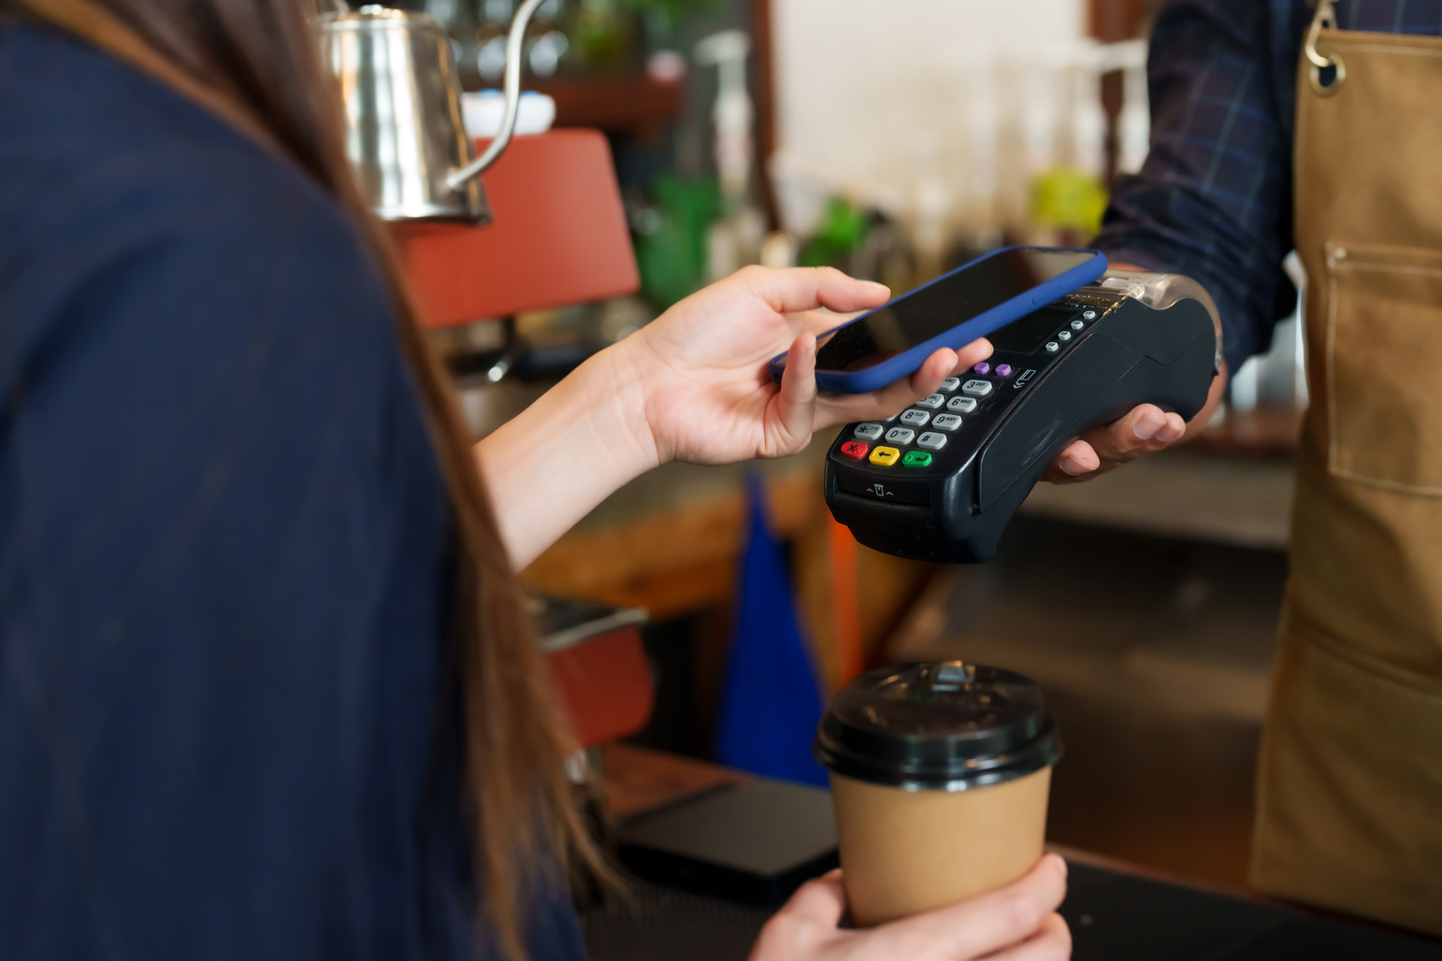
5. ANTICIPATED SPEND

Slide 29
Anticipated spend (on the day of the interview)
TOTAL
621
%
€0
From €1 to €20
From €20 to €50
From €50 to €90
From €90 to €150
€150 or more
Don't Know
The average spend was €64.62 with about half expecting to spend more than €50.
Mean | €64.62
Base: All +16 in Limerick City Centre: 621
Q.6 How much do you personally intend to spend on this trip to the city centre today?

Slide 30
Anticipated spend by demos Anticipated spend is marginally higher among O’Connell Street visitors.
Total |  | Gender |  |  | Age |  |  |  | Where they live |  |  | Location
 |  | Male | Female |  | Under 35 | 35-54 | 55+ |  | Limerick City | Outside Limerick City |  | O’Connell Street | Thomas Street
621 |  | 286 | 335 |  | 242 | 183 | 196 |  | 299 | 322 |  | 330 | 291
% |  | % | % |  | % | % | % |  | % | % |  | % | %
0
From €1 to €20
From €20 to €50
From €50 to €90
From €90 to €150
€150 or more
Average : | €64.62
€67.25 | €62.36
€63.25 | €69.38 | €61.88
€56.23 | €72.36
€68.06 | €60.75
Base: All +16 in Limerick City Centre: 621
Q.6 How much do you personally intend to spend on this trip to the city centre today?

Slide 31
Anticipated spend by mode of transport Average spend per person among bus users is €58.62 which is marginally lower than the average spend.
Average spend: €64.64
% using transport mode to Limerick city centre:
*
*
*
*
€: average spend per person by mode
€78.62
€58.62
€41.18
€90.62
€177.80
€25.56
€60.00
Base: All +16 in Limerick City Centre: 621
Q.4 What was the main mode of transport you used to get into the city centre today?
Q.6 How much do you personally intend to spend on this trip to the city centre today?
*Caution low base size under n=50

Slide 32
Anticipated spend by main purpose of trip Average spend per person is higher among those visiting Limerick city centre for shopping.
Average spend: €64.64
Main purpose of trip to Limerick city centre %:
*
*
*
€: average spend per person by trip purpose
€80.01
€16.83
€74.93
€74.13
€32.00
€45.69
€50.51
Base: All +16 in Limerick City Centre: 621
Q.6 How much do you personally intend to spend on this trip to the city centre today?
*Caution low base size under n=50

Slide 33
Share of Spend by mode of transport used
Other
Walking
Taxi
Bus
Rail
Bus users account for 32% of the total spend while car users for 46% of the total spend.
%
Bicycle/TFI bike
Car
Base: All +16 used a car to get into Limerick City Centre: 621
Q.9 And what is the main mode of transport you have used to get into the city centre over the past four weeks?

Slide 34






Share of spend by mode of transport used Bus users account for 32% of the total spend.
Main mode of transport today: | Total | Bus | *Bicycle/ TFI Bikes | Car | *Rail | *Taxi | Walking | *E-scooter | *Other | NET Public Transport | NET Sustainable
 | 621 | 221 | 9 | 233 | 13 | 10 | 129 | 1 | 5 | 244 | 372
Average spend per mode of transport (on day of interview) | €64.62 | €58.62 | €25.56 | €78.62 | €90.62 | €177.80 | €41.18 | €10.00 | €60.00 | €65.21 | €52.95
Total daily spend (Calculation is sum of spend from all the survey respondents) | €40,081 | €12,955 | €230 | €18,318 | €1,178 | €1,778 | €5,312 | €10 | €300 | €15,911 | €19,593
Share of spend | 100% | 32% | 1% | 46% | 3% | 4% | 13% | 0% | 1% | 40% | 49%
*Caution low base size under n=50
Base: All +16 in Limerick City Centre: 621
Q.6 How much do you personally intend to spend on this trip to the city centre today?
Net sustainable mode includes Bus, Walking, Rail and Bicycle.

Slide 35
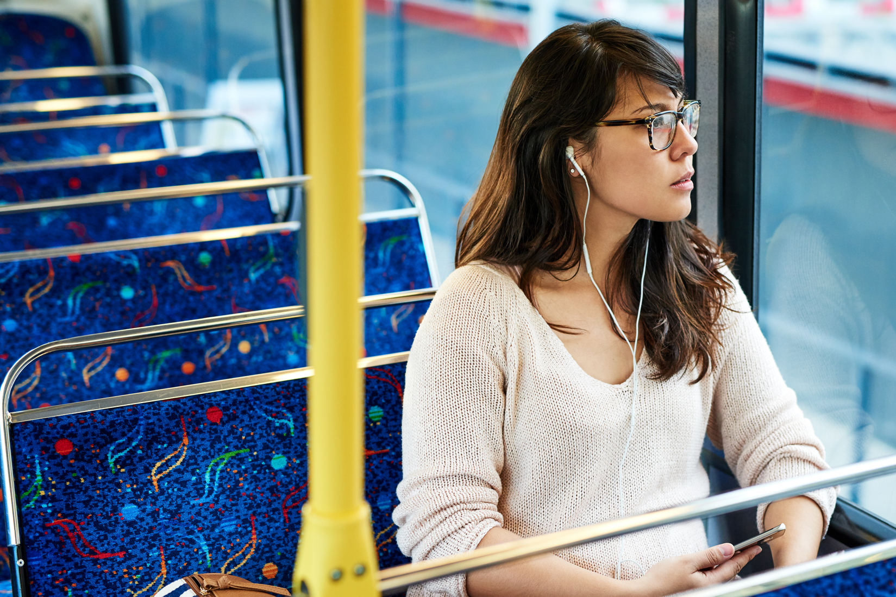
5. Summary of key findings

Slide 36























Key Findings – Limerick City Centre Shopper Survey
Visits to the city centre
Average spend per person
Main reasons:
All 16+ in city centre :
€64.62
Time spent:
All using any sustainable modes:
€52.95
56%
Shopping
79% spent more than 2 hours in the city centre
All using Rail
€90.62
Going to work
All using car
€78.62
13%
All using Bus
€58.62
10.11
Average number of visits in the past 4 weeks
All walking
€41.18
9%
Restaurant/ eat out
All using bicycle/TFI bikes
€25.56
Mode of transport used
Share of estimated daily spend in Limerick city centre
To city centre
Home
NET sustainable mode:
60%
58%
46%
Car
38%
37%
32%
Car:
Bus
36%
34%
Bus:
13%
Walking
21%
20%
Walking:
3%
2%
2%
Rail
Rail:
1%
1%
2%
Bicycle/TFI bikes
Bicycle/TFI bikes:

Slide 37
Limerick Shopper Survey 2024 – Summary of the Results
1
2
3
Shopping was reported as the main reason for visiting Thomas or O'Connell Streets in Limerick City centre with 56% mentioning it. Almost half mentioned more than one reason for visiting with eating the most common second reason (mentioned by 28%). The profile of those visiting Limerick City centre is quite young with almost 4 in 10 under 35 years of age.
Incidence of car and bus usage to reach Limerick City centre is similar; 38% got into Limerick City centre by bus while 36% used a car. About 4 in 10 used public transport to get to Limerick City centre while 6 in 10 used a sustainable mode of transport. Bus is also reported as the most used mode of transport over the last four weeks to reach Limerick City centre.
The average spend was €64.62 while this is slightly lower among bus users with an average spend of €58.62. Bus users’ spend equates to 32% of the total spend. The average spend is higher among car users with average spend of €78.62 equating to 46% of the total spend.

Slide 38

THANK YOU
NAME:
Clare Kavanagh
DETAILS:
Clare.Kavanagh@Ipsos.com
NAME:
Laura Barbonetti
DETAILS:
Laura.Barbnetti@Ipsos.com

