Slide 1
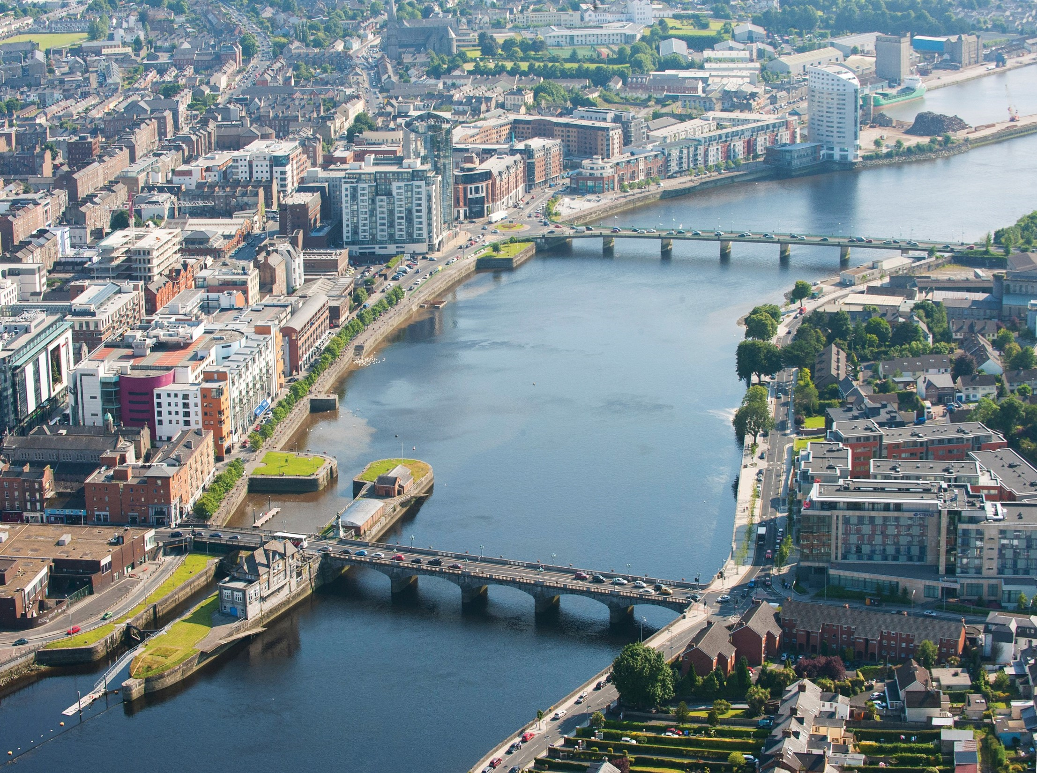
Limerick City Centre Transport Plan Pre-Draft Survey July 2024
Transportation and Mobility Directorate
Limerick City and County Council

Slide 2

Step 1 Inception
Step 2 Scope & Objectives
Step 3 Baseline Assessment
Step 4 Option Identification & Assessment
Step 5 Plan Preparation
Step 6 Public Consultation
Step 7 Plan Finalisation
Pre Draft Survey July 2024

Slide 3
Transport Plan Step 3- Public Survey – June/July 2024
877 respondents
Purpose - to collect insights on the existing travel patterns in Limerick City Centre and to explore the views of the people of Limerick
Leaflet Drop to Traders & Business in City Centre
Significant support for enhanced Public Transport measures

Slide 4
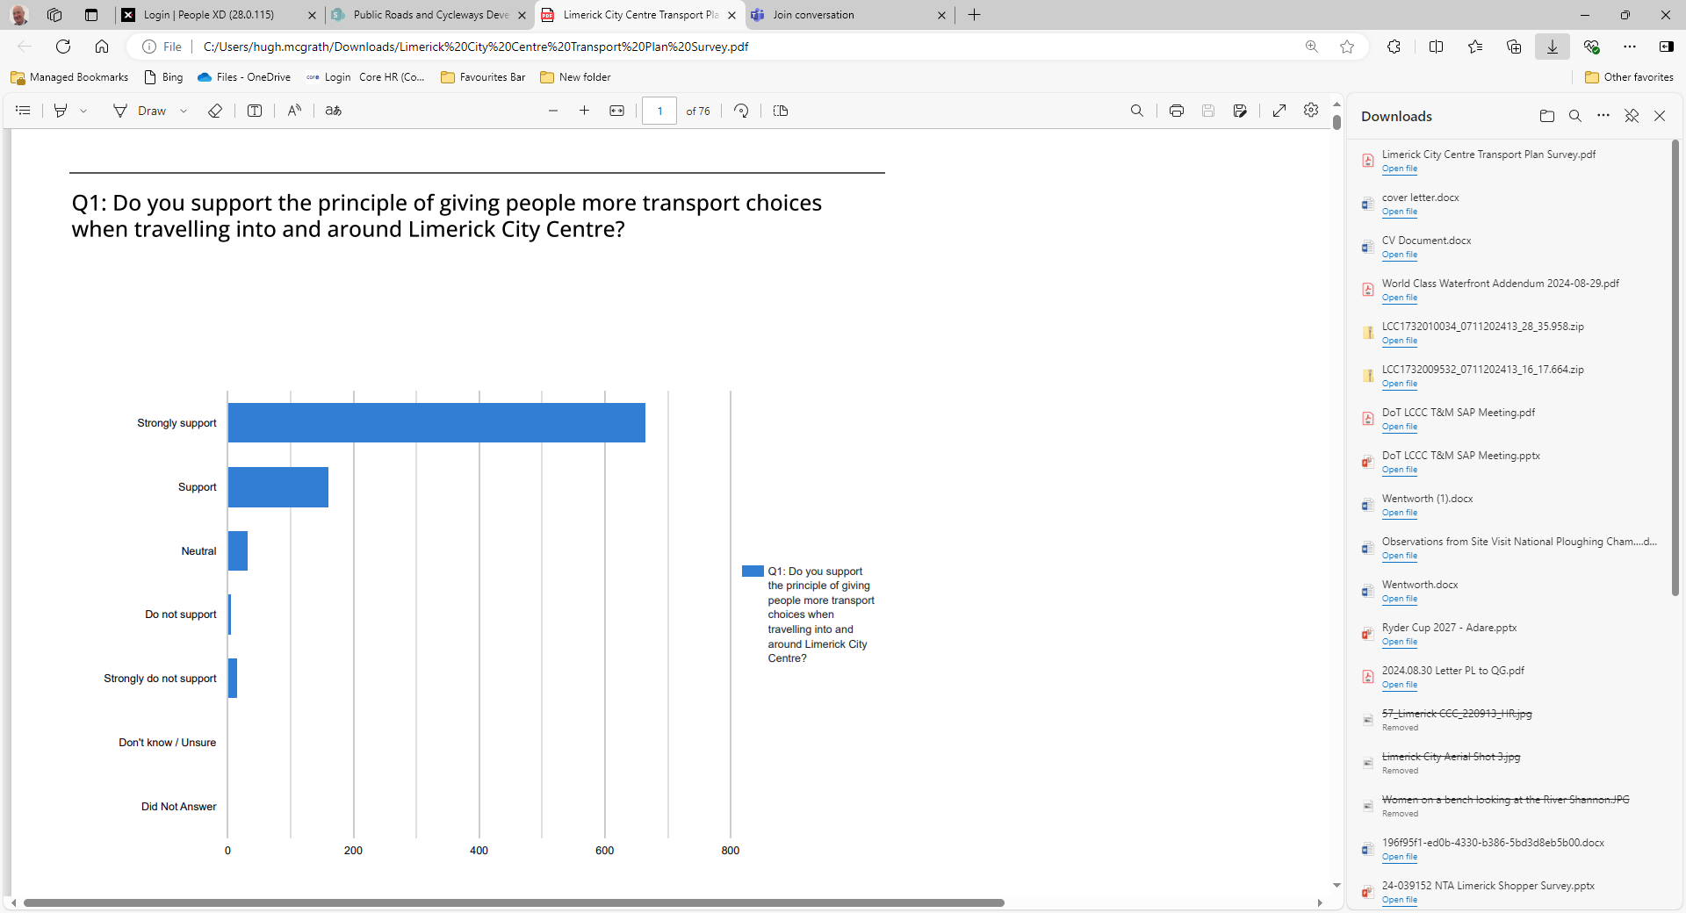

Slide 5
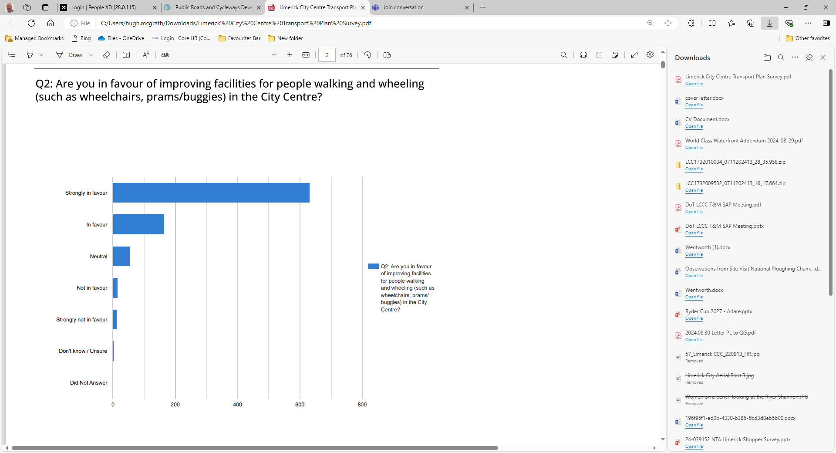

Slide 6
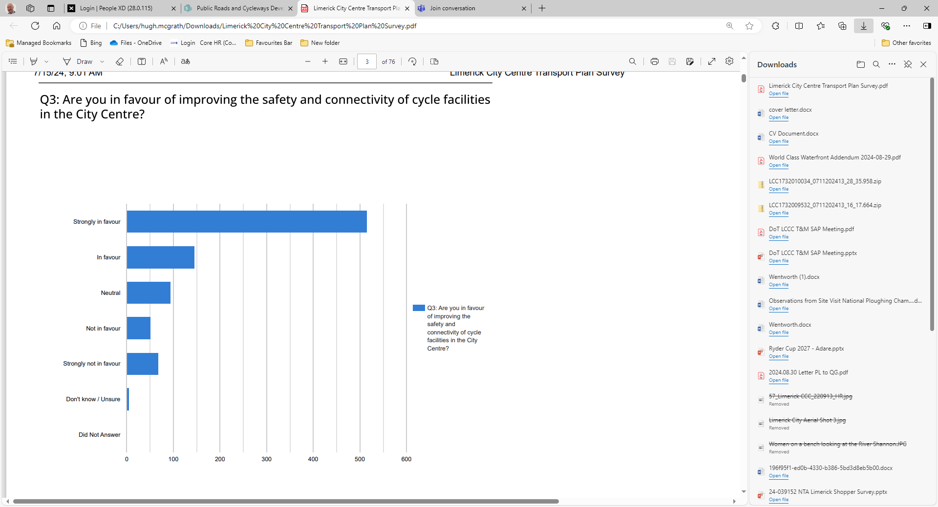

Slide 7
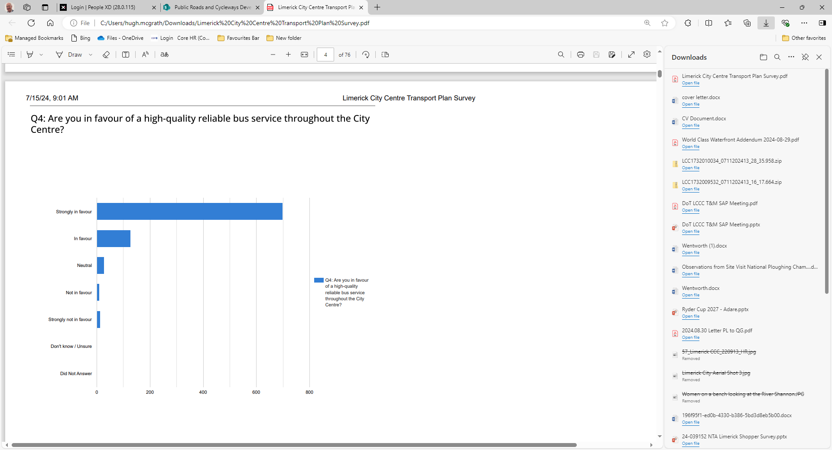
Strongly in favour\ in favour
825 (94%)
Strongly not in favour &
Not in favour
25 (3%)

Slide 8
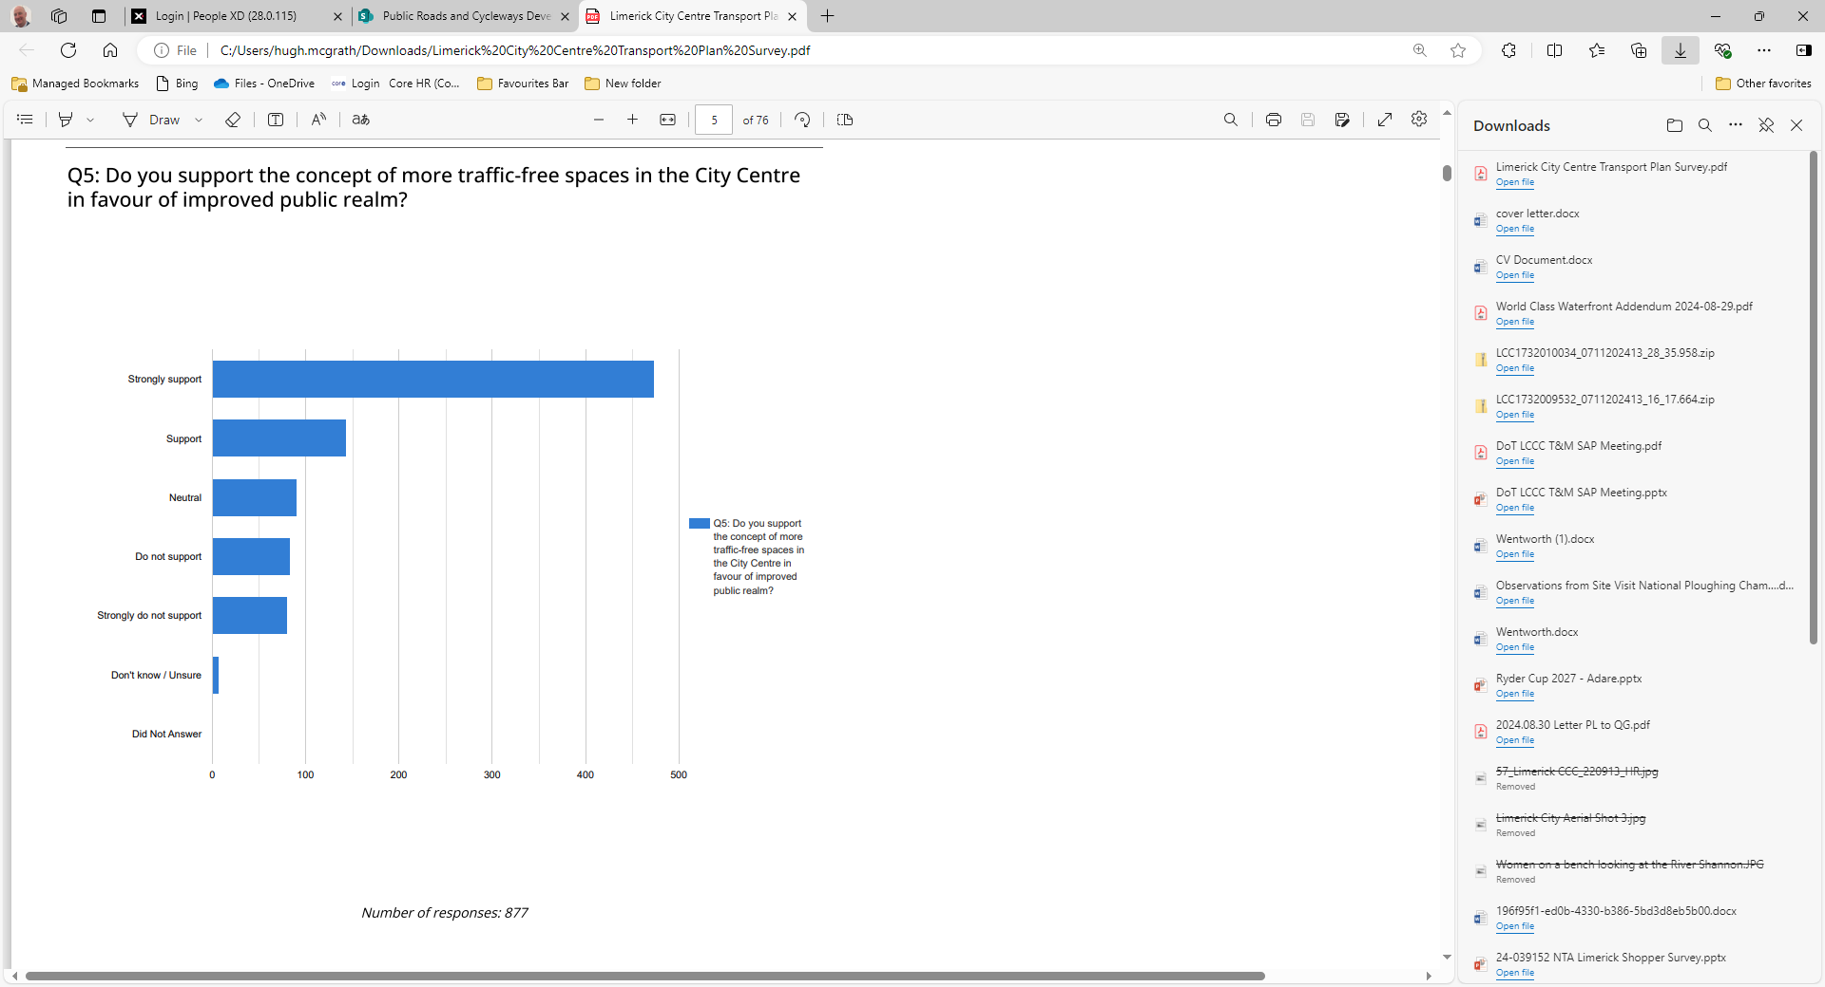

Slide 9
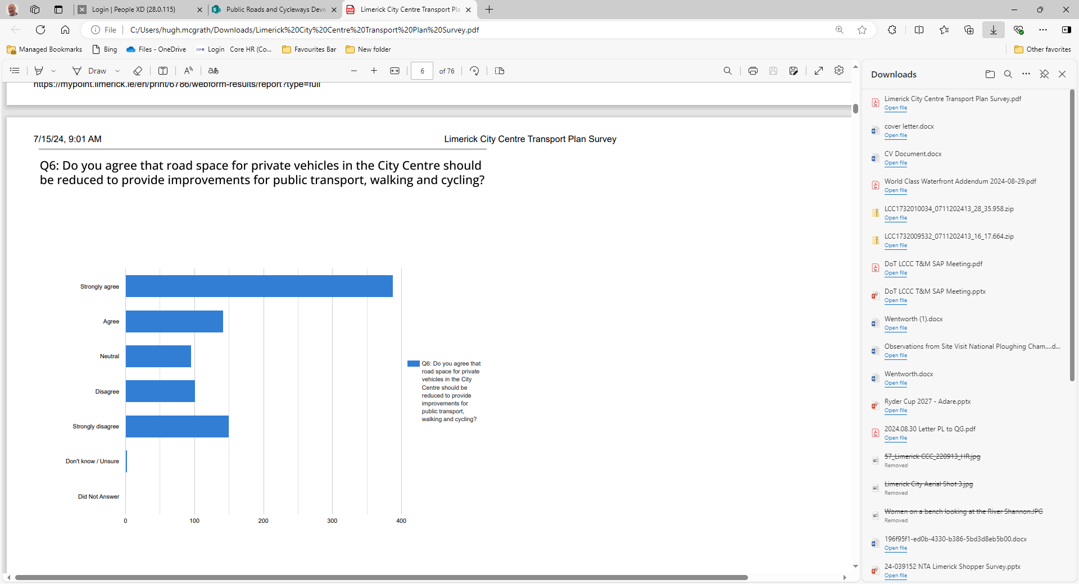
Strongly Agree\Agree
525 (60%)
Neutral \ Unsure
95 (11%)
Strongly Disagree\Disagree
250 (28%)

Slide 10
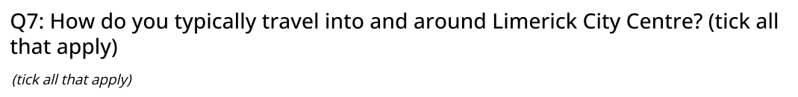
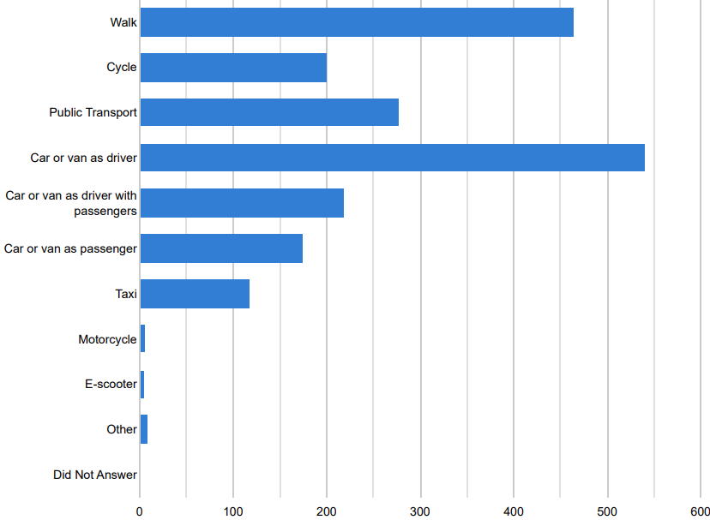

Slide 11
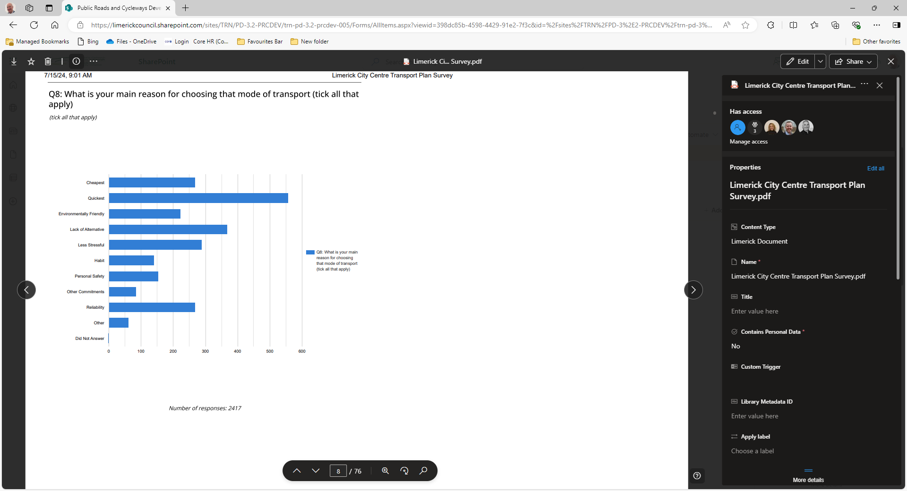

Slide 12
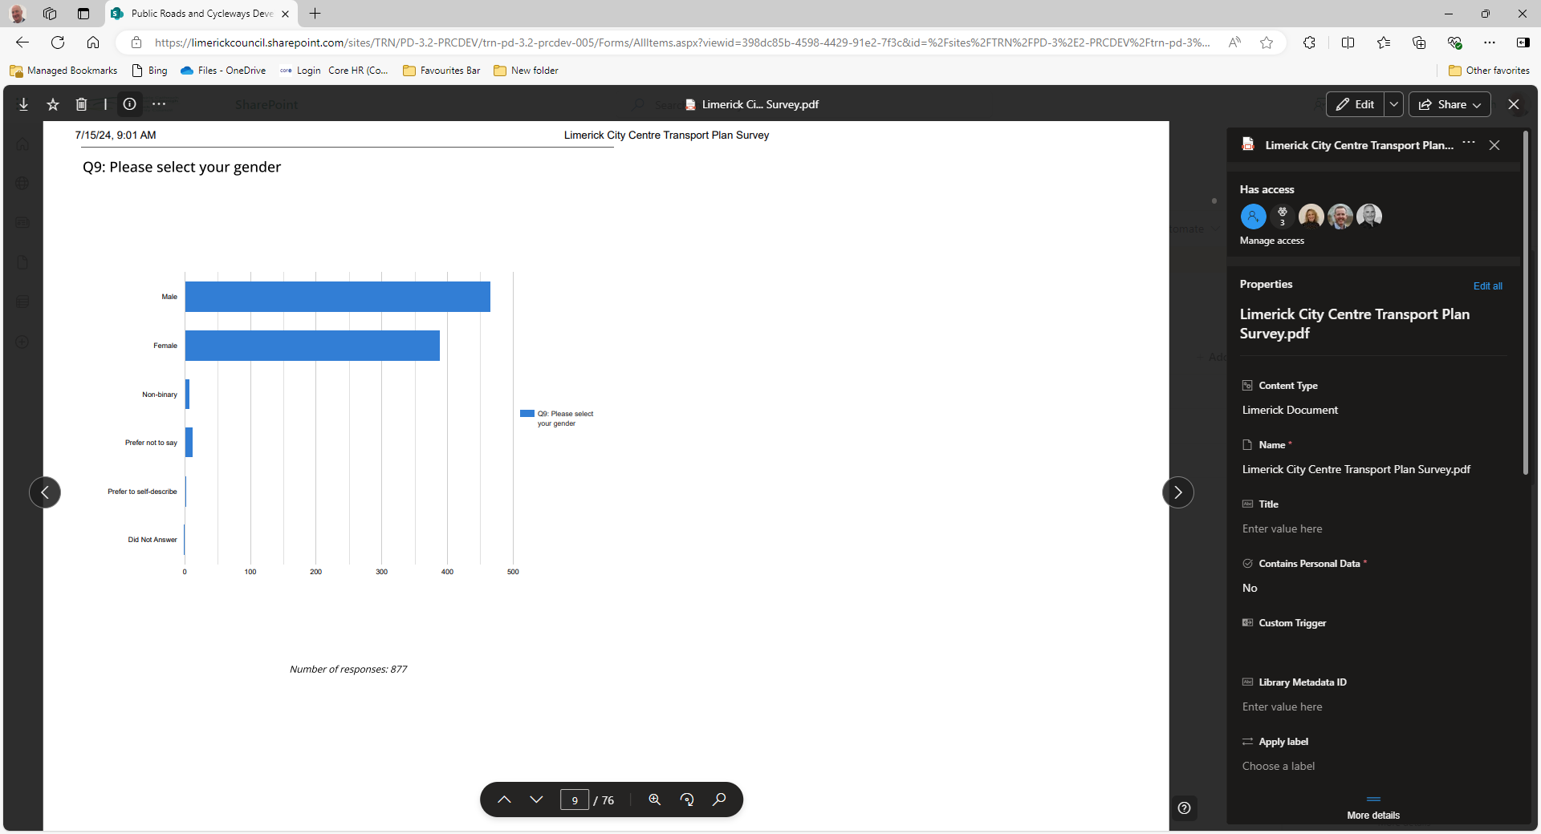

Slide 13
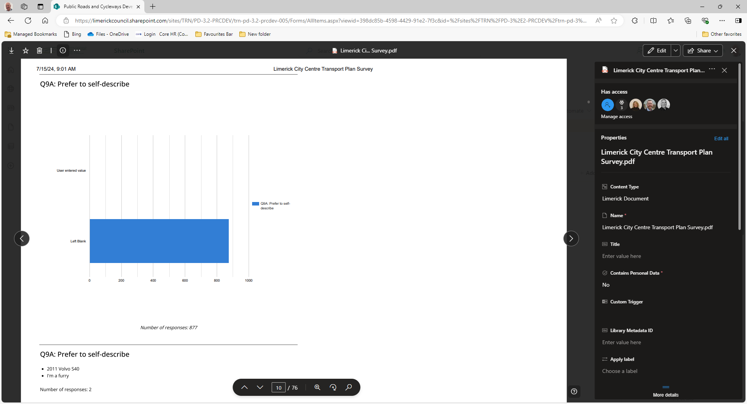

Slide 14
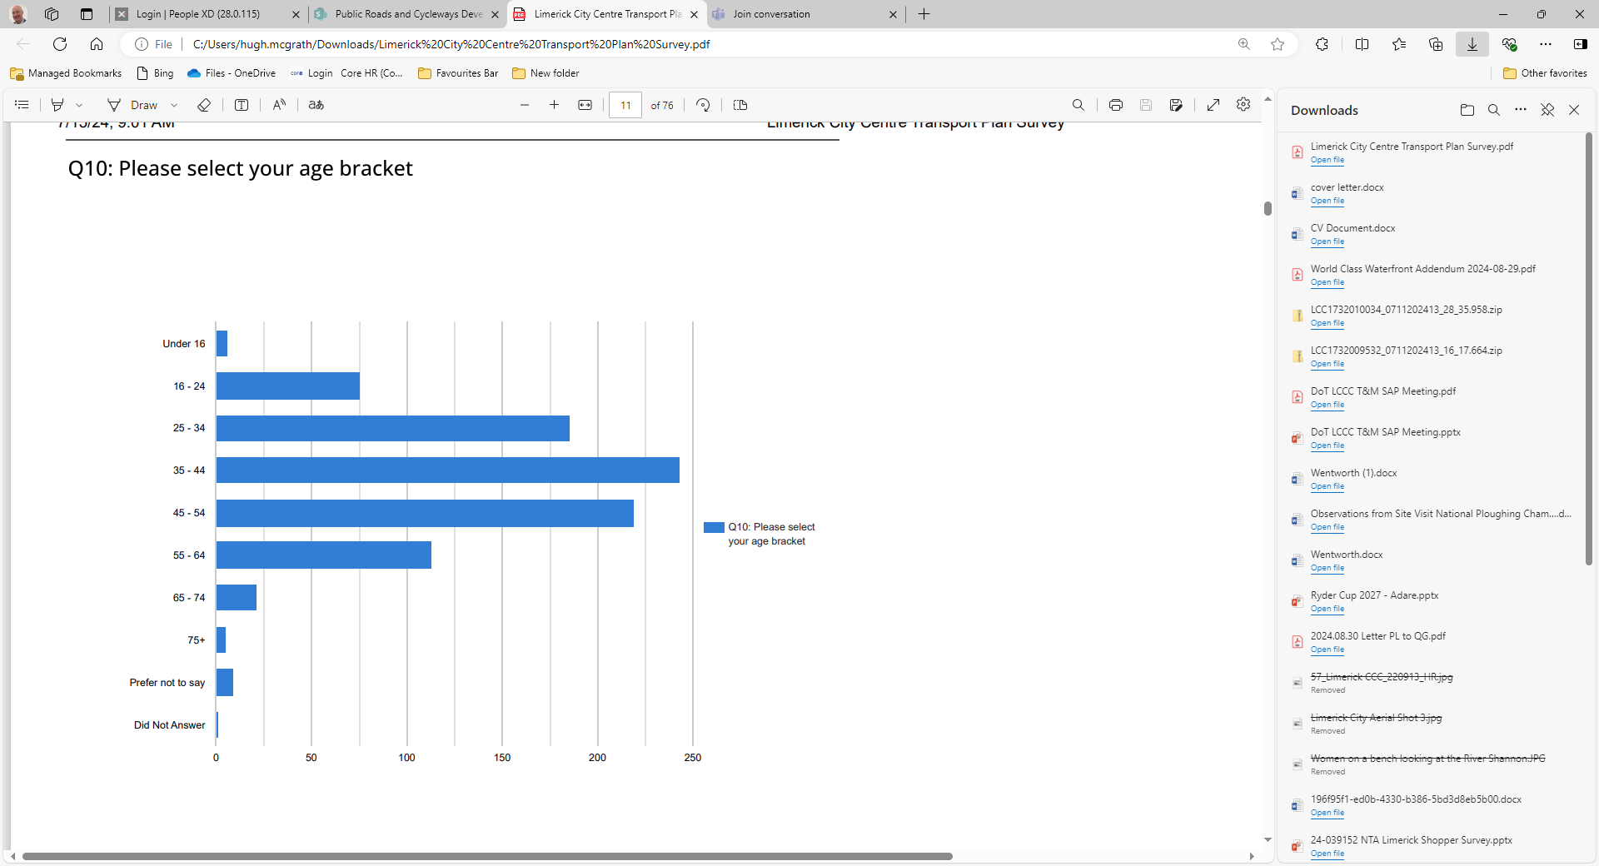

Slide 15
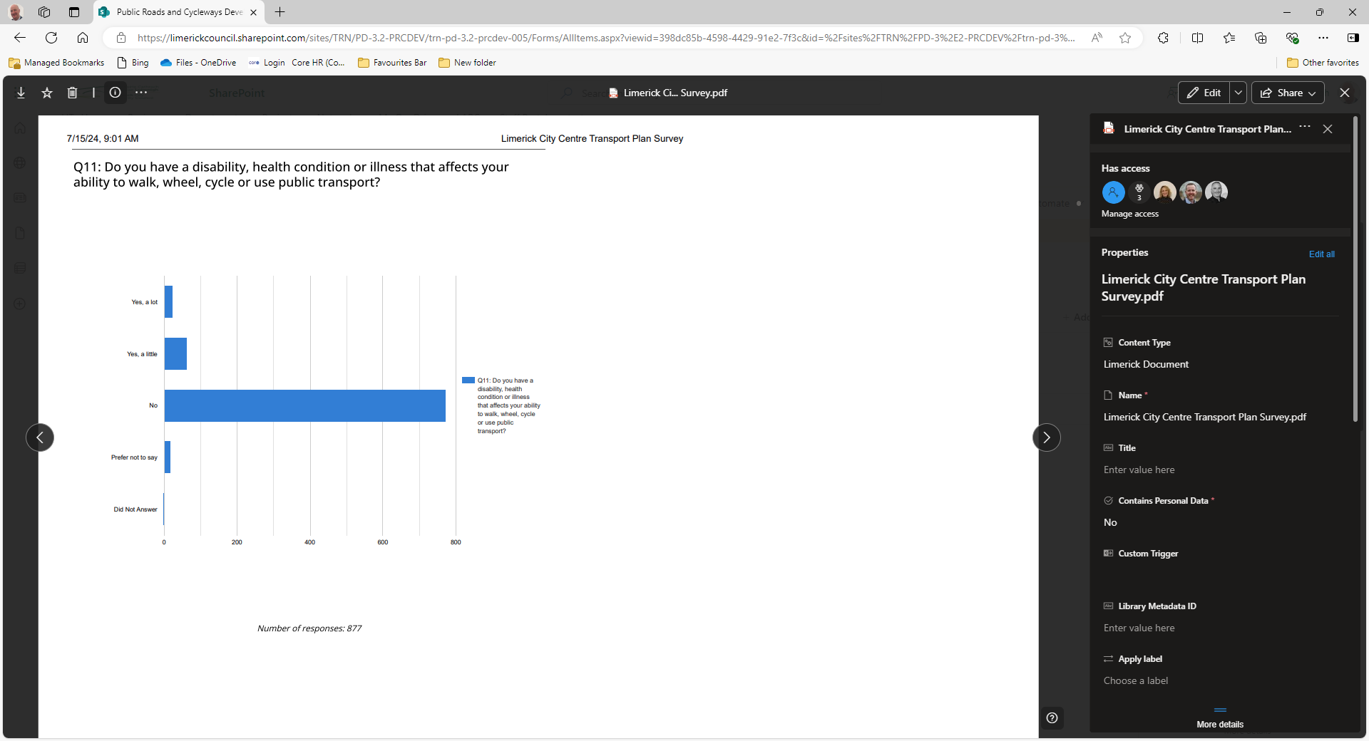

Slide 16
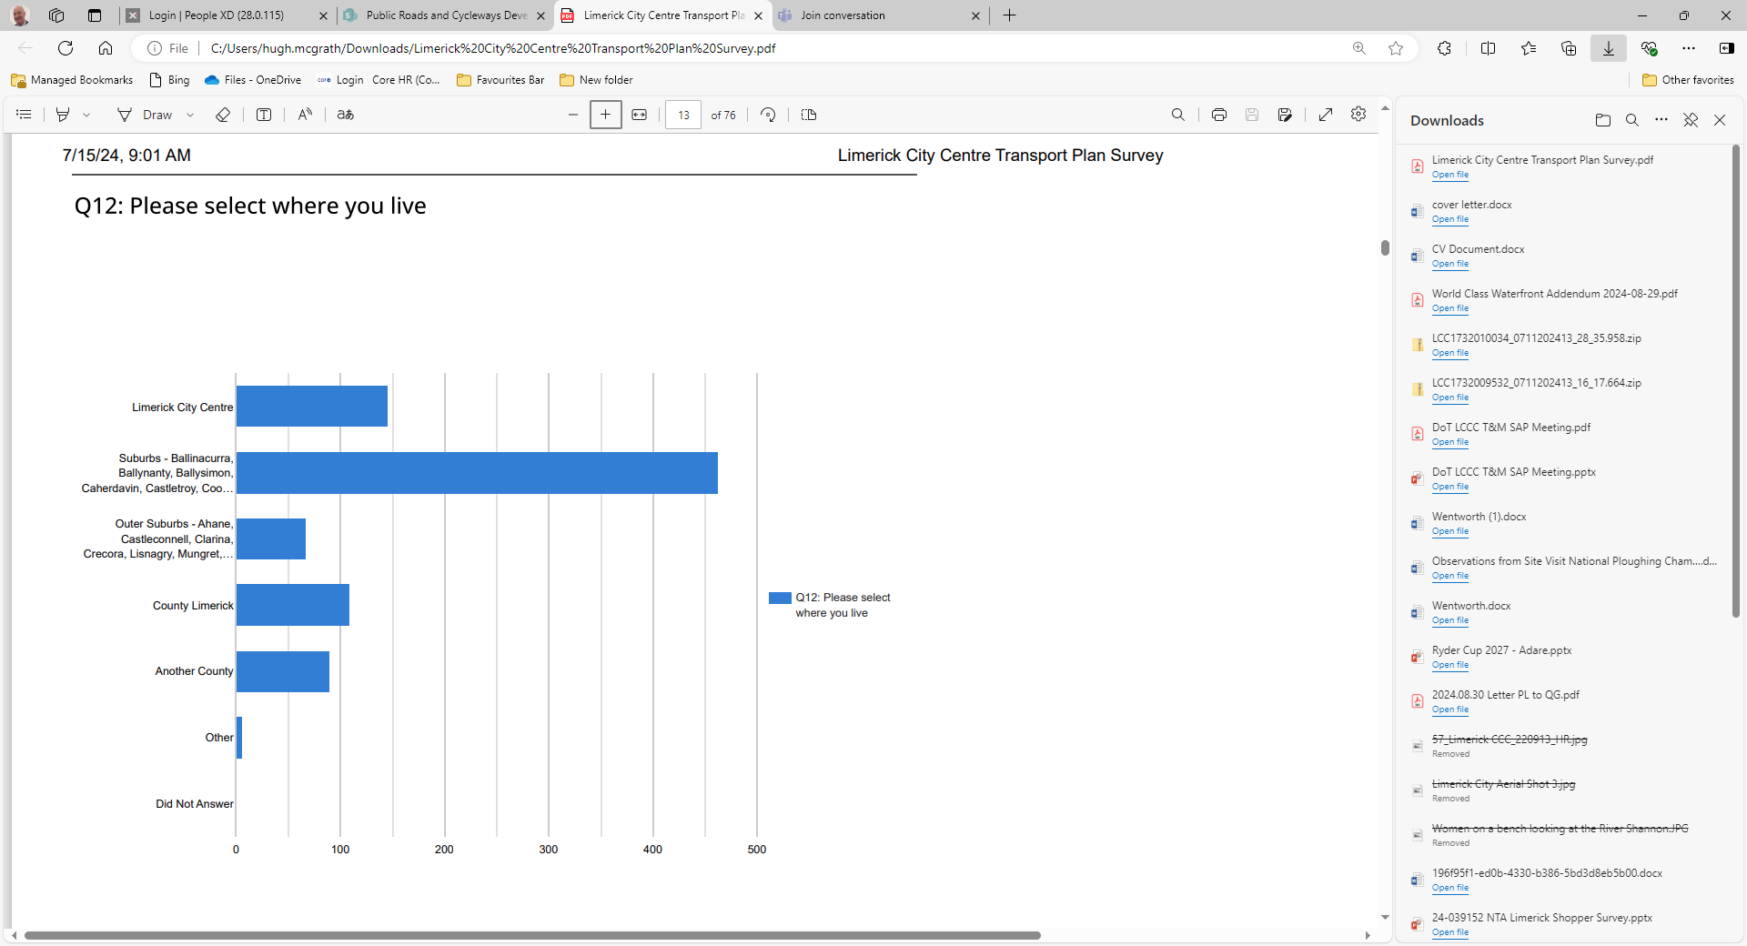

Slide 17
Limerick City Transport Plan -2024
Facilitate the Implementation of Bus Connects with appropriate priority
Examine Parking Demand, Loading & Private Coach movements.
Pre Draft Survey July-2024 (877 submissions)
Consider all modes of transport & needs for road space

Slide 18
Success of Improved Bus Services More Journeys & improved times
In 2023, Bus Éireann passenger journeys in Limerick rose to 4.6 million.(12,600 per day)
This rose by 600,000 on 2022 a 15% increase year on year.
In 2024 journeys are up another 5 to 6% (Over 13,200 journeys per day)
In August Bus Eireann introduced a 24 hour service on the 343 route to Shannon with 20min frequency at peak times & 30min off peak.
Bus Éireann report that since the introduction of the Bus Lane on O’Connell Street in 2022 journey times through the City Centre have reduced from 9mins to 3mins at peak times initially.
They are now reporting 15 to 20min savings at peak times & even more if streets are very congested.

Slide 19
Increase PT
from 4% to 12%
Bus Trips up by 15% in 2023 over 2022
LSMATS
Mode Share
Targets
2016
to
2040
Increase Cycling from 3% to 14%
Increase Walking
From 23% to 33%
Decrease Car trips
From 70% to 41%

Slide 20
Thank You

