Slide 1
Environment Strategy
Cathal Brodie, Senior Executive Scientist
Environment Strategy.
Environment and Climate Action

Slide 2
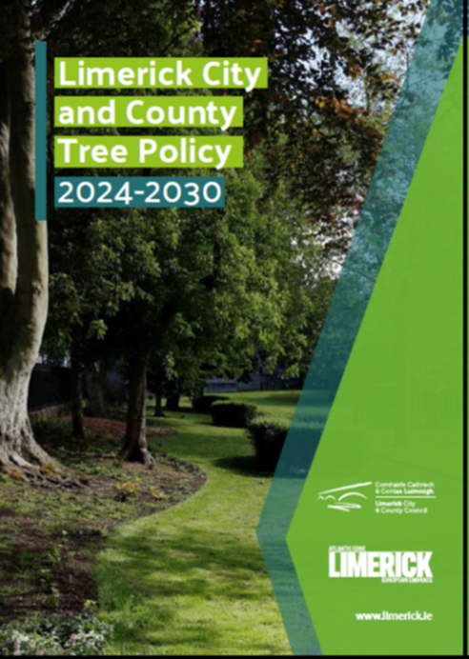
Management Team 27th July 2021
Senior Forum in 2021
Climate Action, Biodiversity & Environment SPC Feb 2024
MyPoint since mid-February 2024.
Climate Action, Biodiversity & Environment SPC April 2024
Senior Forum April 2024
MDs in May 2024

Slide 3

Why do LCCC need a Tree Policy?
LCCC is responsible for the planting, maintenance and management of a large number of trees.
This document will provide a framework to inform and support decisions made by LCCC
Document will act as a point of reference for the public , Councillors, Council staff and professionals interested …establish clearer, consistent and structured approach to issues affecting trees.
Limerick City and County Tree Policy
2024-2030

Slide 4
The policy relates to trees in the ownership, control and or management of the Local Authority.
The key objectives of this policy are to establish the current position with regard to Limerick’s public trees; to implement a proactive tree management programme; and to prepare and implement a public awareness and education programme on public trees. The policy also sets out, in broad terms, the resources necessary to achieve these policy objectives
Details obligations for trees owned by private landowners
Obligations under the Roads Act 1993
Occupiers Liability Act 1995
Wildlife Act 1976
Habitats Regulations 1997 -2005

Slide 5

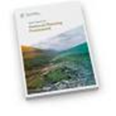
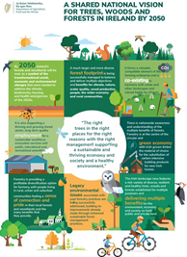
Policy context, International, National & Local
UN Sustainable Development Goals provide green space, manage and restore forests and address Climate change.
Project Ireland 2040- The National Planning Framework Incorporate Green space into development plans
A Shared National Vision for Trees, Woods and Forests in Ireland by 2050 “The right tree in the right place”

Slide 6
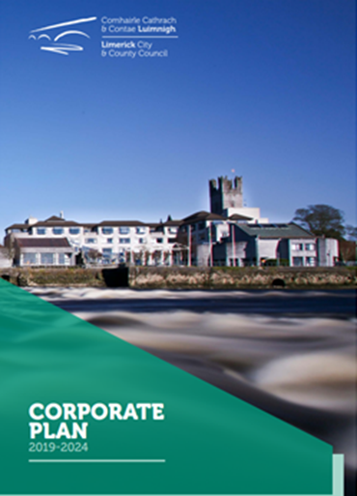
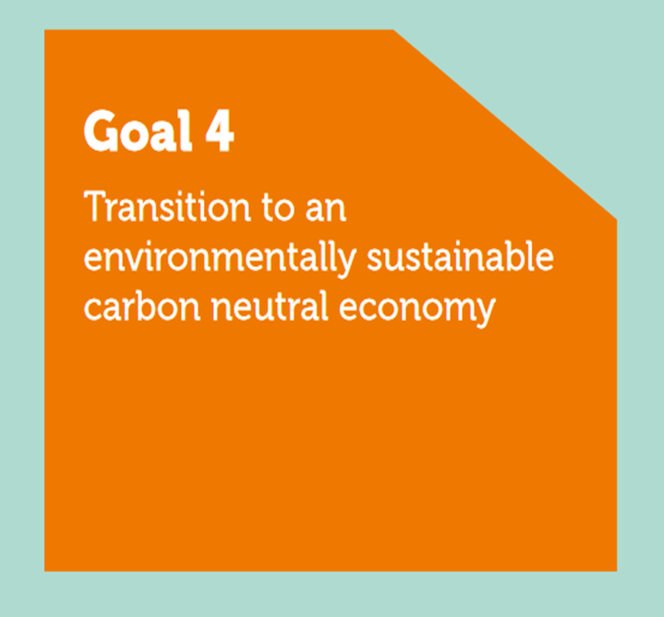
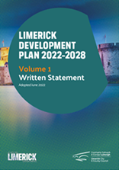
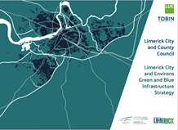
LCCC Corporate Plan 2019 -2024 Transition to an Environmentally Sustainable Carbon Neutral Economy.
Limerick Development Plan 2022-2028 “protect, enhance and connect areas of natural heritage, green infrastructure and open space for the benefits of quality of life, biodiversity, protected species and habitats, while having the potential to facilitate climate change adaptation and flood risk measures.”
Limerick City & Environs Green & Blue Infrastructure Strategy …..recognises the benefits which trees and woodlands provide to society in terms of environmental services; climate change; health and wellbeing; economic and the protection and enhancement of biodiversity

Slide 7
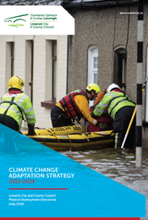
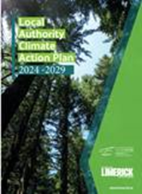
Limerick City and County Council Climate Change Adaptation Strategy 2019- 2024
recognising the ecosystems services which trees and woodlands to protect against the impacts of climate change.
Limerick City & County Council Climate Action Plan 2024- 2029
Highlights the importance of trees and woodlands in addressing the impact of climate change.

Slide 8
Main Elements of the Policy
Map all Local Authority owned & Managed trees.
Appoint a Tree Officer so that LCCC moves from reactive to proactive.
Expand tree stock
Proactive Tree maintenance programme
Increased awareness – Tree week
Planting and replacement of trees ……. 5 for 1.
Right tree in the right place
Policies on pruning and felling. Felling only as a last resort. Not for light, views, solar panels, satellites etc.
Policies on trees affected by development.

Slide 9
Cont’d
Protocols to be developed with service and utility providers.
Ash Dieback
Tree Valuation
Tree Preservation Orders
List of suitable tree species for street planting and general planting.

Slide 10
Budgetary implications.
Tree Officer Appointment…..LCCC is currently reviewing Parks requirements with a view of accommodating this position.
Replacement trees, 5 for 1, person requesting removal will cover cost.
Additional planting , developer funded in case of development.
Grants e.g. Heritage Council , Biodiversity, Climate Action etc.
Maintenance, current maintenance budget for parks.

Slide 11
The development of this Tree Management Policy signals a new commitment by Limerick City and County Council to looking after one of our most valuable natural resources. It represents a significant change in how we manage trees with the development of a more strategic, proactive, planned approach to inspection, planting, maintenance and management. This will enable progress towards an improved service and a more effective and informed tree maintenance programme.

