Slide 1
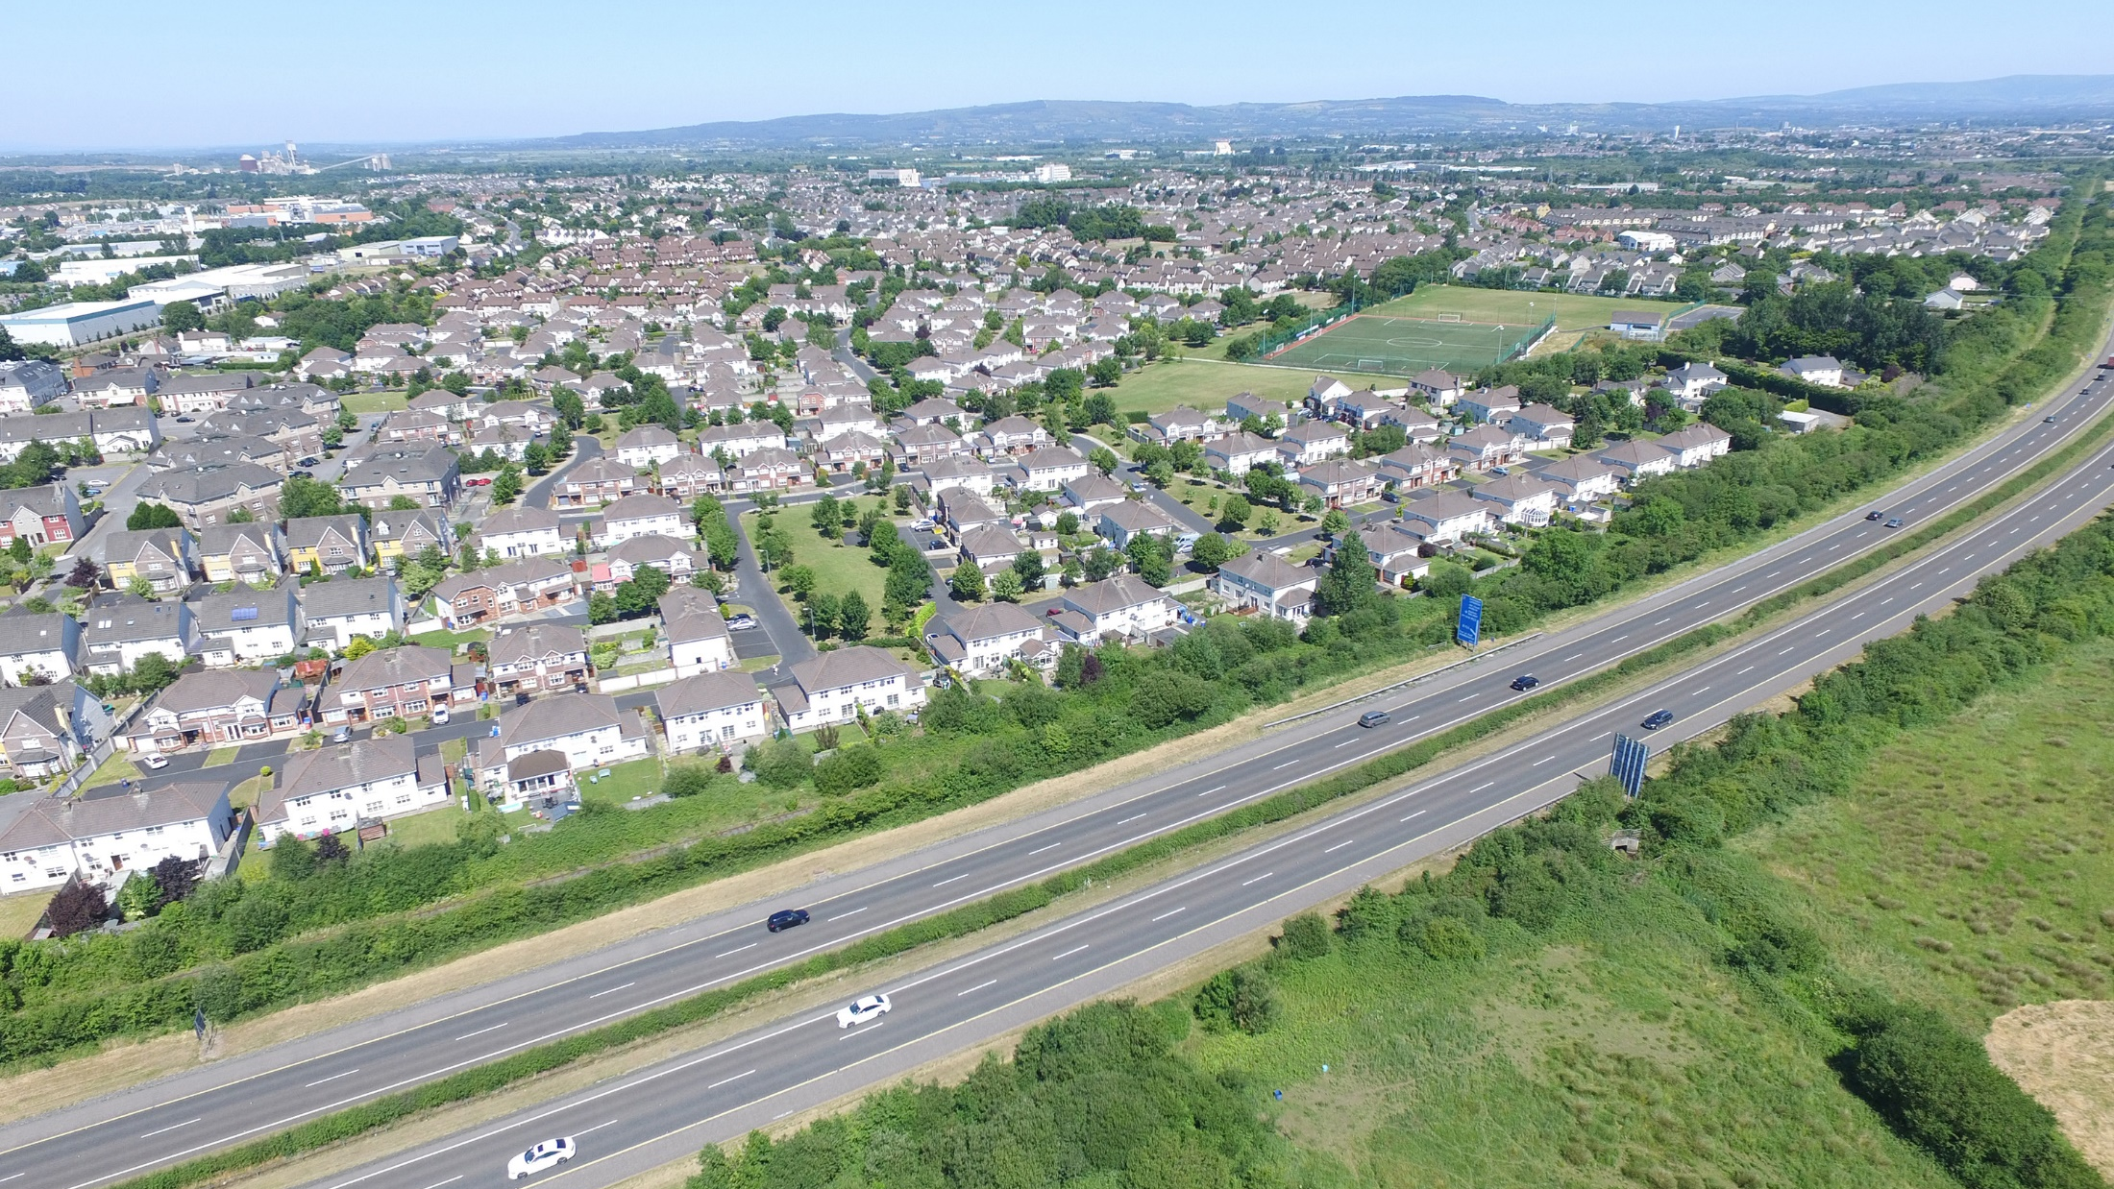

Draft County Limerick and Agglomeration
Noise Action Plans 2024-2028
20th February 2024
Climate Action, Biodiversity and Environment SPC
Simon Jennings
simon.jennings@limerick.ie
Environment and Climate Action

Slide 2
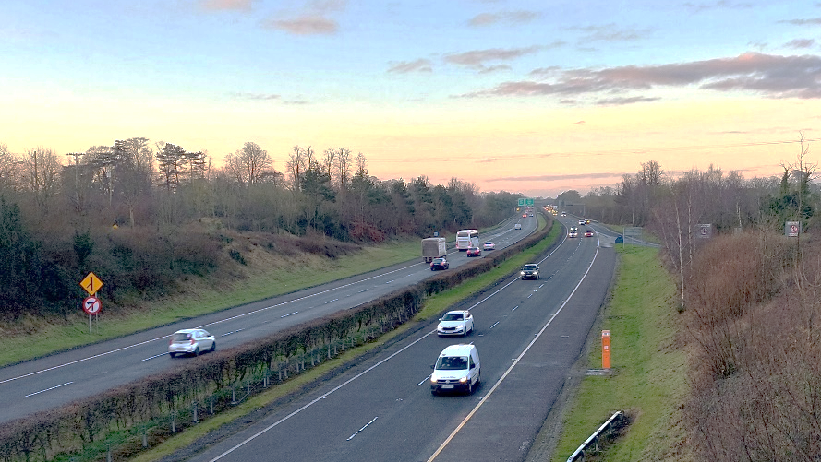
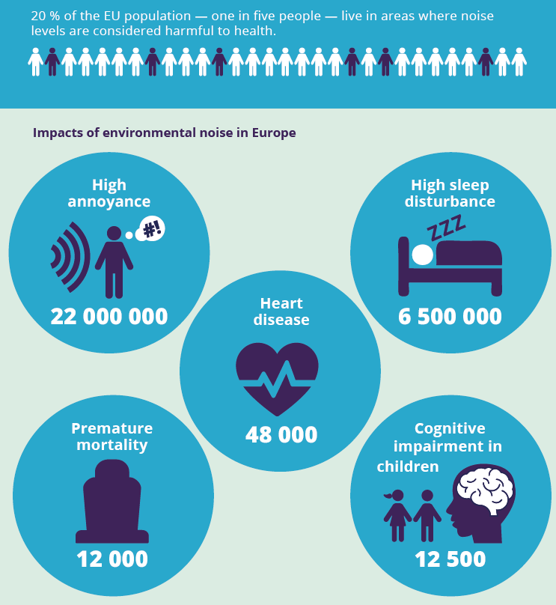
EU Action
Environmental Noise Directive
EEA Report - 2020
Notes:
Road transport is the most significant contributor to environmental noise pollution in the EU. EU policies are put in place to reduce exposure to and the harmful effects of noise pollution.
Overview of the issue
Health issues related to these exposures include annoyance, sleep disturbance, and cardiovascular and metabolic issues. It can also affect children’s ability to learn.
EU Action
Environmental Noise Directive (2002/49/EC)
Transposed into Environmental Noise Regulations (2006, revised 2018)
The Environmental Noise Directive provides the primary legislative framework for achieving noise reduction in Europe. The directive offers a common approach to avoiding and preventing exposure to environmental noise by reporting noise maps and action plans. This helps to reduce the harmful effects of noise and preserve quiet areas.
The Environmental Noise Directive aims to:
Produce strategic noise maps for all major roads, railways, airports and urban areas using harmonised noise indicators.
Determine how many people are exposed to specific transport noise sources inside and outside urban areas and at large industrial installations inside urban areas.
Adopt action plans based on noise mapping results to help prevent and reduce environmental noise, especially in areas where exposure levels affect human health.
Select and preserve ‘quiet’ areas to protect the European soundscape.

Slide 3
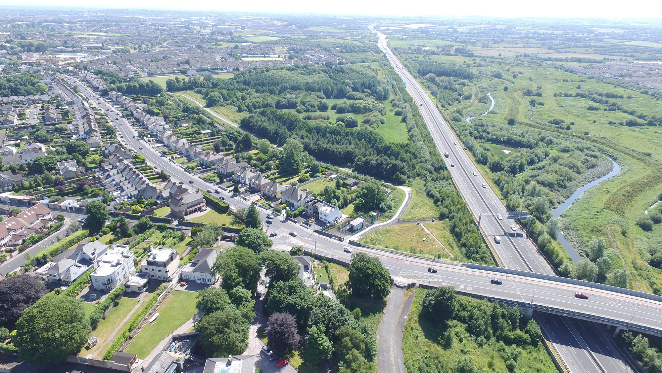
Environmental Noise Regulations, 2006 as amended
Local Authorities required to prepare strategic noise maps and noise action plans every 5 years (Round 4: 2024-2028).
Limerick – County Limerick and Limerick Agglomeration (LCCC and CCC).
Produce strategic noise maps for major roads (>3 million vehicles passages per year) in County Limerick and all roads, rail and industrial IPPC licensed sites selected by the EPA for the Limerick Agglomeration for Lden (>55 dB) and Lnight (>50 dB).
Notes:
Within each of those 5dB bands of noise estimate the number of people exposed
Maps produced in 5 dB bands.

Slide 4
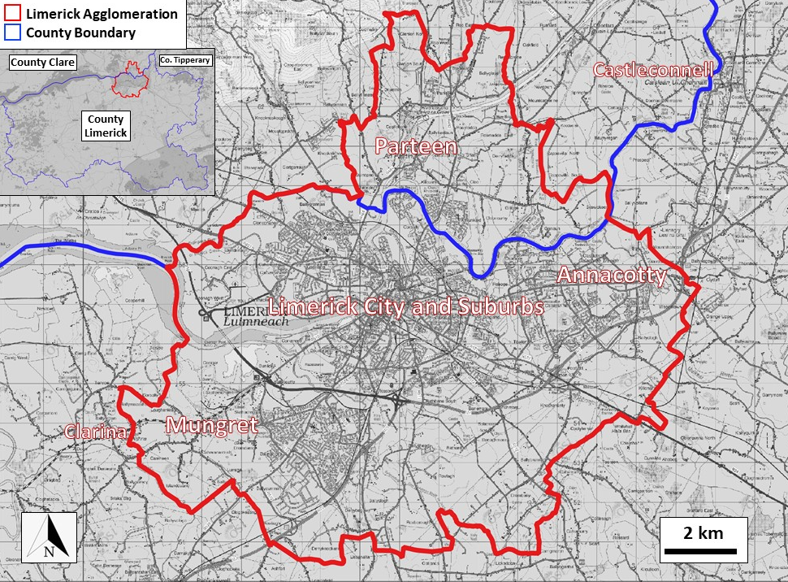
Environmental Noise Regulations, 2006 as amended
Local Authorities required to prepare strategic noise maps and noise action plans every 5 years (4 years for Round 4: 2024-2028).
Limerick – County Limerick and Limerick Agglomeration (LCCC and CCC).
Produce strategic noise maps for major roads (3 million/passages/yr) in County Limerick and all roads, rail and selected EPA industrial IPPC licensed sites for the Limerick Agglomeration.
Limerick Agglomeration
Notes:
Areas defined as the Agglomeration (the Electoral Divisions and associated townlands) in the 2018 Regulations

Slide 5
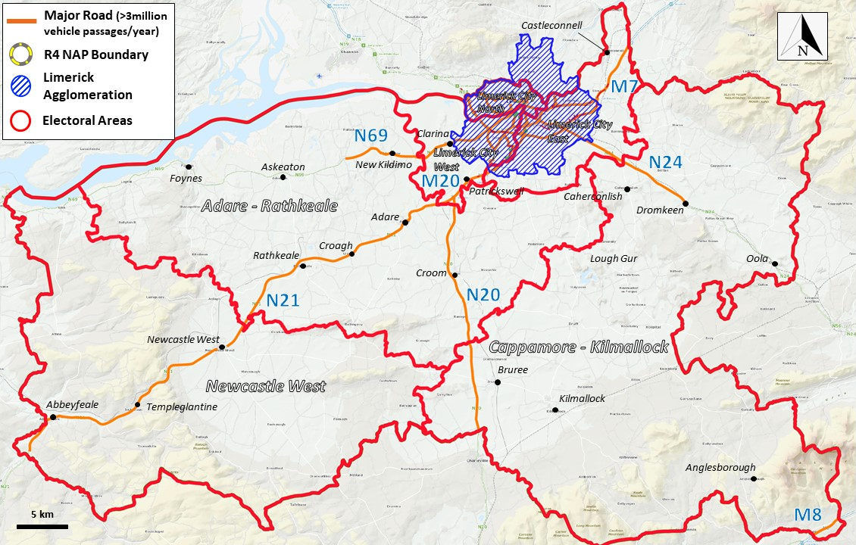
Environmental Noise Regulations, 2006 as amended
Local Authorities required to prepare strategic noise maps and noise action plans every 5 years (4 years for Round 4: 2024-2028).
Limerick – County Limerick and Limerick Agglomeration (LCCC and CCC).
Produce strategic noise maps for major roads (3 million/passages/yr) in County Limerick and all roads, rail and selected EPA industrial IPPC licensed sites for the Limerick Agglomeration.
Limerick Agglomeration
Notes:
Areas defined as the Agglomeration (the Electoral Divisions and associated townlands) in the 2018 Regulations

Slide 6
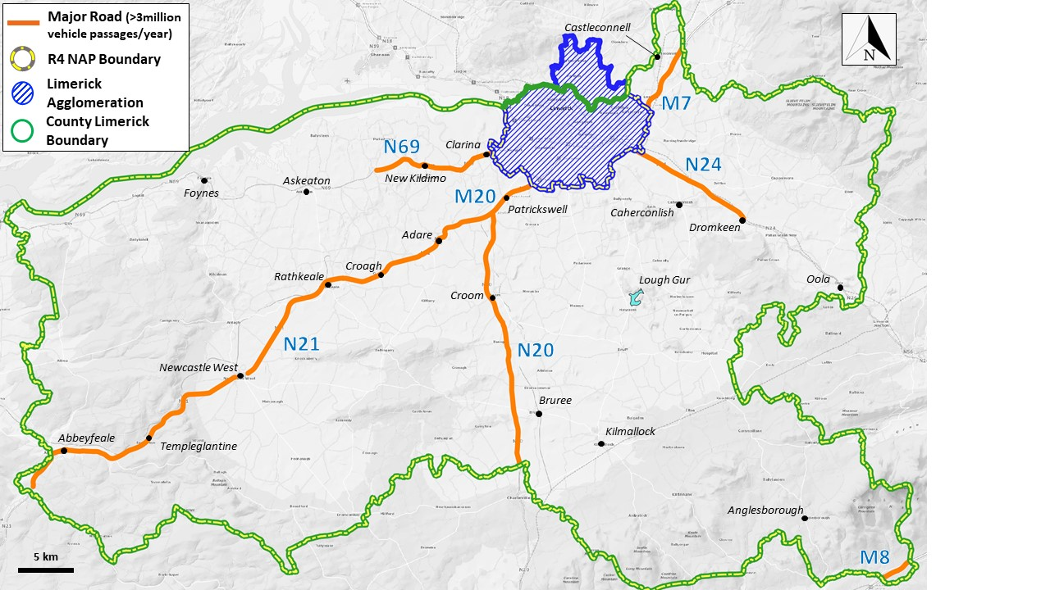
Environmental Noise Regulations, 2006 as amended
Local Authorities required to prepare strategic noise maps and noise action plans every 5 years (4 years for Round 4: 2024-2028).
Limerick – County Limerick and Limerick Agglomeration (LCCC and CCC).
Produce strategic noise maps for major roads (3 million/passages/yr) in County Limerick and all roads, rail and selected EPA industrial IPPC licensed sites for the Limerick Agglomeration.
County Limerick (outside the Limerick Agglomeration)

Slide 7
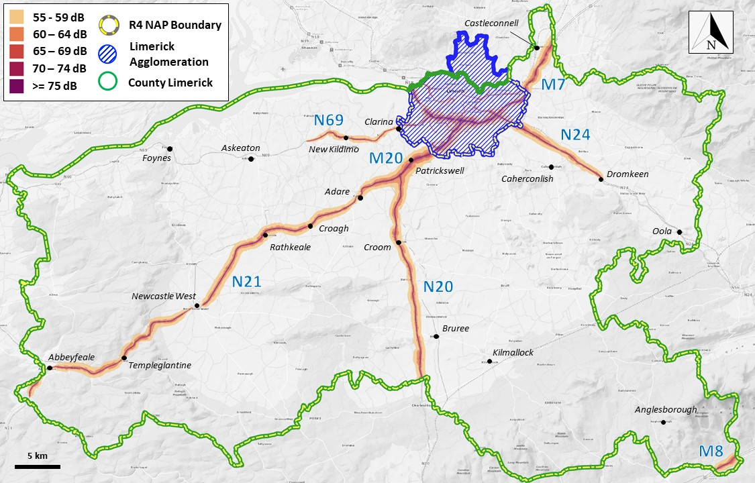
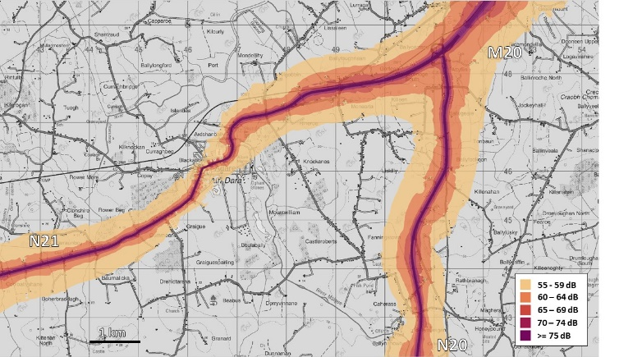
Lden – Major Roads
Environmental Noise Regulations, 2006 as amended
Environmental Noise Regulations, 2006 as amended
Environmental Noise Regulations, 2006 as amended
Environmental Noise Regulations, 2006 as amended
Local Authorities required to prepare strategic noise maps and noise action plans every 5 years (4 years for Round 4: 2024-2028).
Limerick – County Limerick and Limerick Agglomeration (LCCC and CCC).
Produce strategic noise maps for major roads (3 million/passages/yr) in County Limerick and all roads, rail and selected EPA industrial IPPC licensed sites for the Limerick Agglomeration.
Notes:
Noise indicators to be mapped Lden and Lnight – long-term indicators.
What is Lden?
TII are the noise mapping body for the Major roads outside the Agglomerations
TII mapping only available towards end of last year
Preparation based on EPA guidance
For calendar year 2021

Slide 8
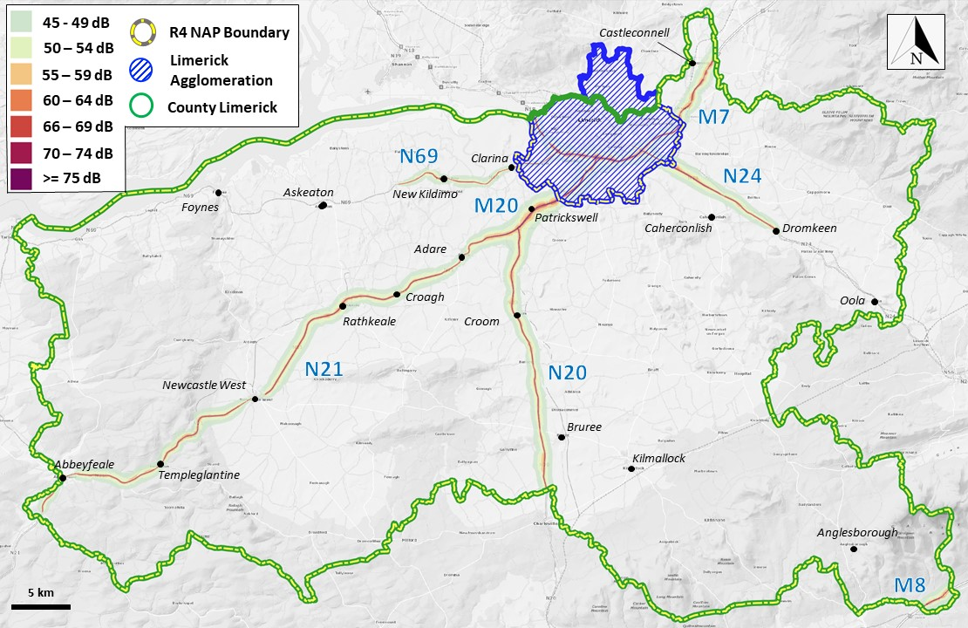
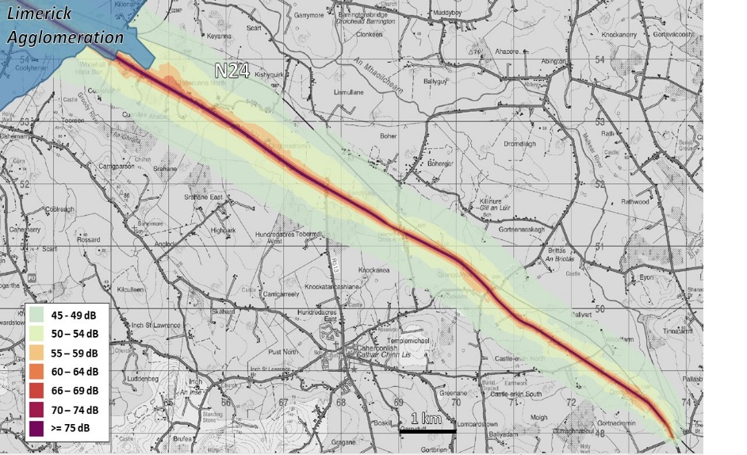
Environmental Noise Regulations, 2006 as amended
Environmental Noise Regulations, 2006 as amended
Local Authorities required to prepare strategic noise maps and noise action plans every 5 years (4 years for Round 4: 2024-2028).
Limerick – County Limerick and Limerick Agglomeration (LCCC and CCC).
Produce strategic noise maps for major roads (3 million/passages/yr) in County Limerick and all roads, rail and selected EPA industrial IPPC licensed sites for the Limerick Agglomeration.
https://www.limerick.ie/council/services/environment/environmental-control/strategic-noise-mapping-and-noise-action-plans
and
https://gis.epa.ie/EPAMaps/
Notes:
And this is Lnight, the night-time indicator, There are also links here for access to the mapping online at the Council’s website and the EPA’s website.

Slide 9
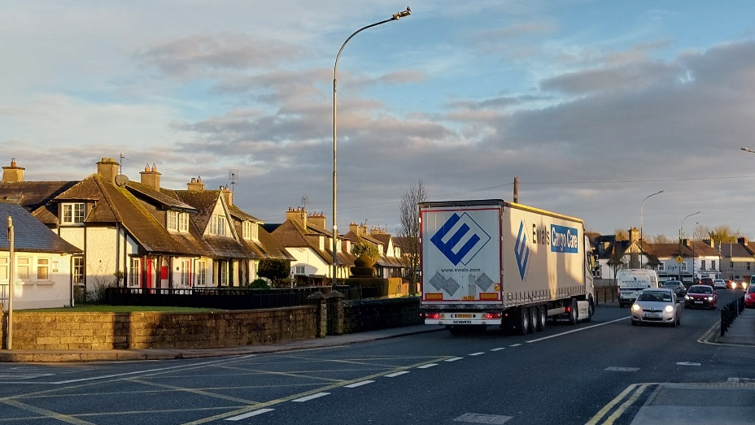
Environmental Noise Regulations, 2006 as amended
Noise Action Plans
Limerick Agglomeration (LCCC and CCC) and County Limerick.
Assessment of the population exposed and harmful effects based on the strategic noise mapping.
Reduce - Identify areas for noise mitigation based on noise mapping and the harmful effects assessment to reduce environmental noise where exposure levels affect human health.
Prevent – Avoid additional members of the population being exposed to the harmful effects of noise.
Protect - Identify potential Candidate Quiet Areas for an application for designation.
Notes:
Within each of those 5dB bands of noise estimate the number of people exposed
EPA guidance
Avoid – aligns with NPO65 in the NDP. Building lines under Transportation Objective in LDP. Separation distance provided unless

Slide 10
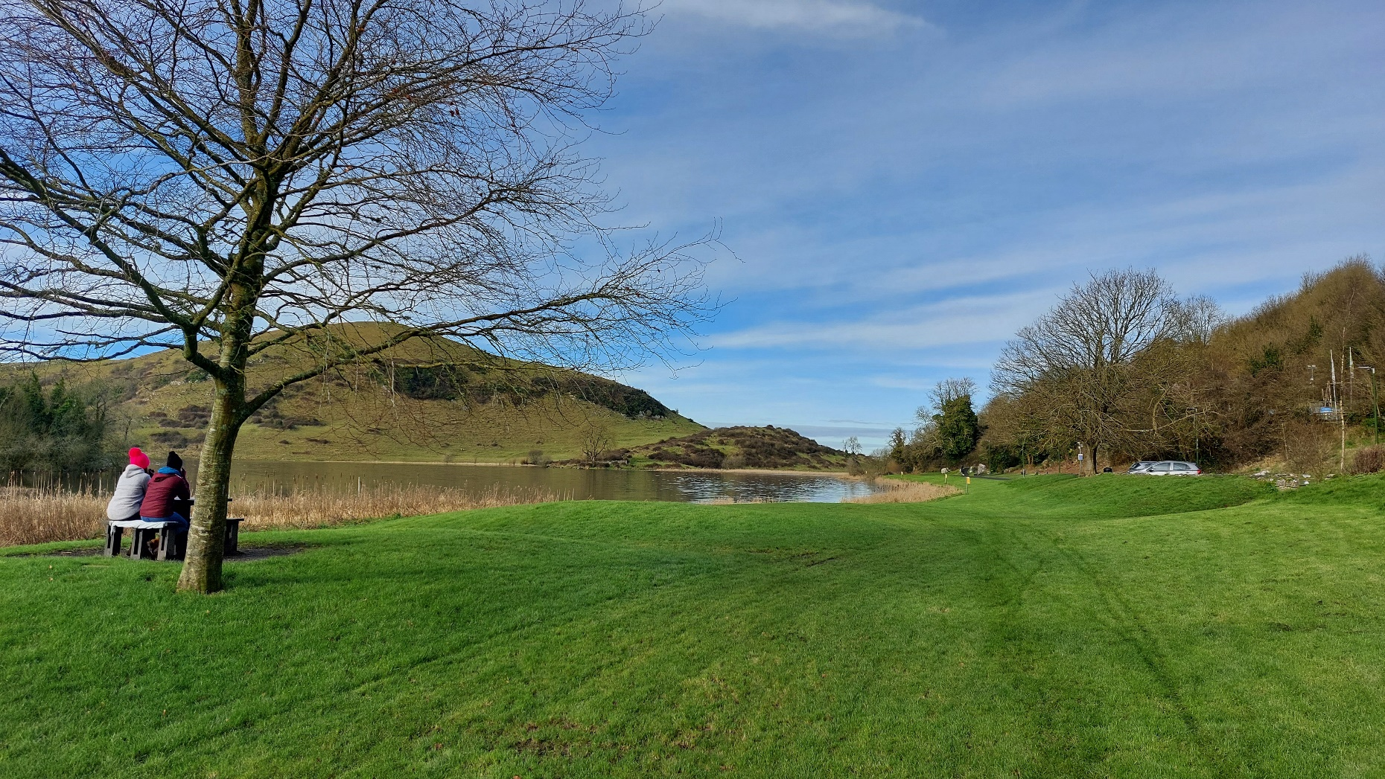
Timetable
Quarter 1 (end March) 2024: Public consultation (6 weeks) on Draft Noise Action Plans (Agglomeration and County)
18th July 2024: Final Noise Action Plans to be submitted to the EPA (Agglomeration and County)
18th January 2025: Summary Noise Action Plans to be reported to the European Commission by the EPA for Round 4.
Notes:
An agglomeration an urban area with greater than 100,000 inhabitants
Preparation based on EPA guidance
For calendar year 2021

Slide 11
Thank you
Notes:
An agglomeration an urban area with greater than 100,000 inhabitants
Preparation based on EPA guidance
For calendar year 2021

