Slide 1

Limerick City and County Council Lees Cross Junction Improvement

Slide 2
Background
Limerick City and County Council (LCCC) are developing the existing preliminary design for Lees Cross Junction Improvement scheme through Part 8 planning.
Lees Cross is a five-arm junction, located in Ballynashig, approximately 4.5km south of Ballingary, in Co. Limerick. The junction is on the border between the Newcastle West and Adare-Rathkeale Municipal Districts.
The main route through the junction is the R520 – R518 carriageway, connecting Newcastle West town with the N20 and Kilmallock town. This carriageway intersects with the R518 from the north-west, the L1210 from the north, and the L-1211 from the south.
Following on from a detailed application in 2022 the department provided €25,000 to progress the scheme through planning in 2023.

Slide 3
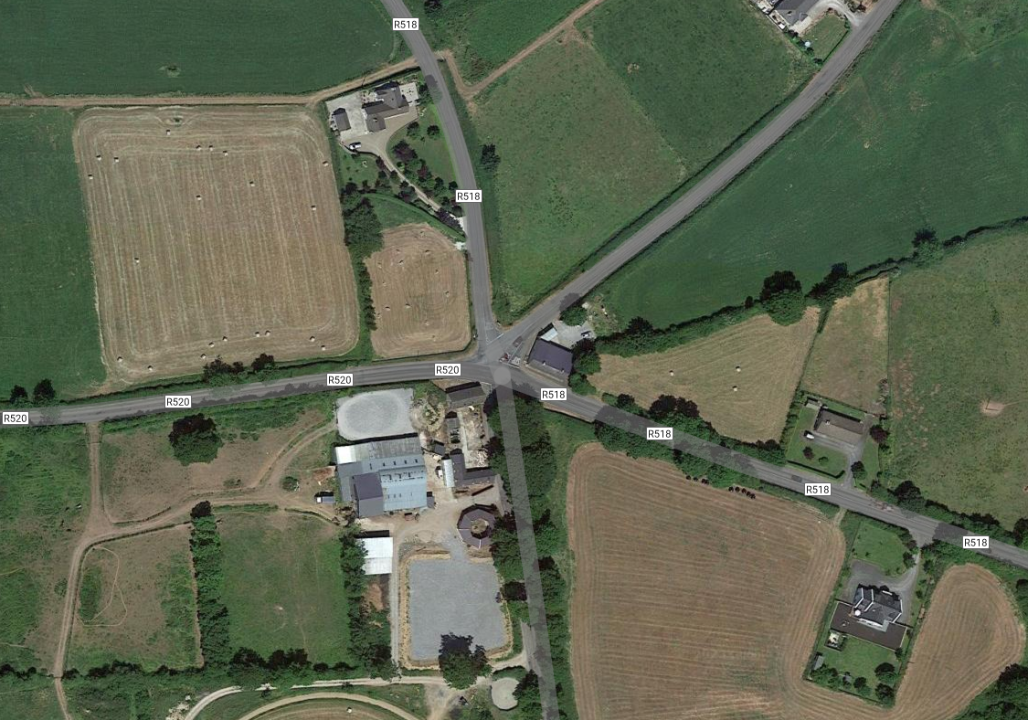
Background

Slide 4
Objectives
There are a number of issues identified with the current junction layout.
The sightlines onto the R518/R520 main carriageway from the R518 Ballingarry Road, the L-1210 Granagh Road and the L-1211 are insufficient.
The existing junction layout lacks definition, especially to the north, between the R518 Ballingarry Road and the L-1210 Granagh Road.
It is not clear to road users approaching the junction where the priority lies, particularly for those travelling south on the R518 where the road joins the L-1210 immediately prior to the R520-R518 junction.
The proposed design seeks to separate the existing five arm junction into two staggered T-junctions.
To formalise each arm of the junction, so that priority is clear, and to improve the sightlines at the junction in accordance with TII DN-GEO-03060 (Geometric Design of Junctions), in so far as is possible.

Slide 5
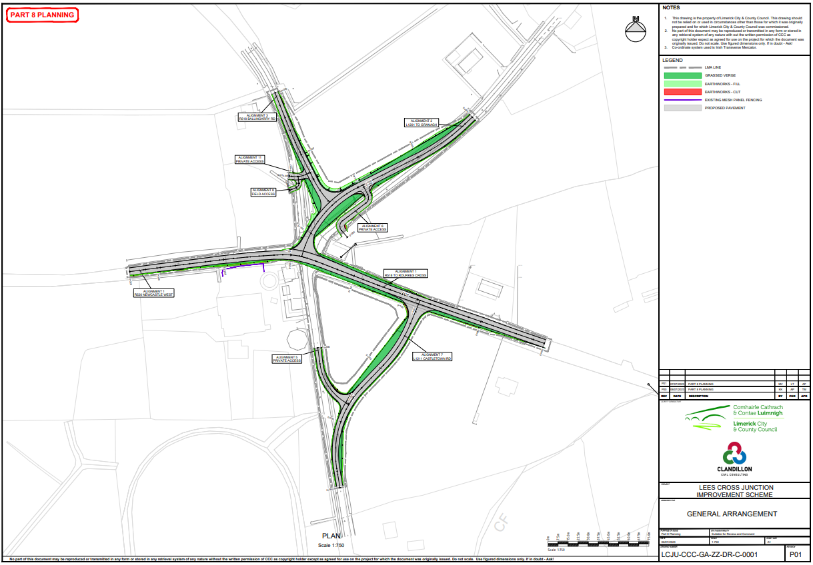
Proposed Design

Slide 6
Environmental Considerations
As Part of the planning process both Appropriate Assessment (AA) and Environmental Impact Assessment (EIA) screening reports were undertaken.
The AA Screening report concluded
“…it is the conclusion of this report that the proposed development will not have a significant effect on any European Designated Sites and progression to a stage II appropriate assessment is not required…”
The EIA screening report concluded
“…it is concluded that there is not a real likelihood of significant effects on the environment arising from the scheme and therefore the preparation of an Environmental Impact Assessment Report (EIAR) is not required…”

Slide 7
Part VIII Process
Plans and Particulars of the proposed development were available for inspection or purchase from Thursday 14th September 2023 up to and including Thursday 12th October 2023 at the following locations
Customer Services Desk, Limerick City & County Council,
Planning Development Department, Limerick City & County Council Offices,
Aras Sean Finn, New Line, Rathkeale, Co. Limerick,
Newcastle West Municipal District Office,
Plans and particulars of the proposed development were also available for inspection online at https://mypoint.limerick.ie
Submissions and observations in relation to the proposed development were to be made in writing to the Planning, Environment and Place Making Department, by email to planning@limerick.ie or online at https://mypoint.limerick.ie On or before 4pm on Thursday 26th October 2023

Slide 8
Submissions
Observation | Submission Synopsis | CE Response
Traffic using the road and speed | Concerns regarding the fact that they feel this road has become a relief road for Adare and traffic numbers exceeds the local access to private dwellings and agricultural activities it was designed for. As for the speed limit of 80 Kph, Cars exited off of R520 a will exceed that speed limit of 80kph. | While this concern is outside of the scope of the scheme the traffic counts carried out in July 2022 indicate an ADT(Average Daily Traffic) of 964 & HGV % of 7.68 in the direction of Granagh and ADT 1134 with HGV % of 8.29 on approach to the junction from Granagh. The figures would be deemed appropriate for the road given its central location within the county and the fact it links a National Road N-20 and Regional Road R-520. The R-520/L-1210 junction has been realigned and traffic exiting the R-520 will need to reduce speed significantly therefore reducing speed across the proposed R-518/L-1210 Junction also.
Lack of signage on L1210 | There are no speed limit signs on L1210 | While this concern is outside of the scope of the scheme the Municipal District Office will be notified of the concern raised and requested to install 80km/hr signs at Anhid Cross along with repeater signs where deemed necessary.
Concern of the new Ballingarry junction | Concerns regarding existing speed of cars traveling from the R518 to L1210 Also with the high volume of traffic using L1210 what impact will the new junction have on residents if the flow exiting the junction isnt suffice. often traffic will accumulate along the L1210 and as a resident on this road will it have impact on a Fire truck or emergency service accessing private residents on this road | The new design sets back the R-518/L-1210 Junction from the R-520/L-1210 Junction thereby removing the possibility of persons from Ballingarry crossing traffic immediately exiting the R-520. We do not foresee this Junction Improvement Scheme having any impact on the existing traffic numbers currently using this junction. The reduction from a 5 arm junction to a staggered junction, along with improved sightlines is aimed at improving the safety and defining movements for road users
Traffic using the road | Concerned with the current volume of traffic that travels on the L1210 local access road, that with the new proposed 'improvement' of the Lees Cross junction and with this large volume of traffic that there will be a lot of congestion and a lot of tailbacks on the road. | We do not foresee this Junction Improvement Scheme having any impact on the existing traffic numbers currently using this junction. The reduction from a 5 arm junction to a staggered junction, along with improved sightlines is aimed at improving the safety and defining movements for road users
Roads in the vicinity | The L1210 is not fit for purpose and the road needs to be properly and clearly lined and marked for road users from Anhid Cross junction to Lees Cross junction. | While this concern is outside of the scope of the scheme the Municipal District Office will be notified of the concerns raised in relation to the line marking along the L-1210.
Signage | Currently from Anhid Cross junction all the way to Lees Cross junction ( L1210 ) there is not one speed limit sign indicating to users the speed limit of this road. | While this concern is outside of the scope of the scheme the Municipal District Office will be notified of the concern raised and requested to install 80km/hr signs at Anhid Cross along with repeater signs where deemed necessary.

Slide 9
Submissions
 | Department of Housing, Local Government and Heritage | CE Response
1 | The Department accepts the conclusion of the Appropriate Assessment Screening Report that the development would not cause adverse impacts on the conservation objectives of any European Site
2 | Any tree or vegetation removal works that are required as part of this development should, where possible, be done outside of the bird nesting season. Bird nesting season is from March 1st until August 31st inclusive. | Any tree or vegetation removal works that area required as part of this development will be done outside of the bird nesting season.
3 | Where hedgerows/treelines are removed to facilitate this development, equivalent lengths (at a minimum) should be re-established along the new proposed route. | Where hedgerows/treelines are removed to facilitate this development, an equivalent length will be re-established along the new proposed route.
4 | Any planting, should consist of native hedging species such as hawthorn, holly, gelder rose, blackthorn, hazel. Additional information can be found at https://pollinators.ie. Limerick County Council is a signatory to the All-Ireland Pollinator Plan. | Native hedging species only will be used.
5 | If reseeding bare bank areas of the new route, a mixed native species of grasses and wildflowers should be used. Such seed can be sourced here http://www.wildflowers.ie/ | Any reseeding works will a mix of species of grasses and wildflowers.

Slide 10
Time Line
Plan to bring the scheme to the Full Council meeting in January 2023.
Should the scheme be passed the timeline of the scheme is as follows.
Limerick City and County Council have applied for SIG funding for 2024 in order to
appoint a consultant to develop the scheme through detail design, construction and handover.
appoint an agronomist to begin landowner negotiations.
depending on those negotiations purchase the necessary land.
Subject to above negotiations and appointments LCCC will be applying for funding for the construction of the scheme in 2025.
The above is subject to successful Landowner negotiations and funding being provided by the department.

Slide 11
Questions

