Slide 1
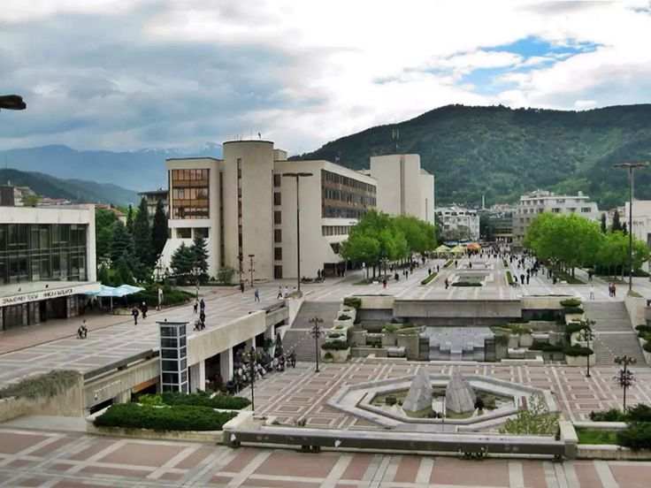

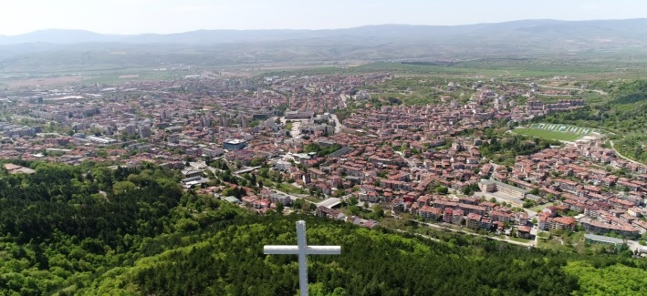
BLAGOEVGRAD
an excellent alternative for a successful business

Slide 2
The Advantages of Investing in Bulgaria - BUSINESS CLIMATE ASSESSMENT
Based on a national survey of more than 50 large companies, half of those polled believe the country's investment climate is good, and a third say it's excellent. Only 18% say the local business development environment is poor.
The biggest advantages for business development in Bulgaria are:
High quality workforce
Low cost of labor
Accessibility to European markets
Good tax regime
Strategic geographical location
Excellent internet coverage
Relatively low utility costs
Competitive real estate prices

Slide 3
Bulgaria and other Eastern European countries
According to a study of businesses that have had business operations in other Eastern European countries over the past five years, compared to Romania, Serbia, Northern Macedonia, Bosnia and Herzegovina, Montenegro and others, about 45% of respondents say that Bulgaria's business climate is better. Experience shows that the leading factors for this response are Bulgaria's membership in the EU, more developed infrastructure and lower levels of bureaucracy compared to other countries.

Slide 4




WHY CHOOSE BLAGOEVGRAD?
Vision of Blagoevgrad Municipality – Modern, Innovative, Connected and Green Municipality, ensuring a high standard of living for its citizens and good conditions for sustainable economic development
MODERN
INNOVATIVE
Municipality of Blagoevgrad
CONNECTED
GREEN

Slide 5
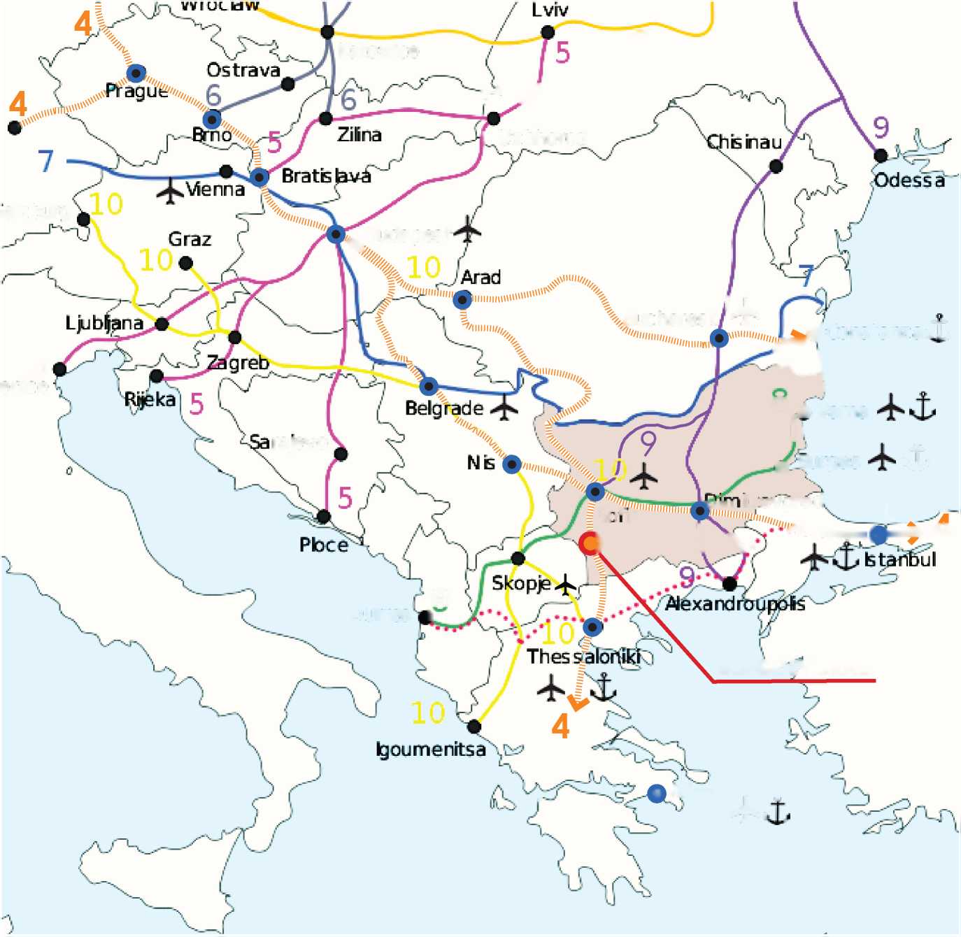
LOCATION AND LOGOSTIC ADVANTAGES of Blagoevgrad
Blagoevgrad region is the third largest in Bulgaria, occupying the southwestern part of the country AND of A great importance for the Balkans and Europe.
The location of the city is its biggest advantage.
Border location:
Northern Macedonia - 28 km
Greece - 83 km
Serbia - 143 km.
Distance to nearby major cities:
Sofia - 96 km
Skopje - 183 km
Thessaloniki - 199 km
Road arteries:
Struma Motorway, which connects Sofia with the Kulata border checkpoint. The highway is being built on the site of part of the existing national road I-1.

Slide 6
State of the local economy
Number of enterprises in the Municipality of Blagoevgrad 2014-2019
As of 2019, Blagoevgrad district forms 2.62% of the country's GDP - more than Kyustendil (0.93%) and Pernik (0.93%) and less than Sofia district (3.23%) - the other reference center in the South-West region of level 2. As of 2019, the GDP per person is BGN 10,329 and remains lower than the national average of BGN 17,170.
As of 2019, there are 6,469 non-financial enterprises operating in the municipality. In the period 2014-2019 there is a dynamics in the number of enterprises in the municipality of Blagoevgrad, as they are gradually increasing.
Production in the Municipality of Blagoevgrad 2014-2019 (thousand BGN)

Slide 7
Types of enterprises on the territory of Blagoevgrad Municipality
The number of non-financial enterprises for 2019 in the municipality of Blagoevgrad and their distribution by groups and employees is as follows:
The number of enterprises, according to economic activities and the number of employees in them by 2019 is as follows:
Type of enterprise | Number of enterprises | employees | Relative share of companies | Relative share of employees in them
Micro enterprise (0-9 employees) | 6 063 | 10 552 | 93,72% | 40,22%
Small business (10-49 employees) | 346 | 6 955 | 5,35% | 26,51%
Medium enterprise (50-249 employees) | 54 | 4 949 | 0,83% | 18,86%
Large enterprise (over 250 employees) | 6 | 3 780 | 0,09% | 14,41%
Economic activity | Number of enterprises | Percentage | Number of Employees | Percentage
Trade | 2124 | 32,83% | 5243 | 19,98%
Services | 1973 | 30,50% | 6398 | 24,39%
Transport | 1126 | 17,41% | 3659 | 13,95%
Industry | 442 | 6,83% | 4978 | 18,97%
Construction | 385 | 5,95% | 3655 | 13,93%
Others | 343 | 5,30% | 526 | 2,00%
Agriculture, forestry and fisheries | 65 | 1,00% | No information

Slide 8
Blagoevgrad Municipality produces 35.69% of the production in Blagoevgrad District

Slide 9
The average annual salary of employees in the municipality of Blagoevgrad increases from BGN 8,146 in 2014 to BGN 11,155 in 2019, but remains lower than that of the country - BGN 14,328.
Average gross annual salary in BGN | 2014 | 2015 | 2016 | 2017 | 2018 | 2019
 | 8146,00 | 8544,00 | 8993,00 | 9712,00 | 10498,00 | 11155,00
The current picture of the Economic Profile of Blagoevgrad Municipality shows a predominant share of the Trade and Services sector. Factories and plants, that were closed after 1989 opened a niche for new economic activity, which is currently being filled with warehouses, transport and logistics services, and repair shops. In the future, the municipality strives to concentrate high-tech and high-performance and outsourcing services that would give a strong boost to the economy and demography of the city and the municipality in another direction.
Economic activity | Number of enterprises | Percentage | Number of Employees | Percentage
Trade | 2124 | 32,83% | 5243 | 19,98%
Services | 1973 | 30,50% | 6398 | 24,39%
Transport | 1126 | 17,41% | 3659 | 13,95%
Industry | 442 | 6,83% | 4978 | 18,97%
Construction | 385 | 5,95% | 3655 | 13,93%
Others | 343 | 5,30% | 526 | 2,00%
Agriculture, forestry and fisheries | 65 | 1,00% | No information

Slide 10
Labor costs and development
Formulated question or concern | Answers, explanations, documents
How much is the average monthly gross wage in real terms? | 1295BGN average gross salary in the manufacturing industry, which is around 700 euro
What salary components does the employee pay? | Personal insurance 40% + Tax 10%
What salary components does the employer pay? | Employer insurance 60%
What is the overall burden for the employer? | Provision of remuneration + compulsory social security contributions under an employment contract and fund SBKO / social-domestic and cultural services / up to 3%
What is the gross/net ratio? How tall is it average net wage in the production environment? | Average net salary 1079LV, approximately 20%
How much is the income tax? | 10%
What was the wage development in the real sector in the last 5 years (statistics on wage increases per year)? | 2017/2018- growth 9%, 2018/2019- growth 10%, 2019/2020-growth 9%, 2020/2021- growth 8%
How will wages change in the next 3-5 years to develop? What is the forecast annual increase? | Approximately between 10 and 15% for each year
What is the minimum wage that each employer is entitled to has to pay? | 2021- 650 BGN, 2022-710 BGN
How high are net wages in the production environment (from-to) for following employees?
machine operator | from 780 BGN
setter | from 702 BGN
shift manager | from 749 BGN
maintenance | from 842 BGN
quality | from 850 BGN
Logistician with a forklift license | from 782 BGN
process engineer | from 1000 BGN
production manager | from 1100 BGN
Quality Manager | from 1100 BGN
process engineers | from 1000 BGN
automation engineers | from 1000 BGN
development engineers | from 800 BGN
Technical Purchaser | from 1100 BGN
Technical Project Manager | from 900 BGN
IT and HR experts | from 900 BGN
clerk in administration | from 850 BGN
financial management | from 1000 BGN
factory management | from 1100 BGN

Slide 11
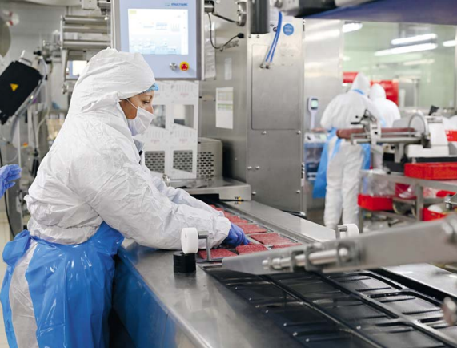
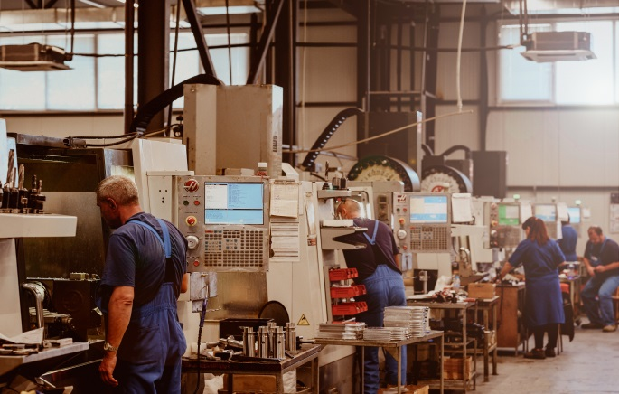
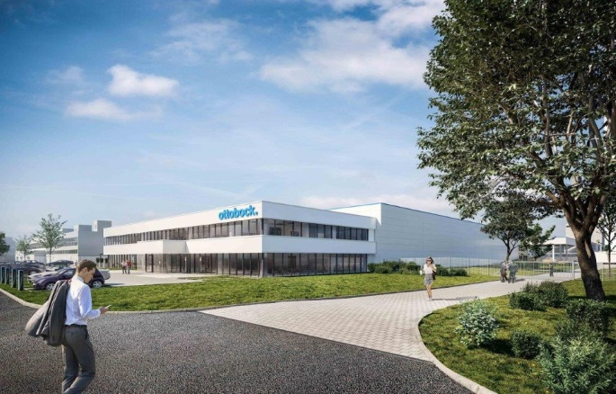

Some of the largest enterprises operating in the Municipality of Blagoevgrad are:
Ottobok Bulgaria
Carol-Fernandez Meat (CFM) Ltd.
Carlsberg Bulgaria AD
Dekovis Ltd.
Vaniko Ltd.
Hydropower Company AD
Groma Hold EOOD
Mitex EOOD
Prestige Business 93 Ltd.

Slide 12
Population dynamics in Blagoevgrad
Blagoevgrad is the administrative center of the municipality and the district. The dynamics of the population in the municipality of Blagoevgrad since 2014 is relatively stable. The share of the population of the municipality from that in the district increases from 24.26% in 2014 to 24.72% in 2020.
Age structure:
The age structure of the population largely determines its demographic capabilities. Stable demographics, relatively even distribution and potential of people of working age between 25 and 55 are indicators of sustainability in the labor market.
/population in Municipality of Blagoevgrad
/Population in the Town of Blagoevgrad
/Men
/Women

Slide 13
Educational structure
The educational structure of the population is important when considering the quality of the workforce and the economic potential of the municipality.
Population aged 7 and over by degree of completed education in Blagoevgrad municipality as of 2011
The percentage of higher education graduates is 23.74%, which is about 4% more than the national average. 50.70% of the population has a secondary education, compared to an average of 43% in the country. At the same time, the share of the population with primary and primary education is significantly lower than in the country (8% and 23%, respectively).

Slide 14
Schools on the territory of Blagoevgrad
The educational infrastructure includes 5 primary schools, 5 secondary schools, three of which provide training for high school students in specialized training
There are 7 high schools on the territory of Blagoevgrad, and three of them are profiled: Language High School "Academician Lyudmil Stoyanov" with a profile in foreign languages, Natural and Mathematical High School "Acad. Sergey Korolev ”with a mathematical profile, a profile of natural sciences, a profile of software and hardware sciences, and the National Humanitarian High School“ St. St. Cyril and St. Methodius ”with a humanitarian profile, social sciences, entrepreneurship, fine arts and music.
BPG "Ichko Boychev" offers training in priority for the labor market specialty "Machines and systems with CNC", as well as training in computer equipment and technology, electrical equipment, electrical appliances, automotive mechatronics. Dual forms of education are already successfully applied on the territory of the school.
PGTLP "Gotse Delchev" offers the specialties "Assistant Dentist", "Advertising Graphics", "Catering", "Organization of Tourism and Leisure", "Hairdressing" and "Manufacture of culinary products and beverages", "Production of bread, bakery and confectionery "

Slide 15
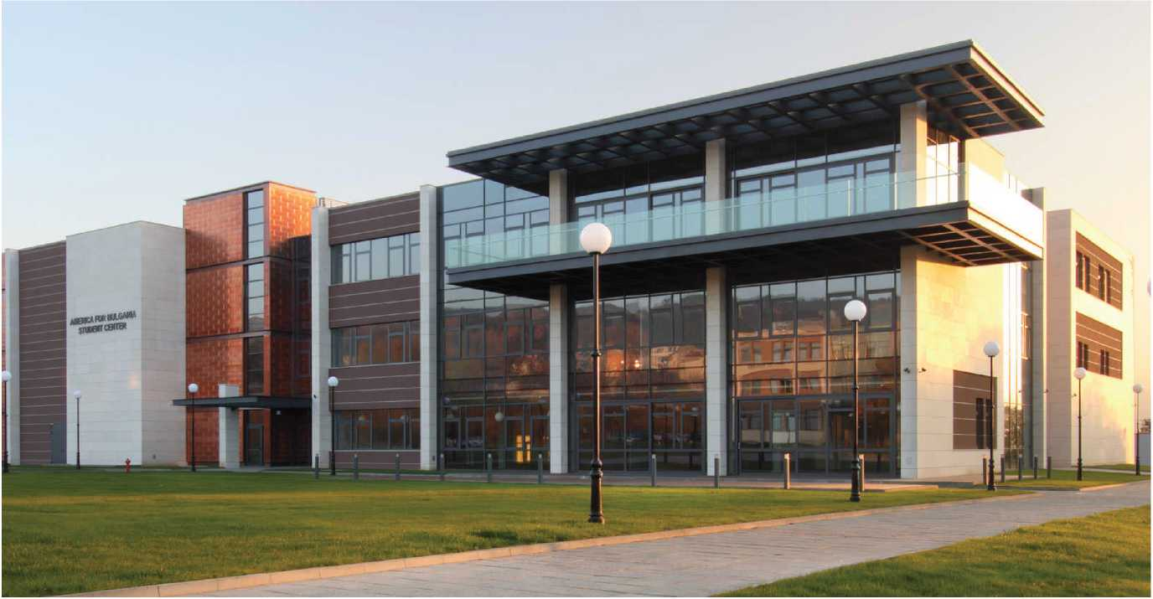
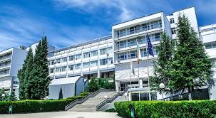
TRAINING OF FUTURE STAFF
Blagoevgrad continues to establish its name as an educational center and is shaping up as a cozy campus. More than 18,000 students from 45 nationalities study at the two larger universities. Apart from them, the Colleges of Tourism and Economics also offer opportunities for quality education.
Southwestern University "Neofit Rilski“
Over 11,000 students per year, taught in Bulgarian and English in 67 bachelor's, 86 master's programs and 43 scientific specialties (doctoral programs) by over 800 lecturers.
Leading Specialties:
Public Relations
Electronics
Informatics
Computer systems and technology
Engineering, technology and entrepreneurship, etc.
American University in Bulgaria
1200 students per year, trained in 9 bachelor's and master's programs by 79 lecturers with diplomas from prestigious universities in 15 countries.
Leading Specialties:
Business Administration
Computer Sciences
Economics
History and civilizations
IT systems
Mathematics

Slide 16
AREAS OF IMPACT
AREA WITH A PREVAILING SOCIAL NATURE
Blagoevgrad | Area / hectares
District IV and Osvobozhdenie district | 44.60
Gramada district | 37.30
Elenovo | 97.75
Strumsko residential area and Strumsko district | 78.60
Villages in the municipality of Blagoevgrad | 383.40
ZONE FOR DEVELOPMENT OF INDUSTRIAL PARKS AND BUSINESS PROJECTS
Industrial zone in Blagoevgrad | 121.22
The territories around Pokrovnishko Shosse and Zelendolsko Shosse near the Struma River | 111.70
Industrial zones for investments from the road junction Kocherinovo to the road junction Zheleznitsa, on the main road E-79 | 90.44
Industrial investment zones around the road junction near the village of Zelen Dol on the Struma Motorway | 148.46
AREA FOR PUBLIC FUNCTIONS OF HIGH PUBLIC SIGNIFICANCE
Central City Hall next to Dimitar Solunski Blvd., AUBG, 216, Bachinovo Park, Hospital Complex | 272.00
TOURISM AND RECREATION AREA
Includes the territories of the Zoo, Park Loven Dom, Botanical Garden, Alley of Health, Bachinovo Park near the villages of Bistritsa and Dabrava, Septemvriyche area, Bodrost area, Kartala ski area next to the hut "Kartala" Macedonia ”, thermal zones“ Aquapark ”, the village of Dabrava and the village of Zelen dol | 1307.75
Four areas of impact have been identified in which support measures will be implemented as a matter of priority, without excluding or restricting investment outside these areas:

Slide 17
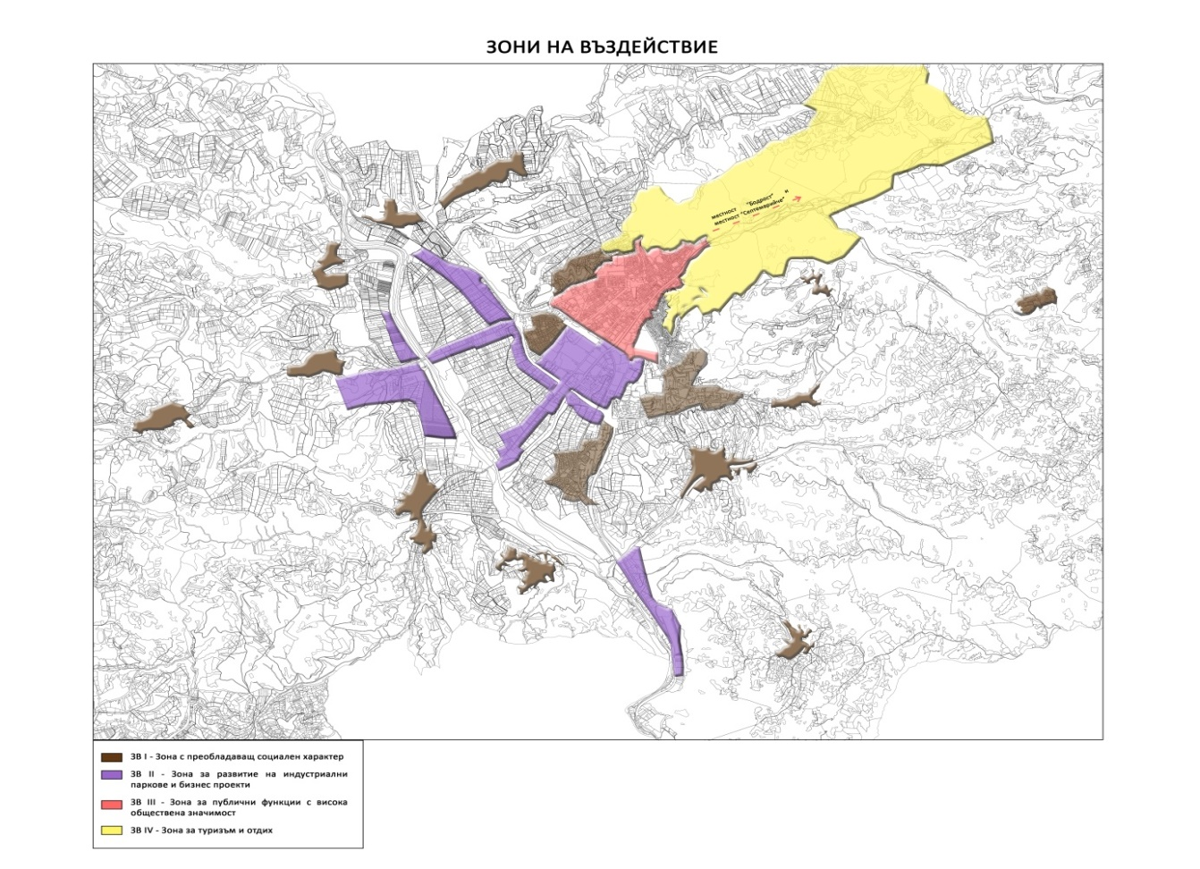
AREA WITH A PREVAILING SOCIAL NATURE
ZONE FOR DEVELOPMENT OF INDUSTRIAL PARKS AND BUSINESS PROJECTS
AREA FOR PUBLIC FUNCTIONS OF HIGH PUBLIC SIGNIFICANCE
TOURISM AND RECREATION AREA

Slide 18
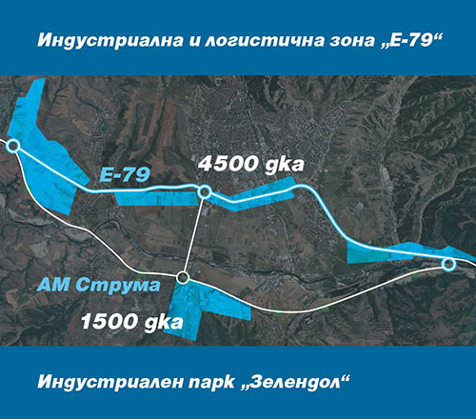
Project development strategies:
Construction of an industrial and logistics zone.
The existence of Struma Motorway allows the realization of two industrial zones:
Industrial and logistics zone "Main road E-79". It covers the areas from the Kocherinovo road junction to the Zheleznitsa road junction. There will be a logistical area for control and coordination of warehousing and transport services. It is planned to build a complete infrastructure with the necessary transport connections.
Zelendol Industrial Park will be built on the land of the village of Zelen Dol. Excellent conditions will be created that meet the specific goals of the business.

Slide 19
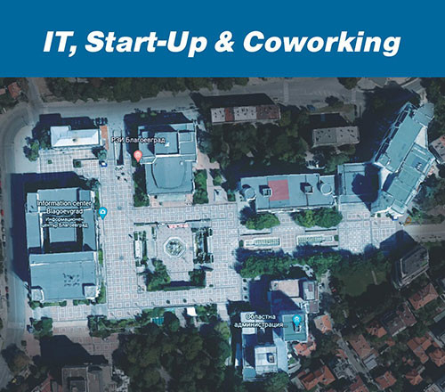
Project development strategies:
2. IT, Start-Up & Coworking
Construction of a high-tech zone: IT, Start-Up (start-up business) and Coworking (collaboration) zone. Blagoevgrad has extremely suitable sites that can be used for this activity. The sites form a solid structure, with capacity in the required scale of buildings and areas, as well as the environment and infrastructure. Located in the "ideal center" with a pedestrian zone near the park and supported by a parking lot with ample parking spaces. These buildings are the result of hundreds of millions of investments made in the city in the mid-1990s. They will be supplemented with new funds invested strategically, with a promising project meeting the latest requirements for creating an attraction center and ecosystem for start-up and developing IT entrepreneurs.

Slide 20
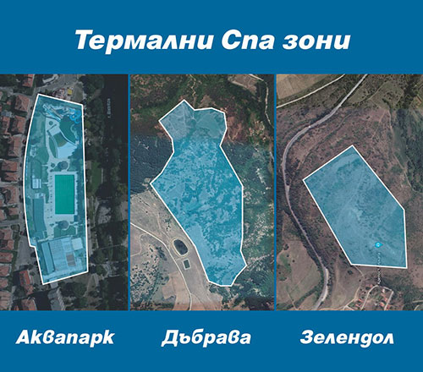
Project development strategies:
3. Thermal Spa areas.
The future is in spa, spa and health tourism. The focus is on the construction of thermal spa areas. It is planned to build three important sites for the region:
Transformation of an existing site in Blagoevgrad into a modern indoor and outdoor Spa area;
Development of two projects for two complexes in the area of ​​Zelendol and Vladishko-Dabrava mineral springs.
Through these sites Blagoevgrad can enter with a flying start in the fast-growing Spa and spa tourism.
In support of the business, a mechanism for retraining of working age staff will be established, as well as centers for professional orientation, dual training and internships.

