Slide 1
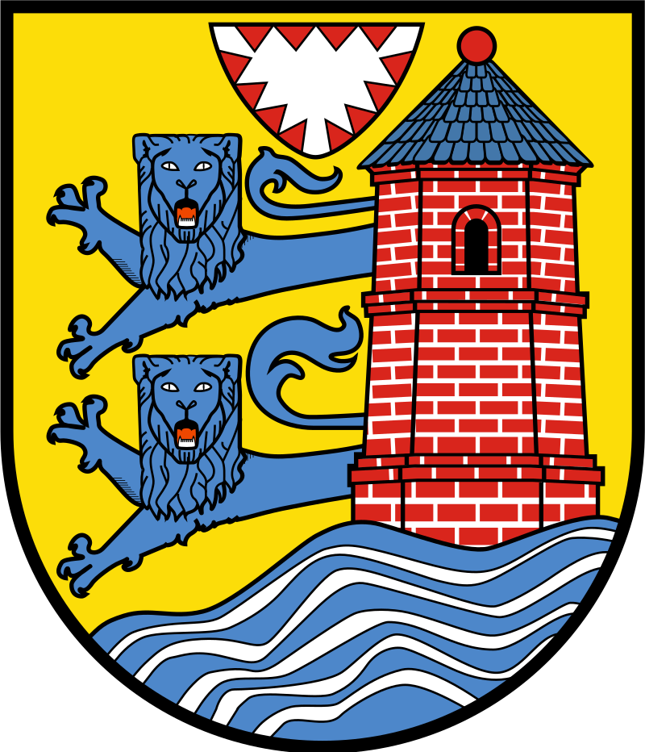
3rd largest city in Schleswig-Holstein
Population 95,000
43 Councillors
Traditionally 3 main party groups – CDU, SPD, and the SSW which represents the Danish speaking minority. The status of largest party has fluctuated between these three since 1945, though no-one has held an outright majority since 1959.
In the last elections the Green Party emerged as a major player for the first time winning 8 seats. Unusually the exact same number of seats (8) was won by each of the other 3 main parties. The other 11 seats are held by a range of smaller groups.
An urban council, but in 2007 Flensburg was granted a boundary extension and took in the rural area of Kattloch.
Executive power rests with the Directly Elected Mayor
Flensburg

Slide 2
Known for: Flensburg Beer (on sale in Wickham tap)
Substantial Danish speaking minority (was part of Denmark until 1866)
Under Danish rule had two Mayors – a “North Mayor” elected by the Councillors from North of the Flensburg Fjord for the Danish speaking population and a “South Mayor” elected by the Councillors from South of the river for the German speakers. Executive power was vested in the North mayor, but the “South Mayor” chaired the Council meetings
In 1870, under German rule this system was changed. The Executive Mayor became the Oberburgermeister (Lord Mayor) and was directly elected by the citizens. The Council Chair became the Burgermeister (Mayor) and was elected by the Councillors.
Flensburg was also the last capital of Nazi Germany
Flensburg

Slide 3
Hitler’s regime eviscerated democratic local government in Germany.
Councillors and senior staff were purged
Direct elections were banned. Mayors remained as figureheads, but were appointed by the local Nazi Gauleiter who held the real power. Often the Gauleiters simply appointed themselves as Mayors.
Post 1945 the victorious allies introduced their own systems of local government in the areas of Germany they occupied – US style Directly Elected Executive Mayors in the South, French style Council Elected Executive Mayors in the Centre and British style Council-Manager systems in the North (including Flensburg).
These differing systems were retained even after the creation of the Federal Republic of Germany and remained in place for over 50 years.
In the Soviet zone a system similar to the Nazi one was retained but with the General Secretary of the local Communist Party Committee taking the role previously held by the Gauleiters.
In Flensburg the title of Lord Mayor was given to the City Manager while the Council Chair took on the title of Town President

Slide 4
After the collapse of Communism and the reunification of Germany, the Eastern Lander went looking for a new system of local government.
Every major town and city in the East opted for the US system used in the South of Germany. The success of Bavaria – in 1945 the poorest part of Germany, in 1990 the richest – was a major factor in the arguments in favour of directly elected mayors.
This unanimous choice led to debates in the former French and British zones about changing their systems. Over the next decade almost every city and large town in central and northern Germany also introduced directly elected Mayors with executive powers and either balanced those roles with Council Chairs elected by the Council members or with an option for referendums to recall the Mayor or overturn their decision (or both). 76% of Germans are currently governed by a Directly Elected Mayor.
Flensburg was one of the last cities to change, adopting a Directly Elected Mayor in 1999. The title of Lord Mayor is now held by the directly elected Mayor.
A professional City Manager – confusingly called the Burgermeister (Mayor) – remains in place, reporting to the Lord Mayor. The office of Town President – the independent Chair chosen by the Councillors – also remains and is sometimes also referred to (even more confusingly) as Mayor.

Slide 5
The DEM debate in Germany
Given Germany’s history, there were obvious concerns about introducing Directly Elected Mayors throughout the country. These concerns centred around the quality and nature of the candidates: i.e. would be able to do the job and was there a danger of extremists being elected.
To date, no member of an extremist party has been elected a Mayor in Germany (though many have been elected as Councillors). Southern Germany has been directly electing Mayors for over 70 years.
In the 20+ years since the adoption of DEMs nationwide the calibre of candidates elected (as judged by their prior education and relevant experience in public administration and elected office) has increased steadily.
The system of checks and balances with a separate Council Chair and/or referenda and professional management at the functional level is seen to have worked well and enjoys broad public support.

Slide 6
What did the Mayor add?
Flensburg was one of the last German cities to introduce a Directly Elected Mayor (1999)
The 1990s were a bad time for Flensburg. The end of the Cold War led to the closure of the German Army’s technical training college, of a large NATO barracks at Briesen in the outskirts of the city, and the dramatic downscaling of the naval base in the city centre, leaving 12.5 ha of land effectively abandoned.
The first DEM was the sitting Council elected Mayor, an economist, Hermann Stell of the CDU.
Stell had been campaigning for several years for the redevelopment of the Briesen barracks as a Garden City. Plans were adopted in 1997. As DEM he was able to see them through to fruition.
Building on this success, he then tackled the Naval base and redeveloped this as a mixed use zone incorporating, accommodation, recreation and a Marina.
He died in office of a stroke in 2004

Slide 7
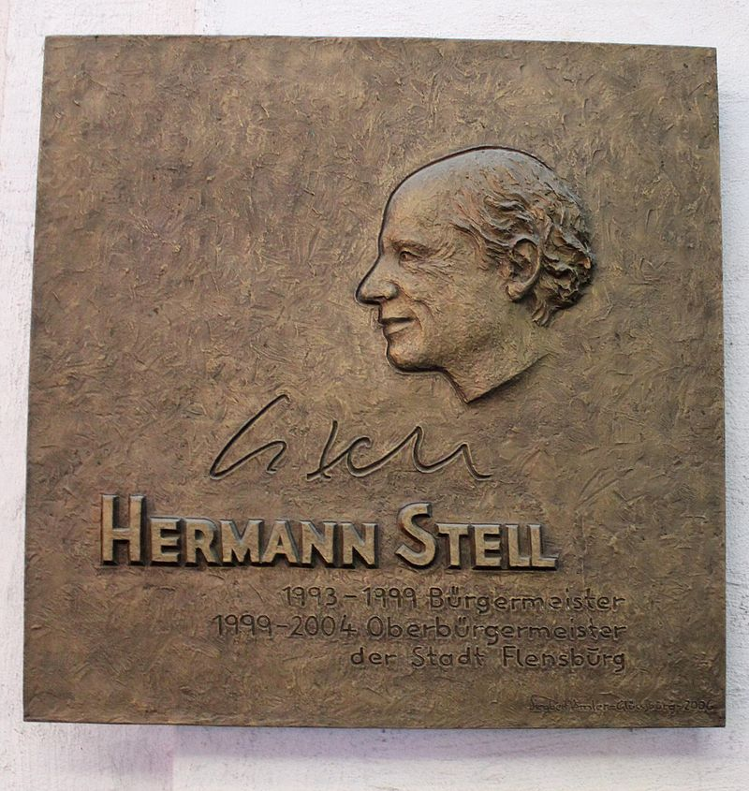
Memorial plaque to Hermann Stell in the Steinbach House, an historic (1630) building incorporated into a new city centre shopping district.
The proposed development caused controversy, but the solution put forward by Stell was embraced by citizens and conservationists

Slide 8
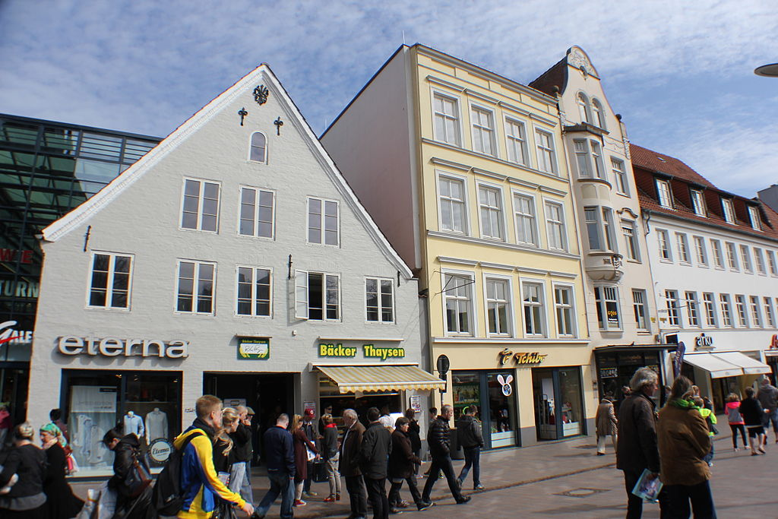

Slide 9
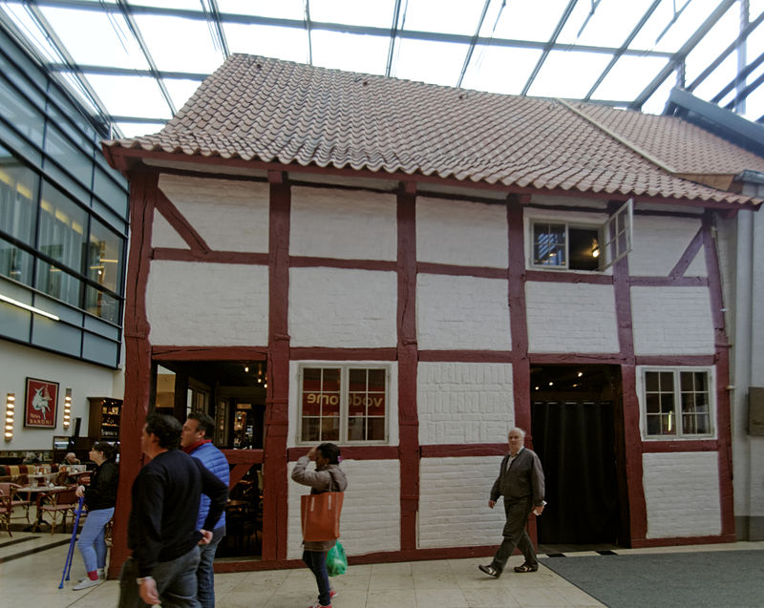

Slide 10
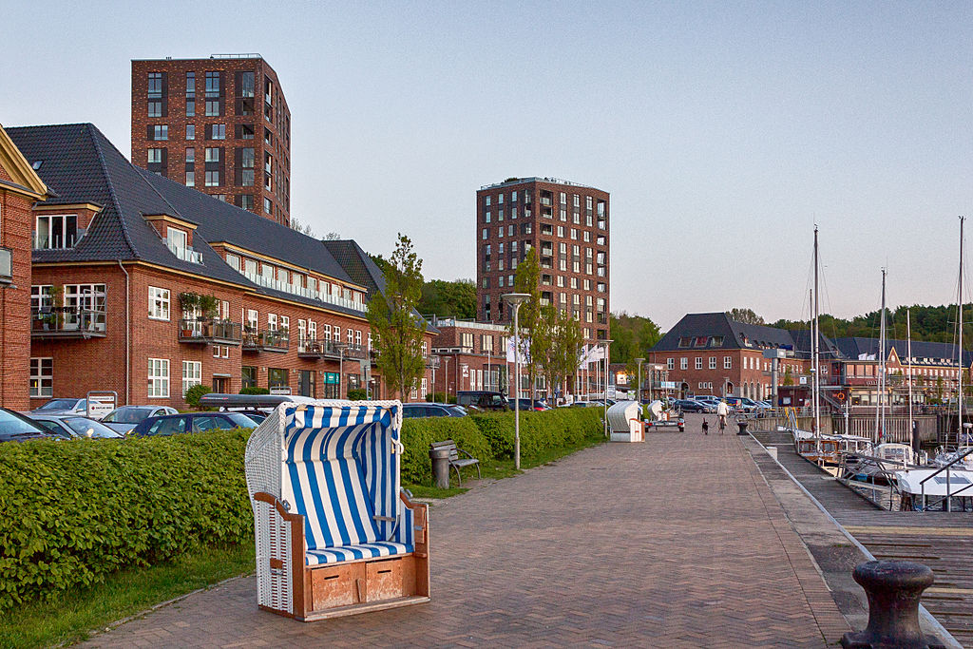

Slide 11
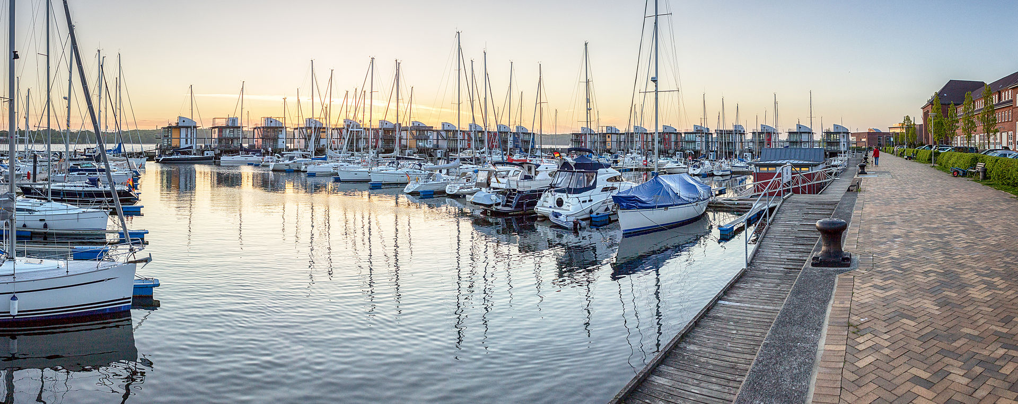

Slide 12
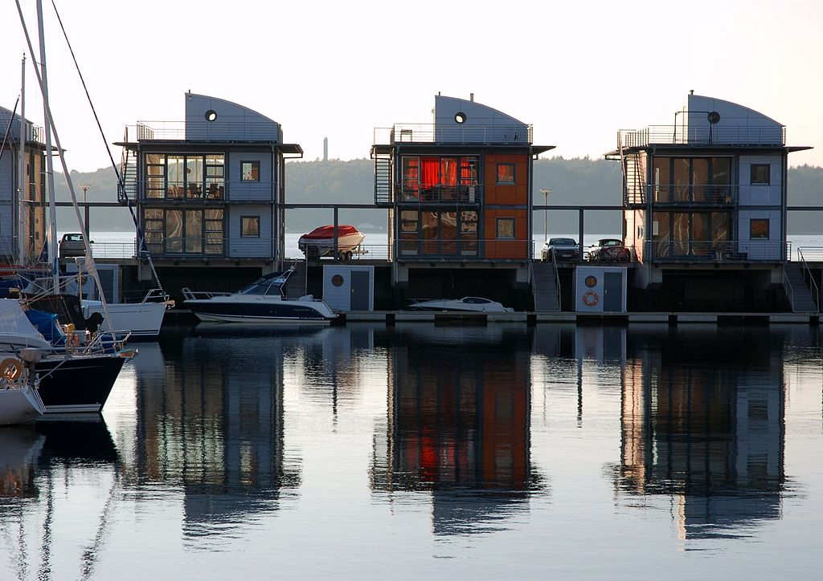

Slide 13
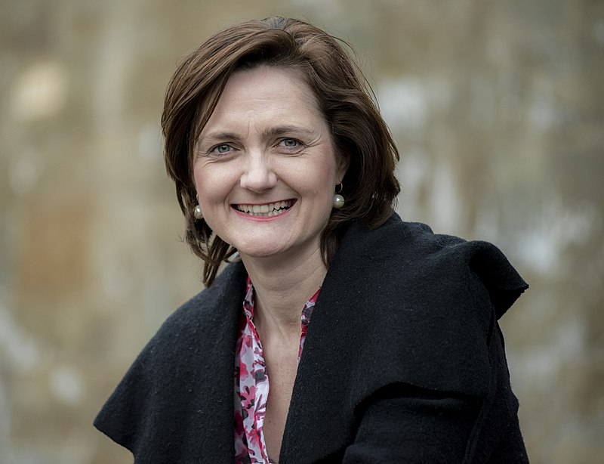
Lord Mayor of Flensburg
Current Lord Mayor is Simone Lange of the SPD. She was elected in 2017.
She holds a degree in Public Administration and from 1999 to 2012 worked for the City Council as an Administrative Officer in the Police Department.
In 2012 she was elected to the State Parliament for Flensburg, resigning that role when elected Mayor.

Slide 14
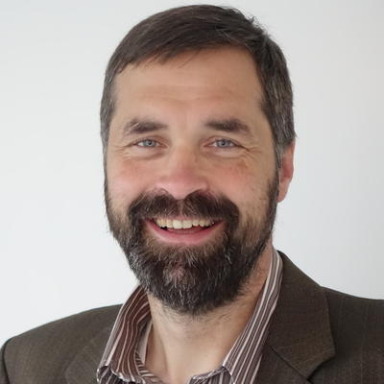
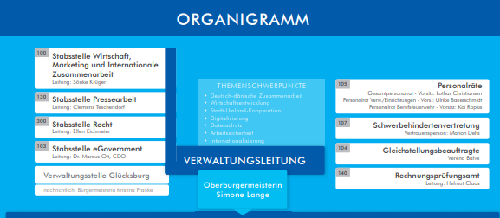
Board of Directors
The Lord Mayor chairs a 4 person Board of Directors comprising of the Lord Mayor, the Manager and 2 Directors of Service which is responsible for co-ordinating the day-to-day management of the City.
Henning Bruggermann
Manager/”Mayor” of Flensburg

Slide 15
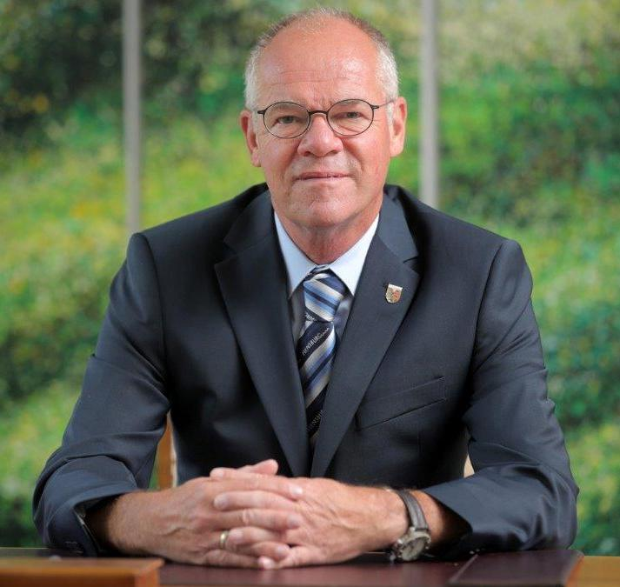
Town President (Chair of Council)
Hannes Fuhrig of the CDU
Former airforce officer, lecturer and free-lance journalist.
Elected by the Council for a 6 year term
Chairs meetings of the Council and of the “Council of Elders” a committee of party leaders and committee chairs that sets the business of the Council
The Lord Mayor sits as an ex-officio member of the Council of Elders and attends all relevant Council & Committee meetings
Represents the Council at some state-wide fora

