Slide 1
MUNICIPAL DISTRICT OF
NEWCASTLE WEST
2014 - 2019
1st May 2019

Slide 2
NCW MUNICIPAL DISTRICT - STATS
Roadway – 1032km
LA Houses – 626
Population of the District – 27,336

Slide 3
Municipal District Councillors
Cllr Séamus Browne
Cllr Michael Collins
Cllr Francis Foley
Cllr Liam Galvin
Cllr Jerome Scanlan
Cllr John Sheahan

Slide 4
ROAD WORKS SCHEME
2015-2019
General Maintenance of roads
Street Cleaning
Road Reconstruction
Surface Dressing
Drainage and footpaths
Bridge Rehabilitation
Low Cost Safety Schemes
Community Involvement Scheme
Local Improvement Schemes
General Municipal Allocation
€16,307,691

Slide 5
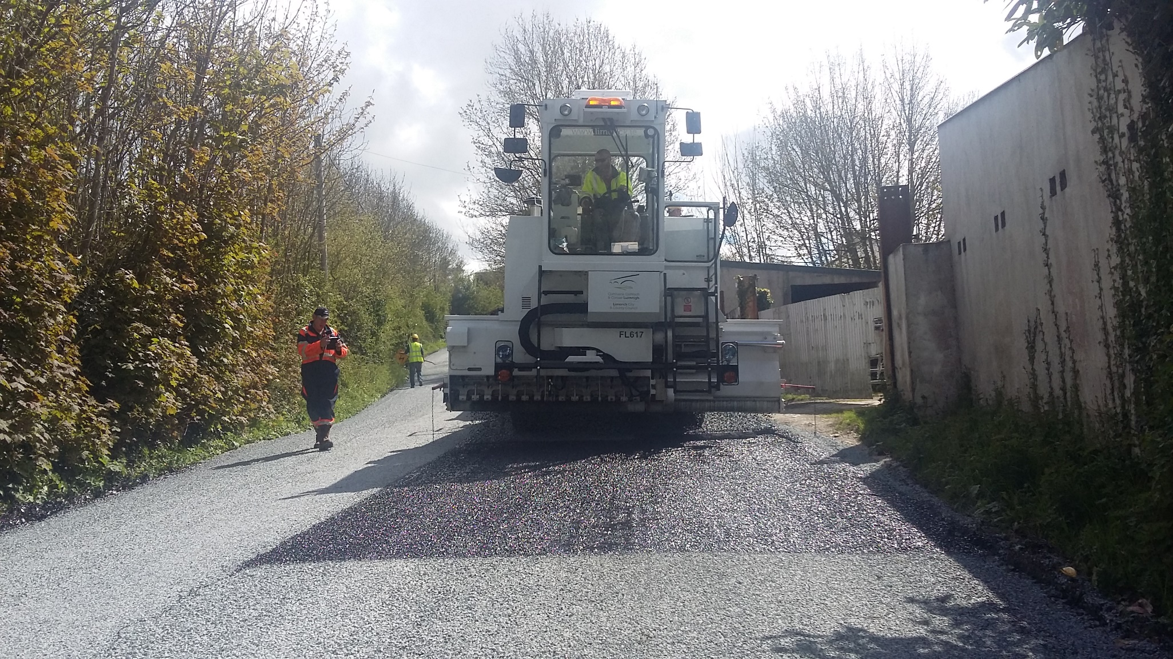
ROAD WORKS - SURFACING

Slide 6
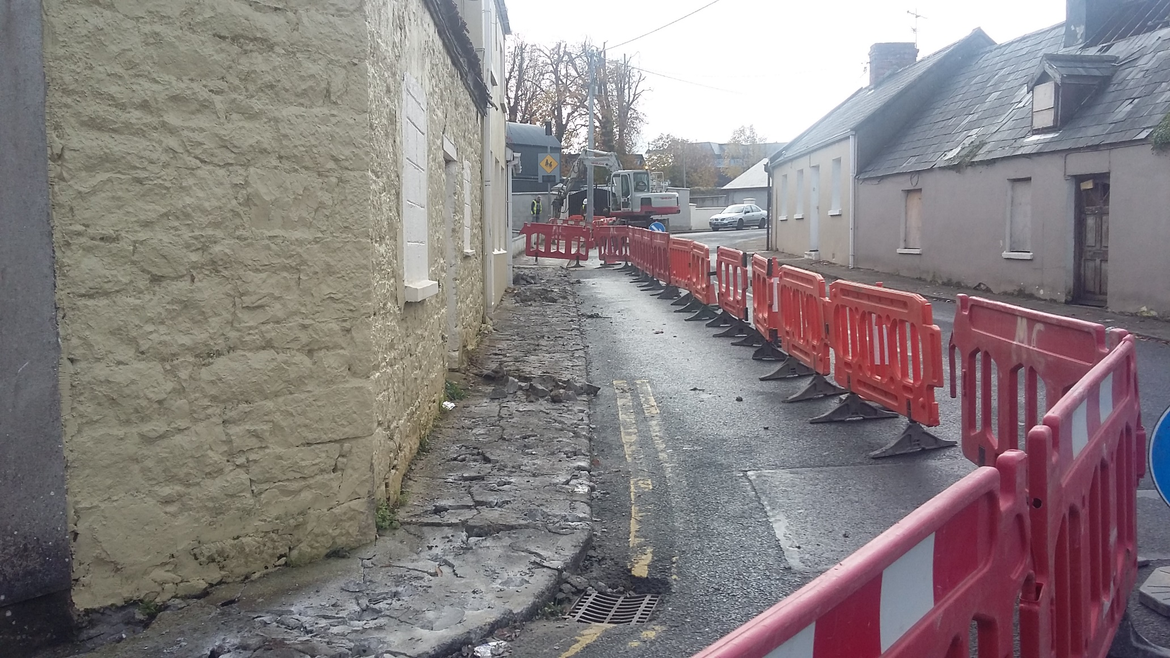
ROAD WORKS - FOOTPATHS

Slide 7
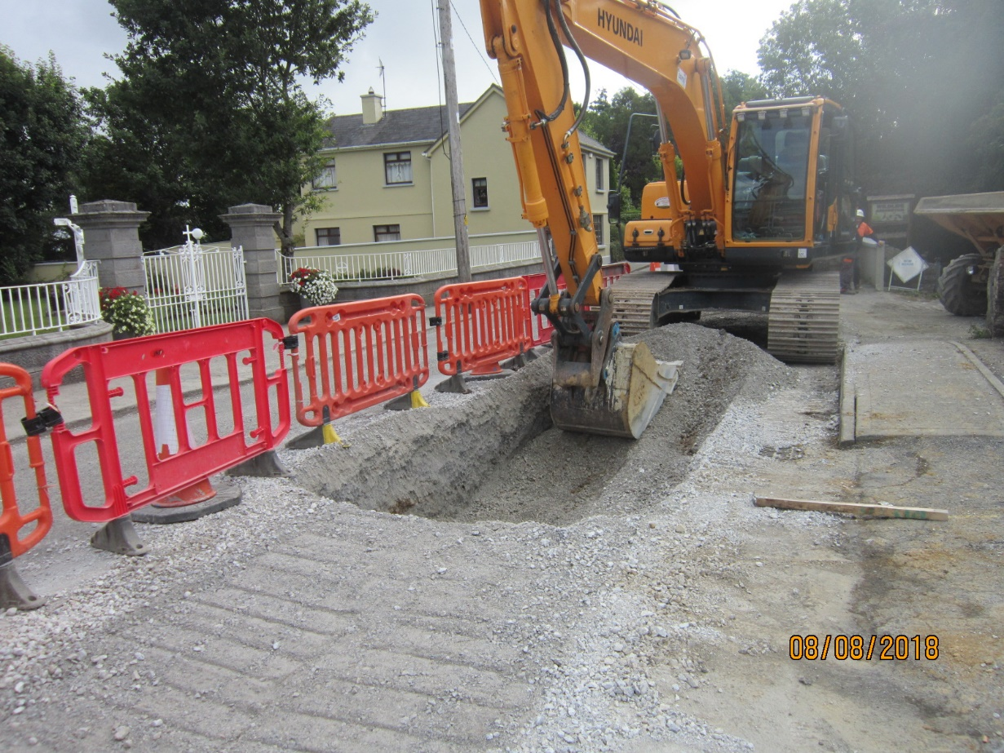
ROAD WORKS - DRAINAGE

Slide 8
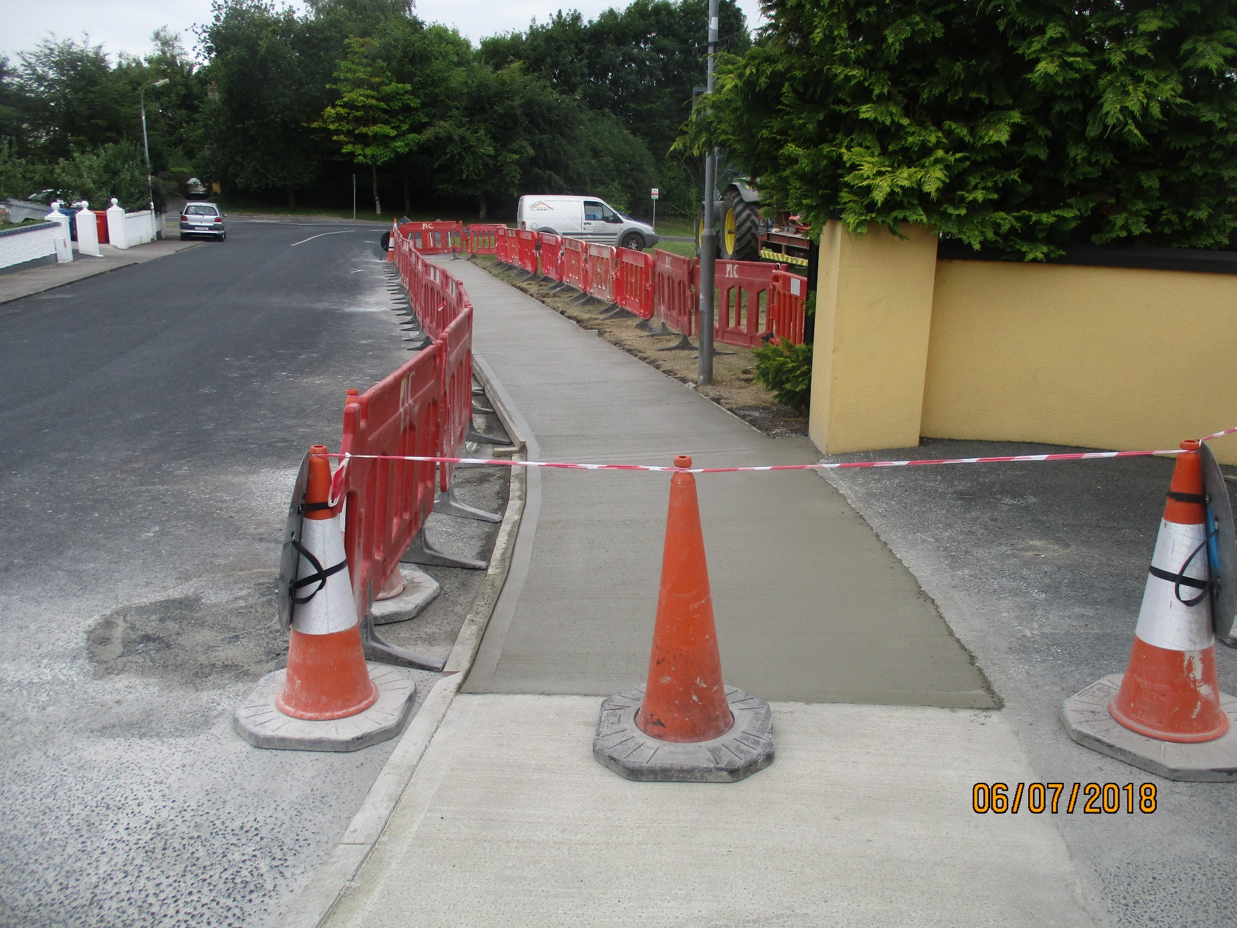
ROAD WORKS - FOOTPATHS

Slide 9
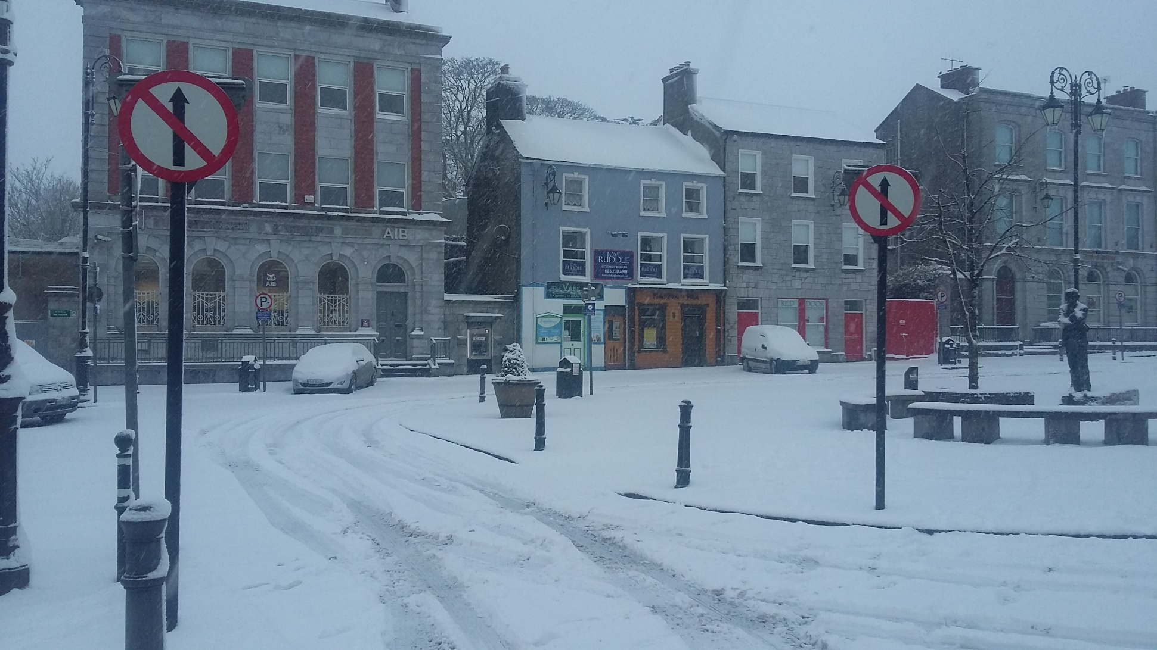
ROADS – WEATHER ALERTS

Slide 10
NCW DISTRICT PROJECTS
Great Southern Greenway Limerick
Regional Athletics Hub Newcastle West
Glin Public Realm Plan
Abbeyfeale Traffic Management Plan
Newcastle West Development Association – Vision 2023
Newcastle West Christmas Lights Project
Fuller’s Folly
REDZ – Curlings Bridge, public lighting Maiden St. & North Quay.
- repairs to Arra River wall.
Town & Village Renewal Scheme:
Abbeyfeale E Hub
Glin Interpretative Centre
Newcastle West- Fullers Folly
Abbeyfeale – Signage & carpark resurfacing
Athea- carpark resurfacing
Knockaderry – upgrade of community hall
Kilmeedy – community café
Kantoher – reed bed

Slide 11
NCW DISTRICT PROJECTS (2)
Clár Programme – sum of €302,460 received within the District.
Projects completed include installation of speed safety signage and lights, road markings at the following national schools:
Glengurt, Mountcollins, Athea, Ashford, Raheenagh, Dromtrasna, Knocknasna, Meenkilly, Feenagh, Kilmeedy.
Pedestrian crossings at Ashford & Raheenagh NS
Funding also received for development of community playground at Raheenagh and safety measures at St. Fergus National School, Glin

Slide 12
NCW DISTRICT PROJECTS (3)
Development Fund – sum of €350,000 allocated to District.
Projects include:
Curlings Bridge
Newcastle West Athletics Hub
Footpath upgrades & road safety measures at Dromcollogher, Newcastle West, Abbeyfeale, Glin
Newcastle Integrated Traffic Movement
Abbeyfeale Traffic Management Plan

Slide 13
GREAT SOUTHERN GREENWAY (GSG)
To date almost €2m has been spent on the development of the Greenway, funding from Hinterland fund, Rural Recreation Fund.
€2.74 m was granted under the Rural Regeneration Development Fund (RRDF) in 2018.
The funding will be used to upgrade the existing Greenway surface, improve drainage, signage etc.
An application has been submitted to Fáilte Ireland for €3.6m

Slide 14
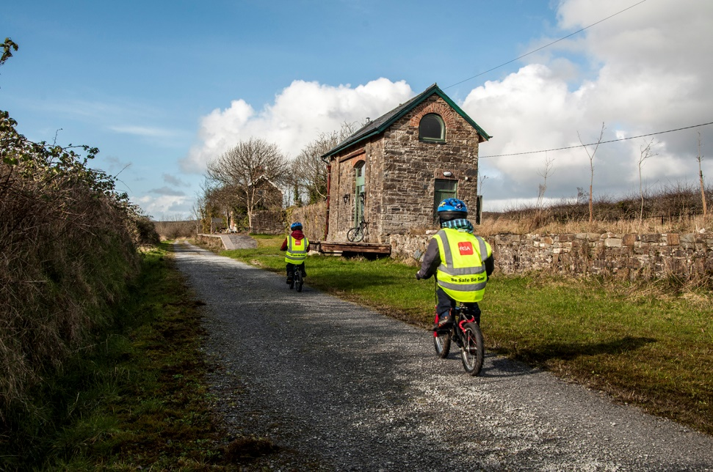
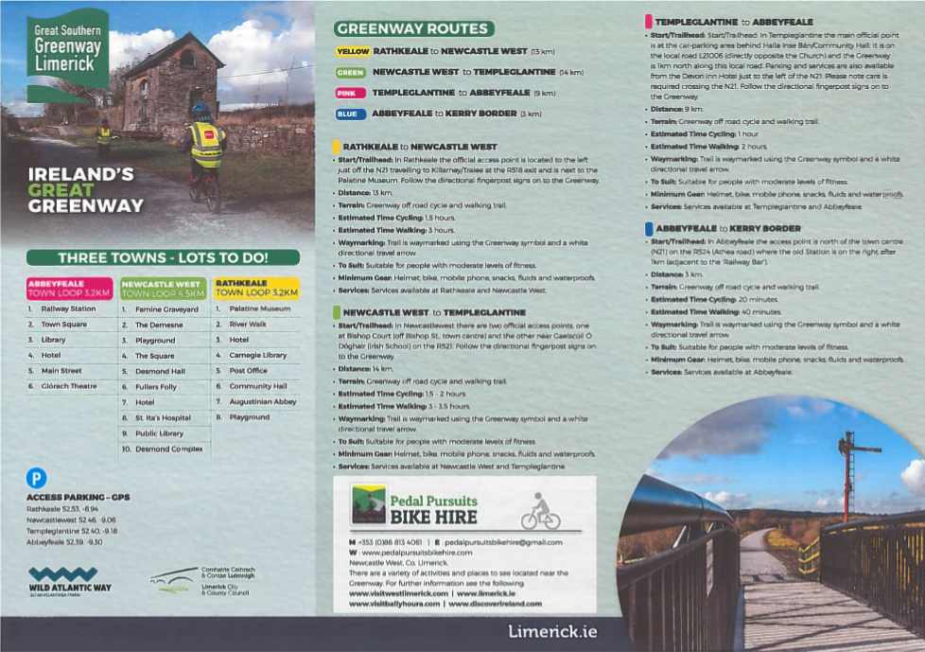
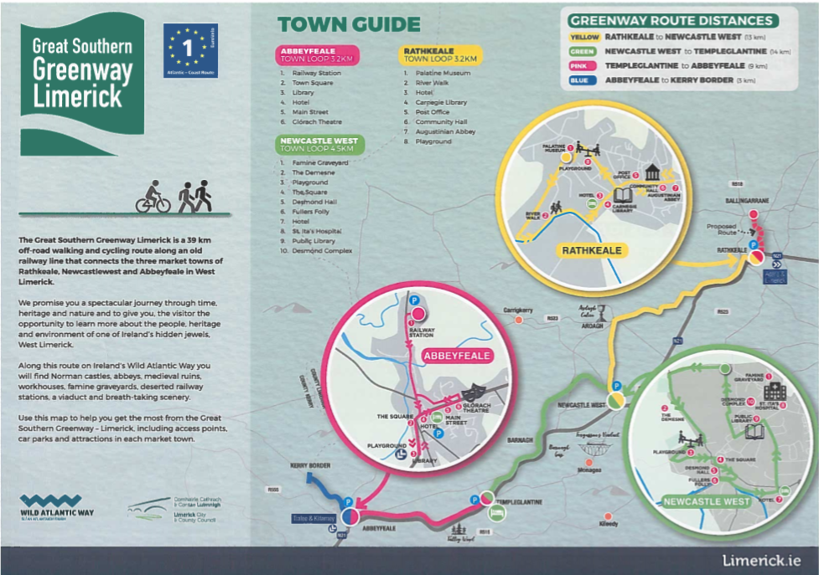
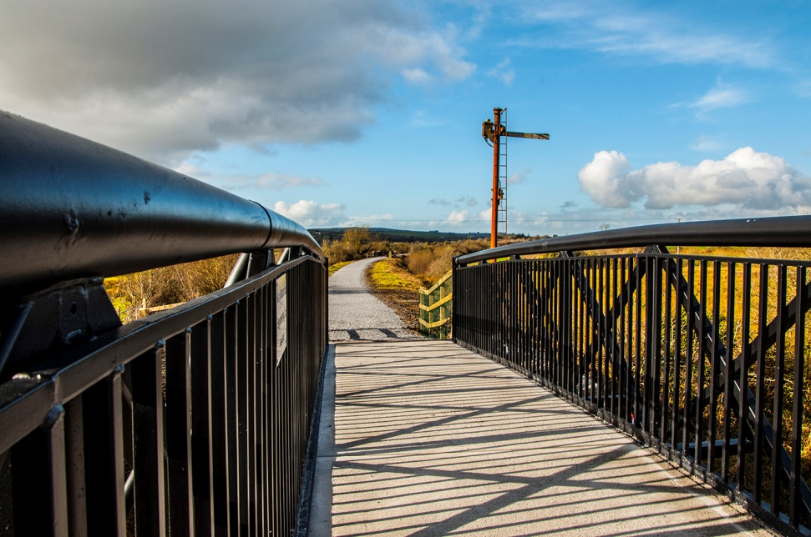
GREAT SOUTHERN GREENWAY (GSG)

Slide 15
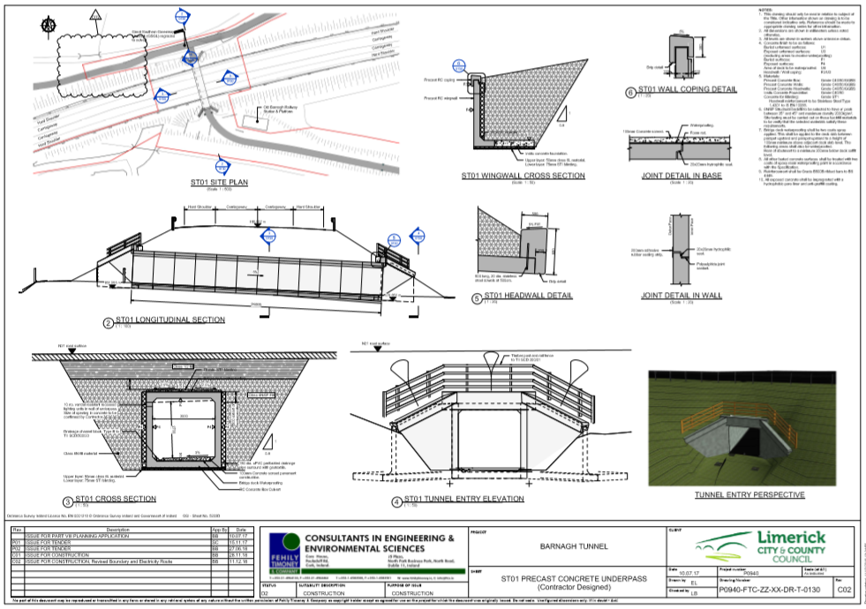
BARNAGH TUNNEL PROJECT
Barnagh Tunnel project is a €0.5m project which crosses under N21 linking the Greenway at Barnagh.

Slide 16
Regional Athletics Hub
Newcastle West
Feasibility Study Funded by the GMA of NCW Municipal District
Purchase of site at Cloonyscrehane, NCW.
Part 8 Planning passed By Municipal District Councillors
Funding already obtained from Hinterland Fund, Development Fund, GMA.
Application recently made to Large Scale Sport Infrastructure Fund.

Slide 17
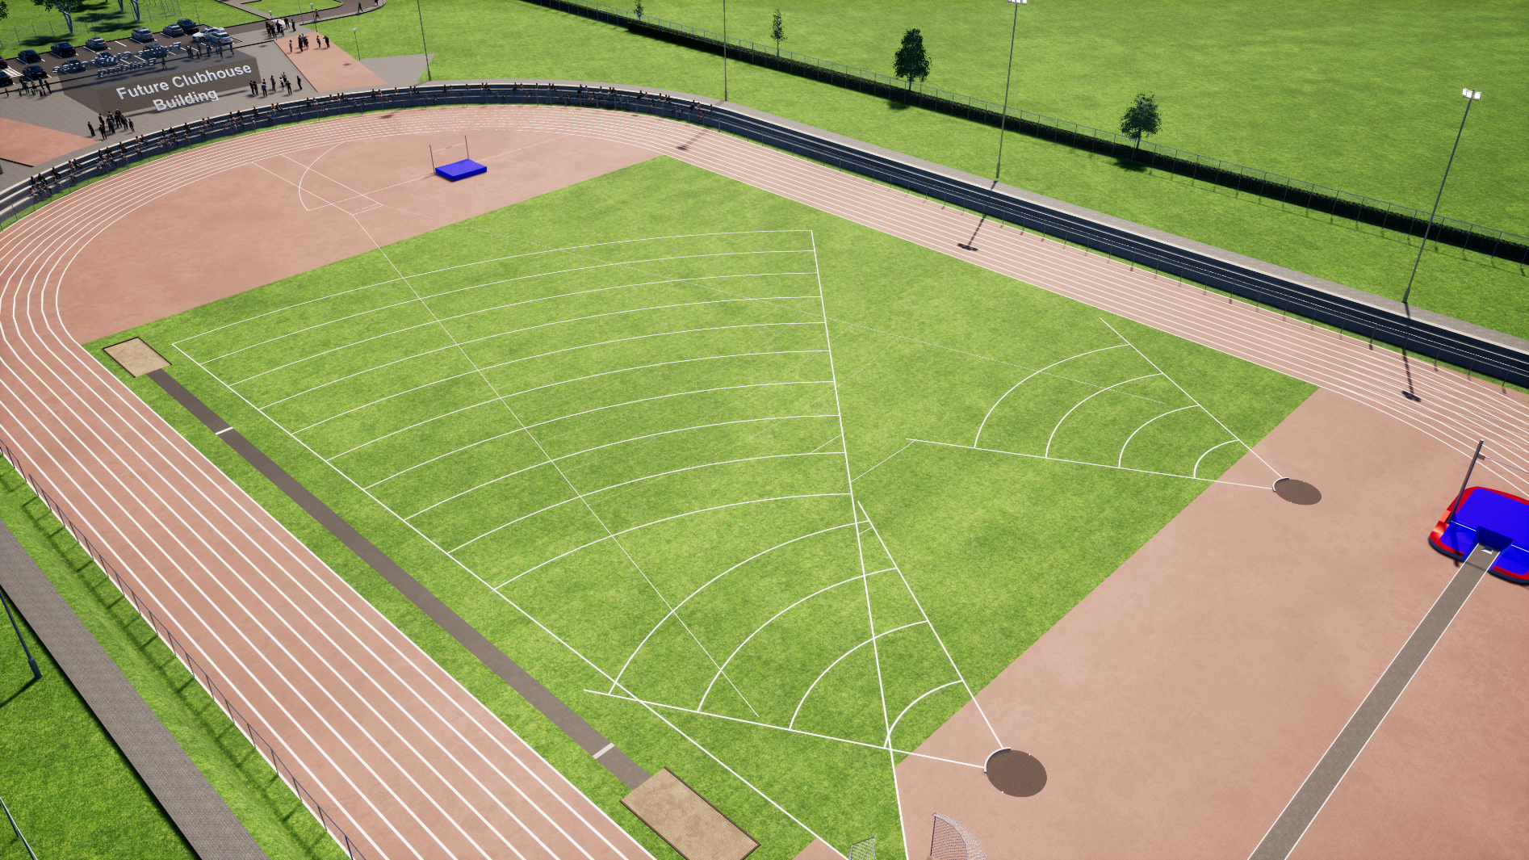
Regional Athletics Hub

Slide 18
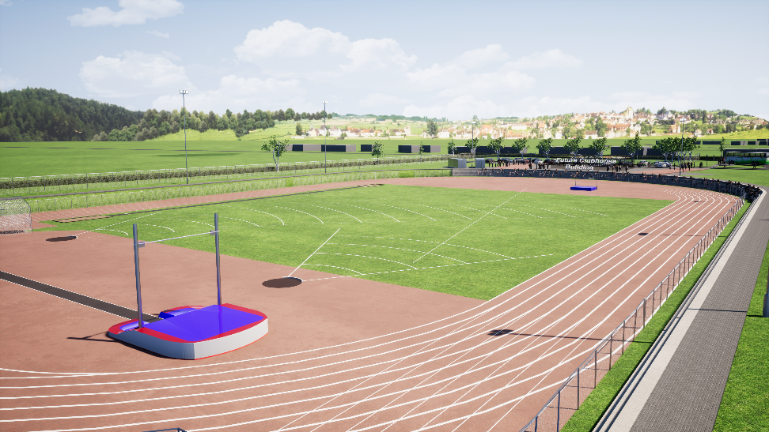
Regional Athletics Hub

Slide 19
Glin Public Realm Plan
Plan Funded by the NCW Municipal District
Plan Launched in July 2018
Part 8 Planning currently being developed by LCCC with public consultation in May 2019.
Funding approved from Town and Village Renewal Scheme for interpretative centre to rear of Library.

Slide 20
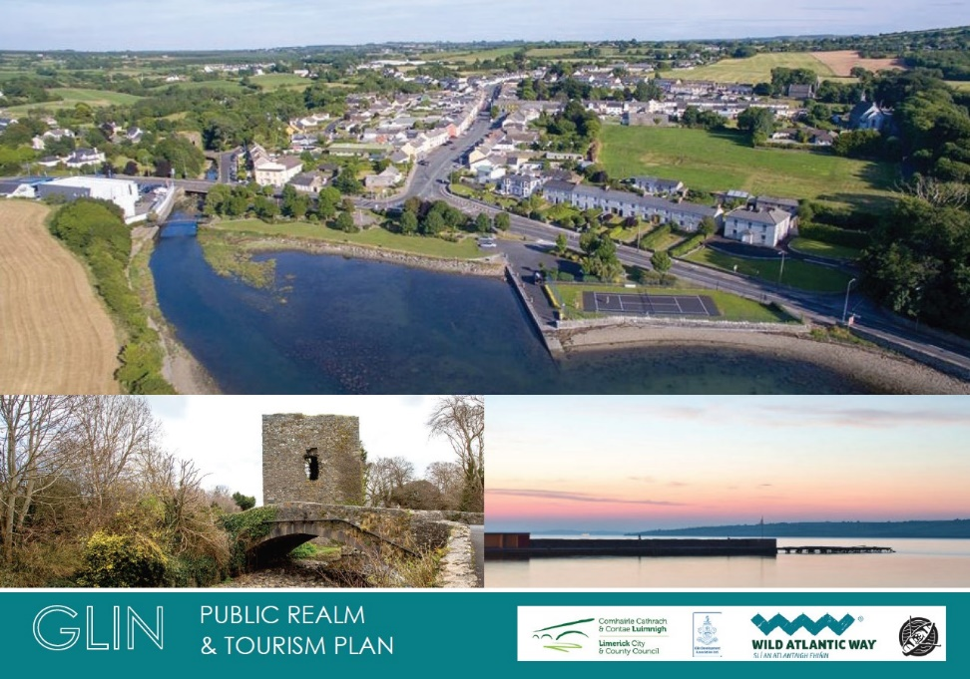
Glin Public Realm Plan

Slide 21
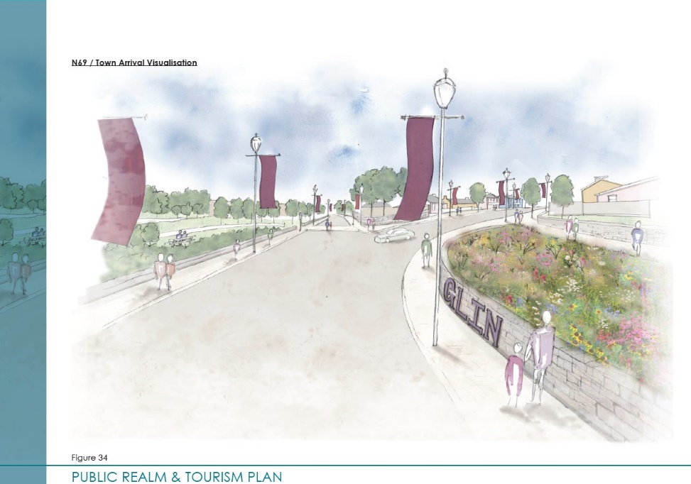
Glin Public Realm Plan

Slide 22
Abbeyfeale Traffic Management Plan
Public display 18th December 2017 – 24th January 2018. Public information day on 18th January and submissions received by 8th February 2018.
Part 8 Planning passed by Municipal District Councillors in May 2018.
Plan being funded by Limerick City and County Council and Transport Infrastructure Ireland.
Cost of plan circa €5m

Slide 23
Fullers Folly
Fullers Folly purchased by LCCC.
Funding approved from Town and Village Renewal Scheme to upgrade and refurbish the Folly.
An building assessment, survey, options report and business plan has been prepared for the building.
Works completed on the Folly in 2018.
Funding approved under the RRDF 2018 - €330,000
Project Ongoing.

Slide 24
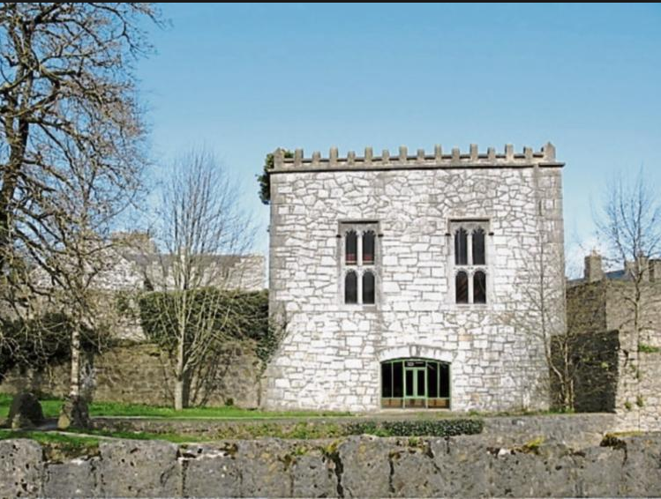
Fullers Folly

Slide 25
HOUSING GRANTS
610 grants to a value €3.2m awarded as follows:
Housing Aid for Older People Grant 324 grants to the value of €1.5m
Mobility Aid Grant 164 grants to the value of €701,654
Housing Adaptation Grant 79 grants to the value of €642,045
Disabled Persons Grants (LA houses) 43 grants to the value of €305,000

Slide 26
NewcastleWest.ie
A new website was launched in December 2018 showcasing the best of County Limerick’s largest town, Newcastle West.
The new website is a joint collaboration between Limerick City and County Council and the Newcastle West Development Association.

Slide 27
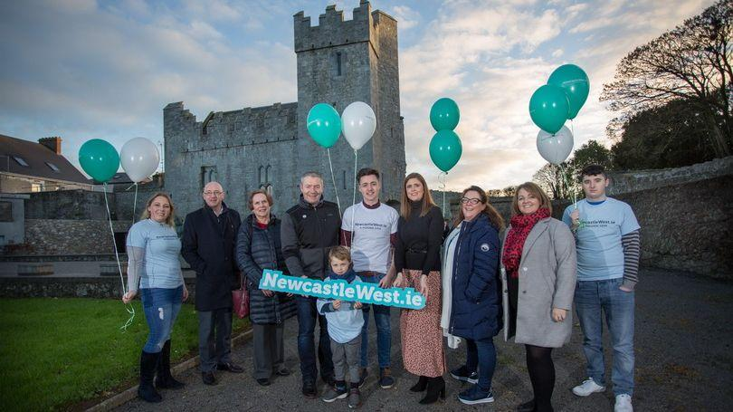
NewcastleWest.ie

Slide 28
CEMETERIES
Details of works carried out on cemeteries within the District to the value of €161,884:
Footpath repairs – Ardagh, Athea, Feenagh, Templeglantine, Kilfergus Glin, Calvary Newcastle West, Dromcollogher
Boundary repairs – Templeathea, Templeglantine, Kilfergus Glin, Dromcollogher
Tree removal/pruning – Templeathea, Ardagh, Castlemahon, St. Ita’s Killeedy, Grange, Dromcollogher
Access road repairs – Springfield
Geophysical Survey - Springfield

Slide 29
GMA SPECIAL PROJECTS
GMA Special Projects funding in the sum of €500,000 provided by Councillors to 83 projects
The following are some of the projects funded:
Feasibility Study for Regional Athletics Facility
Newcastle West Chamber of Commerce for Newcastle West Five Year Plan
Glin Development Association – Glin Public Realm Plan
Abbeyfeale Community Council & Development Association
Broadford Development Association & Broadford Walking Trails
Athea Phone Booth Defibrillator & Athea Tidy Towns
Abbeyfeale Christmas Lights Festival Committee
Tournafulla Development Association

Slide 30
GMA SPECIAL PROJECTS
Knockaderry/Clouncagh Community Council
Fleadh by the Feale
Newcastle West Defibrillator Group
Public Lighting – Ardagh, Dromcollogher, Newcastle West, Broadford, Ashford, Glin, Feenagh
Footpath upgrades – Athea, Tournafulla, Newcastle West, Abbeyfeale, Ardagh, Broadford, Templeglantine, Knockaderry,
Drainage works – Abbeyfeale, Newcastle West, Knockaderry, Athea, Feohanagh, Ashford, Kilmeedy
Road upgrades – Raheenagh, Glin, Abbeyfeale, Knockdown

Slide 31
DERELICT SITES
There were approximately 230 Site Inspections carried out in the Newcastle West area in 2018.
There are currently 10 properties on the Derelict Sites Register within the Newcastle West Municipal District.
We are currently progressing 6 Derelict Sites for Compulsory Acquisition under Derelict Sites Act and a further
1 Derelict Site is being progressed for Compulsory Purchase Order under the Housing Act.

Slide 32
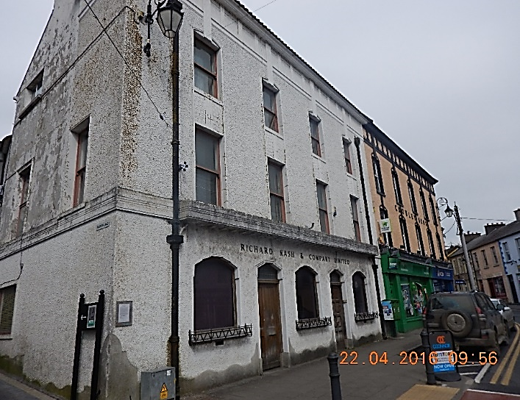
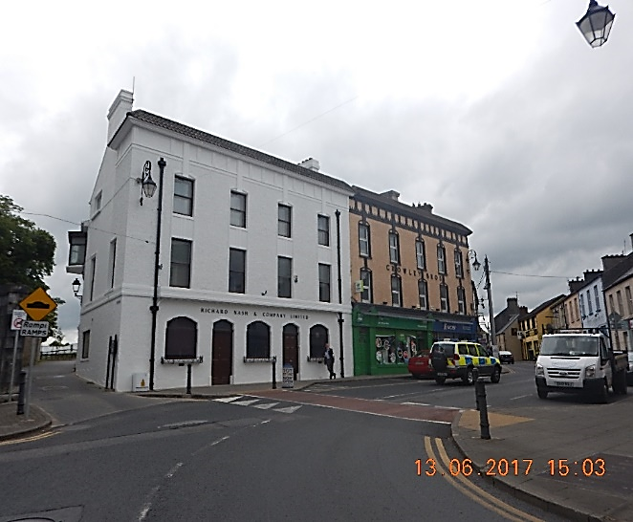

Slide 33
Delegations
Delegations received by the Municipal District from 15 organisations as follows:
Broadford Development Association
Dromcollogher Community Council
Knights of Westfest Committee
Mountcollins Development Association
Knockaderry/Clouncagh Community Council
Abbeyfeale Community Council
Glengurt NS Tournafulla
Kantoher Development Group CLG
Board of Management Scoil Mhuire agus Ide Newcastle West

Slide 34
Delegations
Delegations received:
Tournafulla Mountcollins Parish Committee
Board of Management Killoughteen NS Newcastle West
Board of Management Scoil Mhuire NS Broadford
Board of Management St. Fergus NS Glin
Sikh Community
Cryleview Residents Association Abbeyfeale

Slide 35
Municipal District Receptions
Desmond College – Junior Achievement
Tidy Towns organisations
Newcastle West GAA
Local Athletes and Musicians for their success at national and international events
Feenagh/Kilmeedy Scór Group

Slide 36
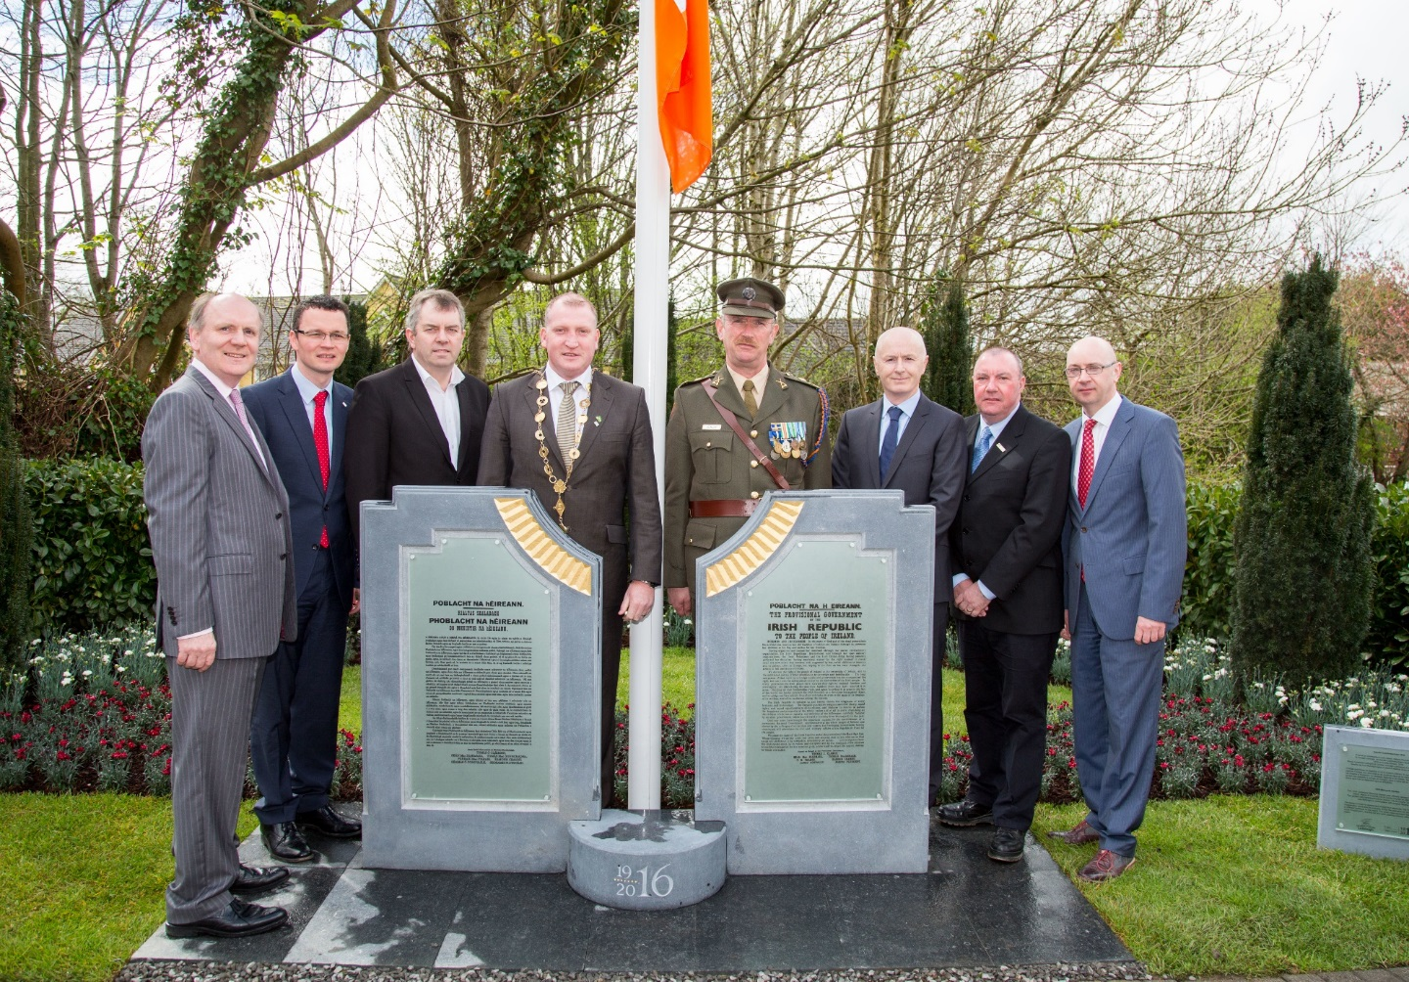
1916 Remembrance

Slide 37
THANK YOU

